Slide 1
Ect for patients with ID/MI
Holly Van Den Beldt, MD
Project ECHO, Jan 2025

Slide 2


disclosures
I have no financial disclosures
I will probably talk about things that are off label (because practically everything is psychiatry is off label)
There will be cat pictures

Slide 3

What is ECT?
Electroconvulsive Therapy
Has been in existence as a treatment for psychiatric disorders in the US since the 1930s
A safe and effective treatment for several disorders
One of the most effective treatments we have
Under-utilized, especially in patients with comorbid ID

Slide 4

What is ECT Not?
Not like what you see in the movies
Not cruel, barbaric, or painful
Not a cause of brain damage
Not a cure all for everything

Slide 5

Who can get ect?
No age limit- can perform ECT on adolescents, the elderly, and everyone in between
Very few medical contra-indications. Safe for pregnant women.
We can work around or adjust any medication regimen for ECT
No MH diagnosis is excluded, including ID, ASD
Well covered by all types of insurance

Slide 6
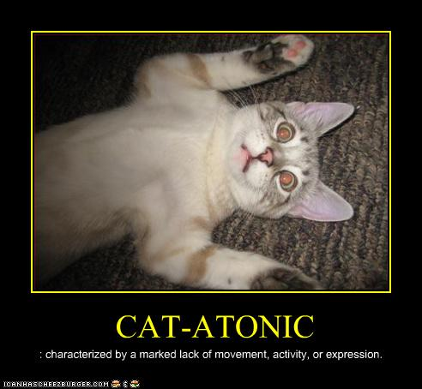
What conditions respond to ect?
Mood disorders
  Unipolar depression
  Bipolar- either depressed or manic
Psychotic disorders
Catatonia
Neuroleptic malignant syndrome (NMS)
Patients are usually more severely ill and/or not responding well to medications

Slide 7

The ect procedure
The patient is put under general anesthesia and paralyzed via IV medications
An electrical stimulus is delivered to the brain
A seizure occurs, is monitored, and resolves
The patient wakes up and is monitored
Start to finish- about 20 minutes (most of which is preparation)
  The actual ECT procedure is <5 minutes

Slide 8

After treatment
Patient may (temporarily) be:
  Tired
  Disinhibited
  Agitated
They may be experiencing:
  Headaches
  Soreness
  Confusion
  Nausea
  Dizziness
  Short term memory loss

Slide 9
Typical treatment course
Most patients start off with an index series
  2-3 treatments per week for 6-12 treatments
  This is highly variable and always tailored to the patient
Monitor response at every treatment
  Observe for improvement and then watch for a plateau of symptoms
  Once plateau has been reached, we either stop or transition to maintenance ECT
  Information on response gathered from patient, family, care team, ECT team members
Can be inpatient or outpatient
  Outpatient requires appropriate transportation and supervision

Slide 10

Maintenance ECT
This may be considered for various reasons
Typically start with once per week then try to gradually decrease frequency over time
  Goal is always to try to stop if possible
  Can increase frequency or repeat index series if decompensation occurs

Slide 11
What does response look like?
It depends!
Acute episode goals:
  Resolution of mania
  Resolution of catatonia- patient now able to eat, talk, move around, etc.
  Resolution of acute SI/new self-harming behaviors
  Improvement in mood (if depressed)
  Decreased positive symptoms in schizophrenia
Maintenance goals:
  Maintain gains achieved during index series
  Avoid decompensation
  Minimize use of meds, if patient intolerant

Slide 12
why does Ect work?
The short answer: We’re not sure!
Some theories:
  Increases release of neurotransmitters (serotonin, dopamine, etc.)
  Increases neuroplasticity of the brain
  Changes hormone release
  Changes blood flow to parts of the brain

Slide 13

Ect does not cause
Personality change
Brain damage
Worsened intellectual function
Severe memory loss, loss of old memories
A seizure disorder

Slide 14

Special considerations for ID/mi
ECT is not indicated for management of agitation or problem behaviors
However, if there is an underlying psychiatric disorder causing new behaviors, ECT may be used to treat it
Procedure may need to be adapted to patient needs
  Low-stimulation environment, non-verbal, presence of support persons, etc.
From what we know, patients with ID tolerate and respond to ECT as well as patients without ID
Monitoring for improvement can be more challenging

Slide 15
Why Ect is under-utilized
Stigma, stigma, stigma. Oh, and stigma.
Lack of awareness of the availability of the procedure
Lack of access, few providers perform the procedure
Consent and legal issues- vary by state
Diagnostic uncertainty- especially in patients with developmental disorders
Concerns about side effects
Logistics

Slide 16
You are crucial in this process
Information you have is invaluable to us:
  How can we make the patient as comfortable as possible?
  What side effects do they seem to have after treatment?
  Have there been changes in symptoms or behaviors with treatment?
  How will we know when they’re doing well again?
Transportation, preparation, close supervision after treatment, support, co-ordination, communication, etc.
We couldn’t do this without you!

Slide 17

summary
ECT is a safe and effective treatment for several psychiatric disorders.
It is underutilized, especially in patients with comorbid ID.
Direct support caregivers are a vital and much appreciated part of the process.

Slide 18

Questions?

Slide 19
references
Mankad, M. V., Beyer, J. L., Weiner, R. D., & Krystal, A. D. (2010). Clinical manual of electroconvulsive therapy. American Psychiatric Publishing, Inc..
Wilkinson, S. T., Agbese, E., Leslie, D. L., & Rosenheck, R. A. (2018). Identifying Recipients of Electroconvulsive Therapy: Data From Privately Insured Americans. Psychiatric services (Washington, D.C.), 69(5), 542–548.
Cutajar, P. & Wilson, D. (1999). The use of ECT in intellectual disability. Journal of Intellectual Disability Research, 43(5), 421-427.
Tsoukalas I. How does ECT work? A new explanatory model and suggestions for non-convulsive applications. Med Hypotheses. 2020 Dec;145:110337

