Slide 1

Medications
The good, the bad and the ugly
Jodi Tate, MD
1/9/2024

Slide 2
take home points
Medications should be used to treat a specific medical/psychiatric condition.
It can be challenging to accurately diagnosis mental illness.
Less is more!
Non-specific use of medication to treat ‘behavior’ should be avoided.
Side effects can cause challenging behavior. Side effects and idiosyncratic reactions to medications are common.

Slide 3
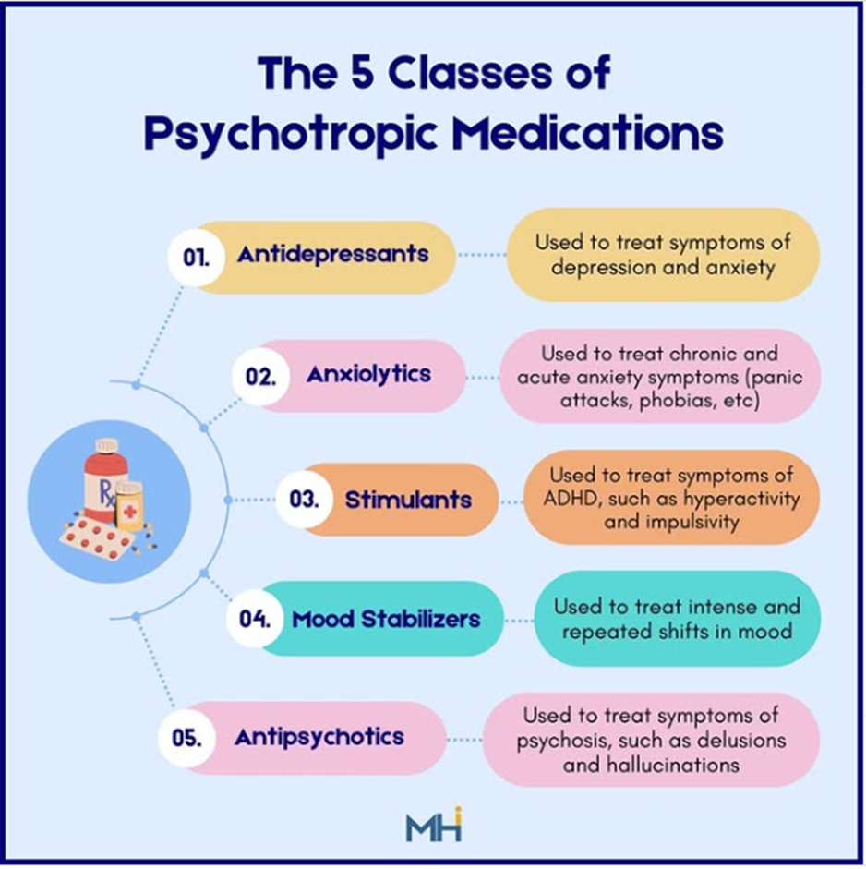
1. Medications should be used to treat a specific Mental Illness
No difference in medications use to treat mental illness in individuals with/without IDD
Medications should be started at a LOW dose and increase SLOWLY!
Individuals with IDD are more likely to have side effects and/or unusual side effects

Slide 4
take home points
Medications should be used to treat a specific medical/psychiatric condition.
It can be challenging to accurately diagnosis mental illness.
Less is more!
Non-specific use of medication to treat ‘behavior’ should be avoided.
Side effects can cause challenging behavior. Side effects and idiosyncratic reactions to medications are common.

Slide 5

2. Making a diagnosis is challenging!
Below information is SUPER helpful in making an accurate diagnosis
What is your client’s baseline?
Does behavior in all environments?
Change in sleep or appetite
Change in interest level
Change in behavior
Change in level of functioning

Slide 6
take home points
Medications should be used to treat a specific medical/psychiatric condition.
It can be challenging to accurately diagnosis mental illness.
Less is more!
Non-specific use of medication to treat ‘behavior’ should be avoided.
Side effects can cause challenging behavior. Side effects and idiosyncratic reactions to medications are common.

Slide 7


3. Less is More!!!!!!
X

Slide 8
take home points
Medications should be used to treat a specific medical/psychiatric condition.
It can be challenging to accurately diagnosis mental illness.
Less is more!
Non-specific use of medication to treat ‘behavior’ should be avoided.
Side effects can cause challenging behavior. Side effects and idiosyncratic reactions to medications are common.

Slide 9
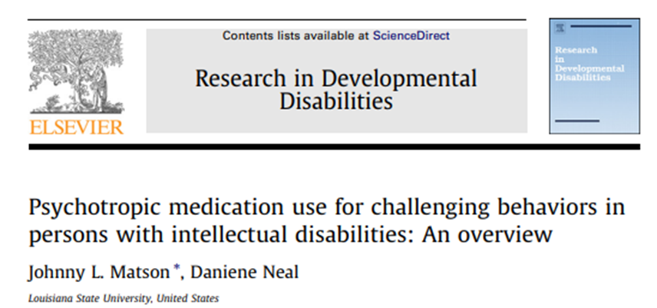
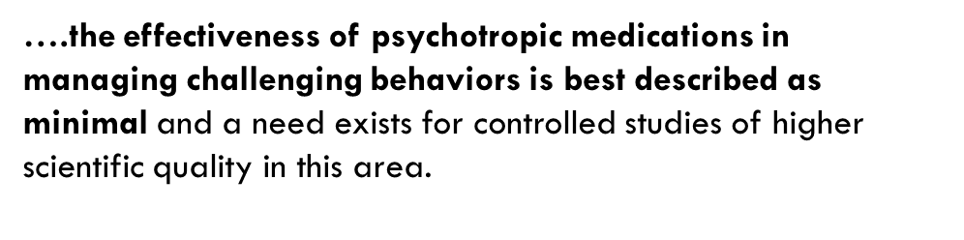
4. Avoid Non-specific use of medication to treat ‘behavior
HIGH rates of psychotropic medications used in adults with ID
Lots of ‘Off Label’ use to treat ‘behavior’

Slide 10

You bring your client to see a psychiatrist to treat her/his/their challenging behavior.
The psychiatrist prescribes an antipsychotic, Haldol, and schedules a follow up in 1 month.
Do you think your client received good care?
Yes
No
What is the first step in treating challenging behavior?
1. Get a prescription for Haldol
2. Get a prescription for Lorazepam/Ativan
3. Advocate for your client to get a full evaluation to determine what is causing the challenging behavior

Slide 11


FIRST, determine cause. THEN, treat the underlying cause!
I want something.
I don’t want to do that.
Pay attention to me.
I have a medical illness.
I have side effects from my medications.
I need to develop new skills.
I have a mental illness.
I am being abused.
I am bored.

Slide 12



EXCEPT….. Abilify and Risperdal are FDA approved to treat IRRITABILITY in Autism
Is there a specific medication to treat challenging behavior in adults with IDD.
1. Yes
2. No

Slide 13
take home points
Medications should be used to treat a specific medical/psychiatric condition.
It can be challenging to accurately diagnosis mental illness.
Less is more!
Non-specific use of medication to treat ‘behavior’ should be avoided.
Side effects can cause challenging behavior. Side effects and idiosyncratic reactions to medications are common.

Slide 14
5. Side effects can cause challenging behavior.
Side effects and idiosyncratic reactions to medications are common.
Individuals with ID are often prescribed A LOT OF MEDICATIONS
Side effects of medications can cause challenging behavior
A great way to advocate for your client is to know what meds your client is taking
I have side effects from my medications.
Notes:
What do look for?
Can’t sit still
Tremor
Tight muscles
Tired
Slurred speech
Unsteady on feet/falls
Constipation
Decreased in ability to do ADL’s
Weight gain

Slide 15
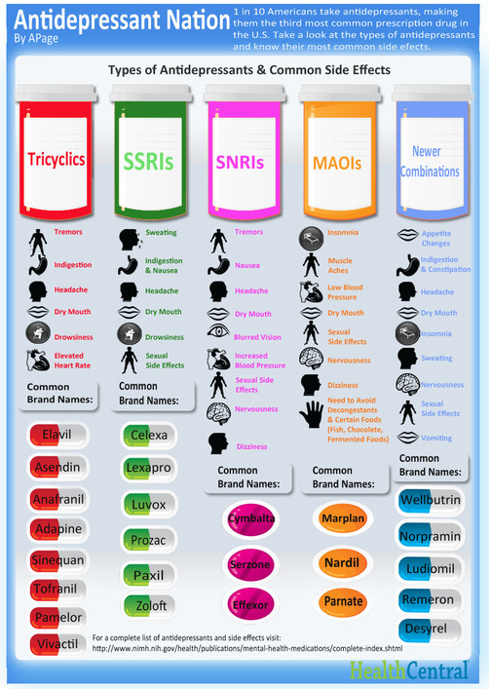
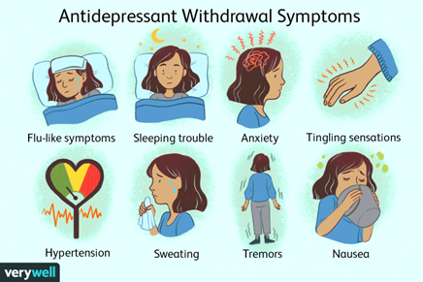
Side Effects - Antidepressants
Headache
Constipation/Diarrhea
Sedation/Activation
Sexual
Withdrawal if stop suddenly!!

Slide 16
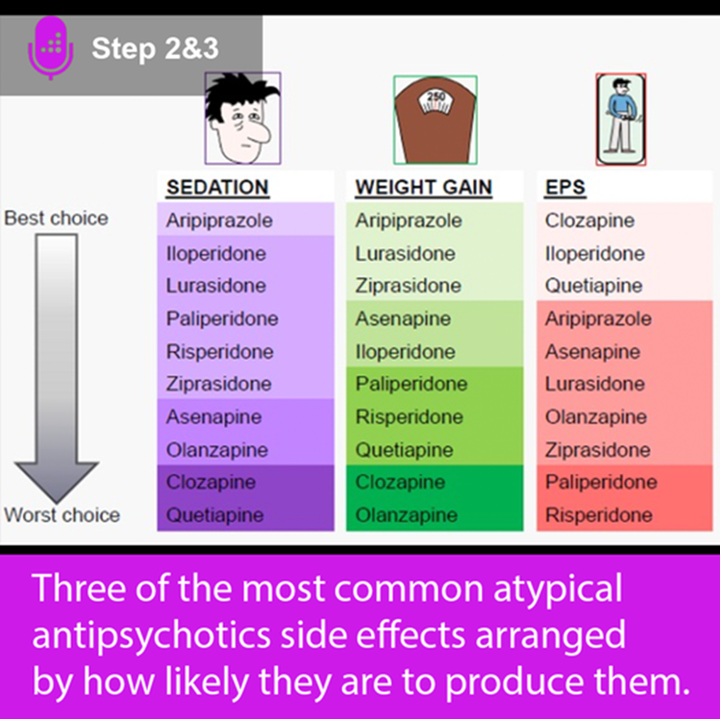
Side Effects - Antipsychotics
EPS (Extrapyramidal Symptoms)
  Dystonia (tight muscles)
  Akathisia (restlessness)
  Parkinsonism
https://www.bing.com/videos/riverview/relatedvideo?q=short+video+of+extrapyramidal+symptoms&mid=6631118D52BE6D90EB8B6631118D52BE6D90EB8B&mcid=5C5E8D7FA3DD443EB9AD15D6CB630C3A&FORM=VIRE
Notes:
Metabolic syndrome = large waist, high BP and glucose > 100; high lipids
Insulin resistance

Slide 17
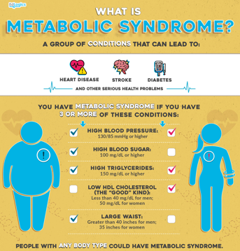
Weight Gain and Metabolic Syndrome
Ensure labs get drawn to monitor glucoses and lipids
Exercise
  Online Special Olympic workouts!
  Video 1: Welcome and Warm Up
Healthy Foods
  Healthy snack ideas on above site
Notes:
Increasing Physical Activity and Exercise in Adults with Disabilities

Slide 18

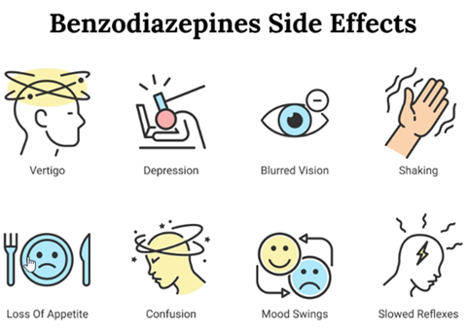


Side Effects - Benzodiazepines
Notes:
Benzos work by binding to the same neurotransmitters in the brain as alcohol, including the gamma-aminobutyric acid (GABA). GABA is responsible for controlling a person's anxiety levels and is shown to contribute to the development of some psychological disorders

Slide 19
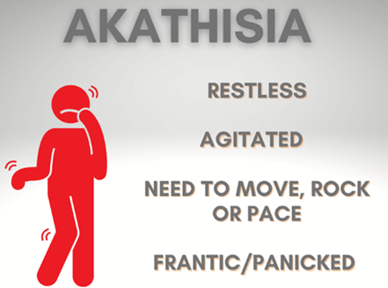

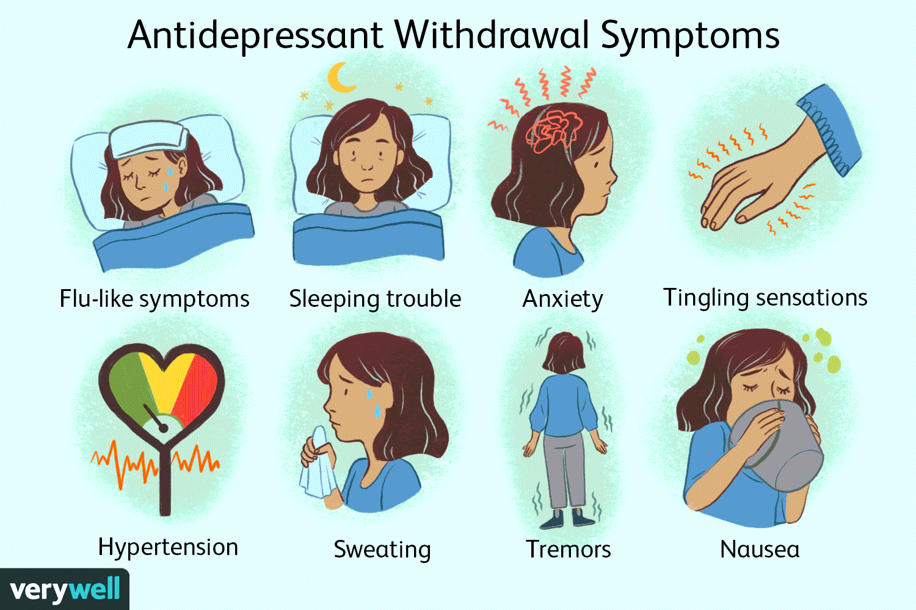
Side effects from medications
What do look for?
Can’t sit still
Tremor
Tight muscles
Tired
Slurred speech
Unsteady on feet/falls
Constipation
Decreased in ability to do ADL’s
Weight gain

Slide 20
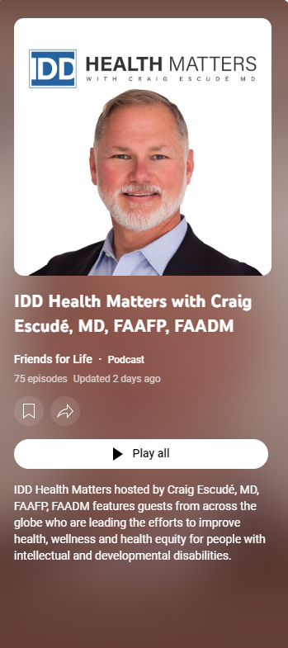
Thank you!
https://podcasts.apple.com/us/podcast/idd-health-matters/id1699602619
IDD Health Matters with Craig Escudé, MD, FAAFP, FAADM – YouTube
15 to 20 minutes!

Slide 21
Tips on how to get the best care for your clients….
Health Care Team
Be prepared for appointments
Primary Care Provider
Mental Health Provider
Therapist (BCBA)
Dentist
Speech Therapist
Last hearing exam
Last eye exam
Ensure client is seen regularly by all providers
Don’t over rely on Quick Care
Consistent staff accompany client to appointment
Medication list
Health care team and date last seen
Best way to communicate
Interests/Physical activity
Change in sleep, appetite
Change in behavior/functioning
Bowel Movements
Stressors/changes
Any concerns/questions

