Slide 1
Environmental and Functional Causes of Behavior
October 11, 2024
Notes:
Make disclaimer that going to lean heavy into the challenging behaviors—not recognize all of the goodness

Slide 2
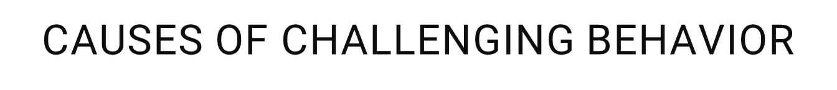
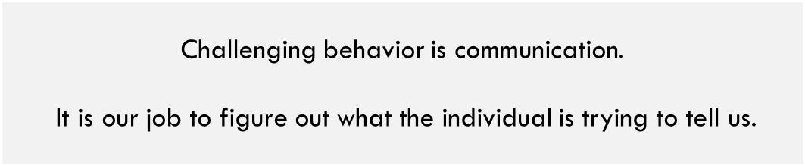

I want something.
I don’t want to do that.
Pay attention to me.
I have a medical illness.
I have side effects from my medications.
I need to develop new skills.
I have a mental illness.
I am being abused.
I am bored.

Slide 3
Applied Behavior Analysis
Applied Behavior Analysis is the science in which tactics derived from the principles of behavior are applied systematically to improve socially significant behavior and experimentation is used to identify the variables responsible for behavior change (Cooper, Heron and Heward, 2007).

Slide 4
Behavioral Assumptions
Behavior is learned
Behavior serves a specific purpose
Behavior is related to the context in which it happens
If behavior continues to happen, it’s being reinforced (or will continue to occur)
Changing the environment can change the behavior
Changing the way we navigate the behavior can change the behavior

Slide 5
Function
Function = The WHY
What in the environment is reinforcing or maintaining the behavior?
Why is the individual engaging in this behavior?
What is the purpose for the behavior?
Can use the function to build an intervention plan

Slide 6
Goal
Pro-social replacement behaviors
Challenging behaviors

Slide 7
Functions of Behavior
4 primary functions:
Attention-behavior occurs to obtain access to attention
Tangible-behavior occurs to obtain access to preferred items/activities
Escape-behavior occurs to escape from something aversive (person, place, situation)
Automatic- behavior occurs in the absence of any social reinforcement

Slide 8
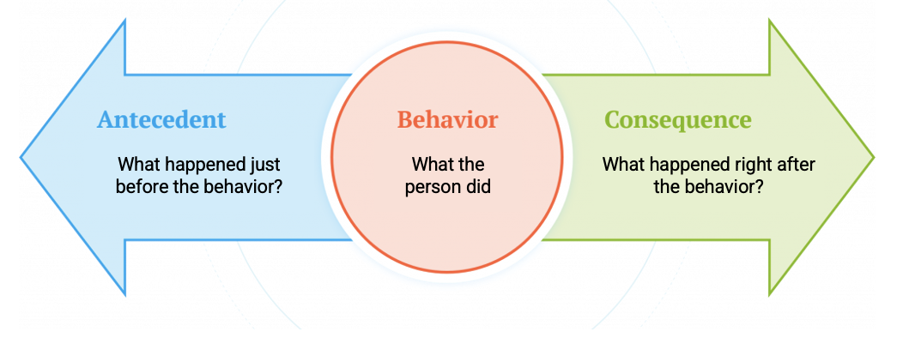
Antecedent-Behavior-Consequence (ABC)
Notes:
Antecedent: what occurs before behavior
Behavior: clearly defined behavior
Consequence: what occurs immediately following behavior

Slide 9
Notes:
Antecedent: what occurs before behavior
Behavior: clearly defined behavior
Consequence: what occurs immediately following behavior

Slide 10
Antecedent: Things to Consider
Were directions provided?
Verbal, visual?
What did the space look/feel like?
Loud? Lots of people?
Warm, cold, etc. ?
What was the task presented?
Something that is already mastered vs new task
Was attention present or absent?
Preferred items available or out of eyesight?
Notes:
My no means an exhaustive list

Slide 11
Antecedent-Behavior-Consequence (ABC)
Notes:
Antecedent: what occurs before behavior
Behavior: clearly defined behavior
Consequence: what occurs immediately following behavior

Slide 12
Notes:
Sara

Slide 13
Consequences
What immediately comes after the behavior
Can increase or decrease the likelihood that a behavior will occur again
What is used to determine the function of behavior
This applies to both positive and challenging behaviors
Function | Possible Behaviors
Attention | Discussion, coaxing, negotiating, physical proximity
Tangible | Given a snack (even if not preferred)
Escape | Task or expectation is reduced or goes away entirely

Slide 14
Consequences, cont.
Important to recognize that our behaviors will contribute largely to client responses
Sam is told to put away his tablet at dinner time to take meds.
Each time, he yells “No! Five more minutes!”
Staff give him additional time
Micah is told to put his coat in the closet after Day Hab.
Each time he does so, staff say, “Thanks man, really appreciate you taking care of that.”
Micah continues to put his coat away.

