Slide 1


Mental Illness
Jodi Tate, MD
10/24/2024
Welcome to

Slide 2



I want something.
I don’t want to do that.
Pay attention to me.
I have a medical illness.
I have side effects from my medications.
I need to develop new skills.
I have a mental illness.
I am being abused.
I am bored.

Slide 3
High rates of mental illness and abuse
Mental Illness often present differently in individuals with ID
Often associated with challenging behavior
Monitor changes in sleep, appetite, interest, level of functioning
I have a mental illness.
I am being abused.

Slide 4

ID
Autism
Both neurodevelopment disorders but separate conditions
Notes:
ID = 1-3 %
ASD = 3%

Slide 5
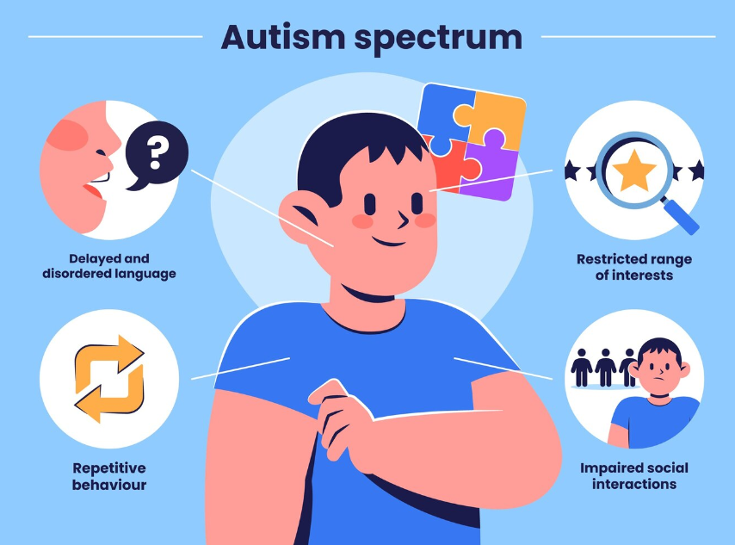

ID
Autism
Both neurodevelopment disorders but separate conditions
ASD + ID = strong predictor of psychotropic medications and challenging behavior
ASD and ID both have higher rates of mental illness
No treatment for core symptoms of Autism
Therapy is treatment of choice
2 FDA approved meds to treat irritability associated with Autism
Risperidone (Risperdal) Aripiprazole (Abilify)

Slide 6


Mental Illness: Diagnosis is Challenging!!!
Baseline Exaggeration
Increase in baseline behaviors in times of stress (medical, psych, psychosocial)
Intellectual Distortion
IQ affects ability to understand/answer questions
Example:
‘Are you hearing voices’
Psychosocial Masking
Developmental delay may affect presentation
Example:
Self Talk
Temper Tantrums
Cognitive Disintegration
Example:
Increase in SIB with staff turnover, constipation, depression
Example:
~ psychotic symptoms in times of stress
Stress/Illness can affect cognition/thought process

Slide 7


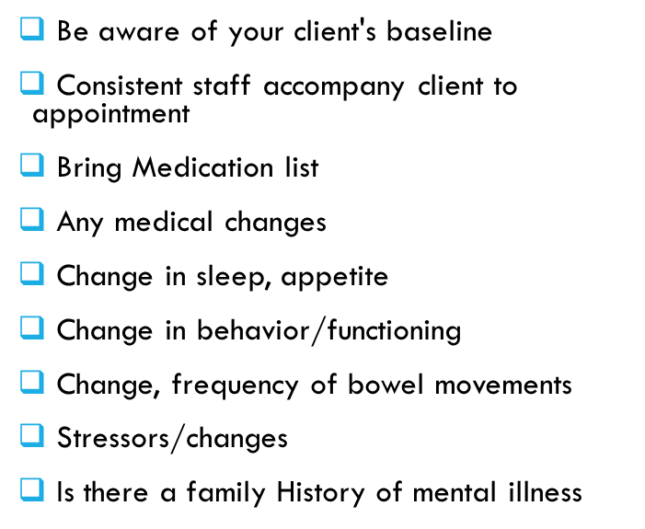
Diagnosis is challenging

Slide 8
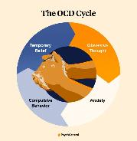



Anxiety Disorders
Generalized Anxiety
Disorder
Obsessive Compulsive Disorder
Panic Disorder
Specific Phobia

Slide 9

Depression
Sleep
Interest
Guilt
Challenging Behaviors at night; Tired/napping during the day; Important to track sleep
Energy
Refused preferred activities; Challenging behavior when asked to participate in activities he/she used to enjoy; withdrawn or spends time alone
Negative self statements; Worried others are mad; Excessively seeks reassurance
Refused or becomes agitated about activities that require physical effort; in bed
Symptoms last >/= 2 weeks
Not just a few bad days
Concentration
Appetite
Psychomotor Activity
Suicide
Unexplained skill loss; Decreased self care skills; Behavior when asked to do activities that require concentration
Stealing food; Obsessed with food; Challenging behavior around mealtimes
Agitation is more common; paces, fidgets; vocalization; ↓ physical activity
Talks about death or people who have died
Frequent physical complaints/fears about illness or death

Slide 10

Grief/Bereavement (NOT A MENTAL ILLNESS!)
Historically considered impossible for people with ID to grief
Underestimated
Simple events such as staffing change can cause grief
Grief may be delayed as they may not initially understand the loss

Slide 11
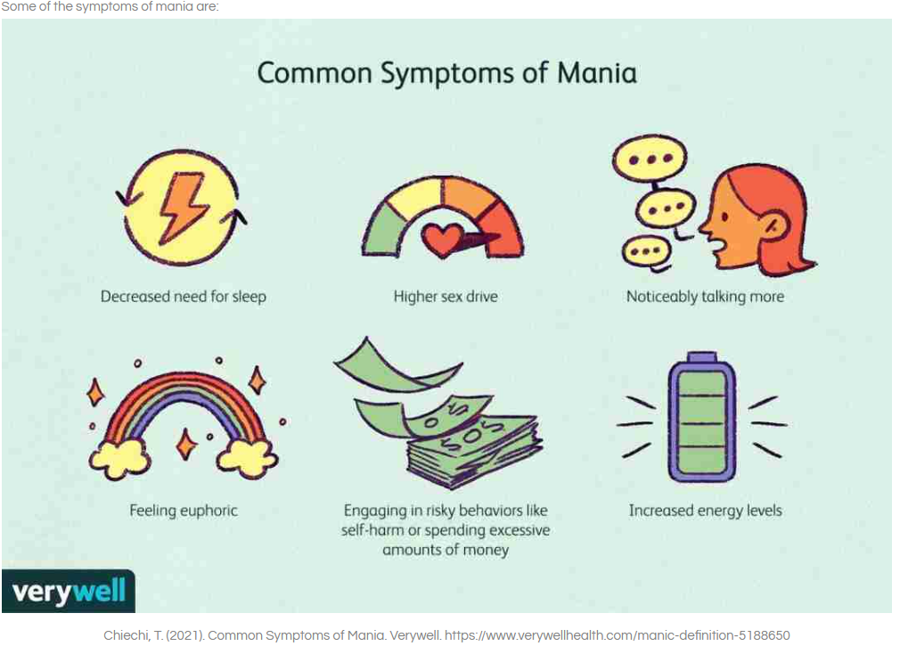
Mania
Sleep
Challenging behavior at night
High sex drive
Taking clothes off
Touching others
Increased masturbation
Talkative
Increased vocalizations
Increased Energy
Pacing
Intrusive
Symptoms need to last > 1 week

Slide 12
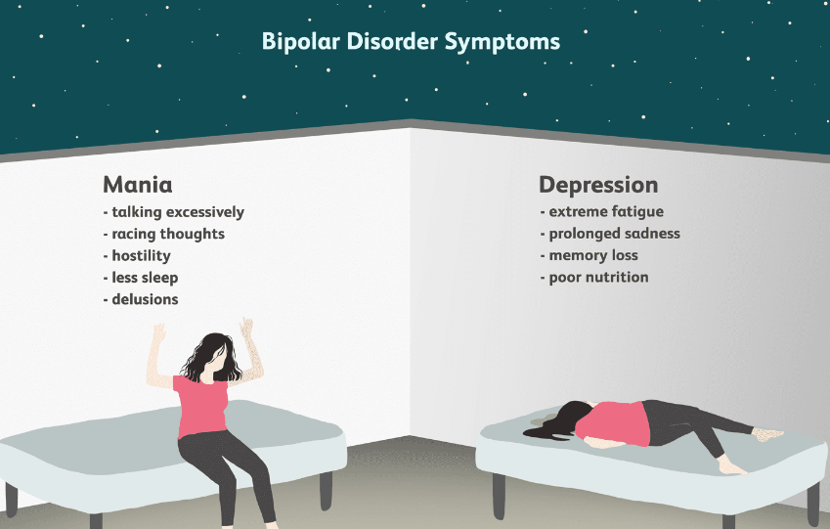
Bipolar affective disorder

Slide 13
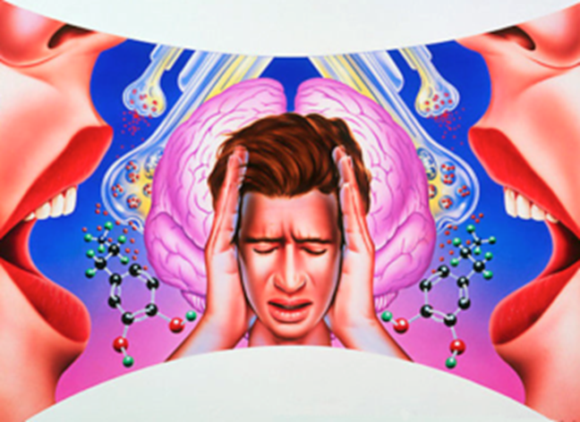
Psychosis
Psychosis can be present in Schizophrenia, Depression, Bipolar Affective Disorder, Substance induced
VERY difficulty to diagnosis
Close to impossible to diagnosis in severe to profound ID
PLEASE DON’T ask leading questions
‘Are you hearing voices?
Observe behavior
Does individual appear to be hearing things?
Yelling or talking while no one in the room (this could also be self-talk)
Important to differentiate between normal development behavior
Self Talk
Imaginary Play/Friends

Slide 14
Self Talk/Private Speech
NOT indicative of pathology
Common and developmentally appropriate
Often misinterpreted as psychosis
Talk out Loud
(2-3 yrs)
Whisper
Silent inner talk
(7-10 yrs)

Slide 15
partner with psychiatric provider to ensure your client gets that best care
Be prepared for appointments
Health Care Team
Be aware of your client's baseline
Consistent staff accompany client to appointment
Bring Medication list
Any medical changes
Change in sleep, appetite
Change in behavior/functioning
Change, frequency of bowel movements
Stressors/changes
Is there a family History of mental illness
Primary Care Provider
Mental Health Provider
Therapist (BCBA)
Dentist
Speech Therapist
Last hearing exam
Last eye exam
Ensure client is seen regularly by all providers
Don’t over rely on Quick Care

