Slide 1
Communication and Skill Building
November 7, 2024

Slide 2
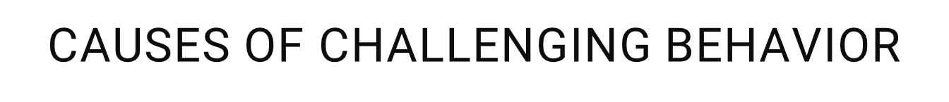
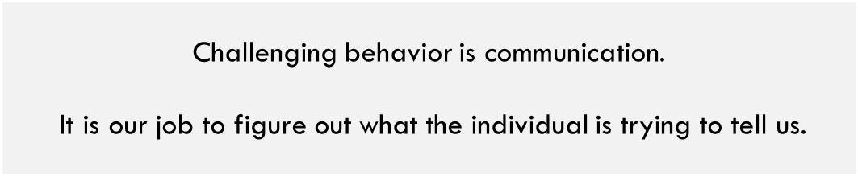

I want something.
I don’t want to do that.
Pay attention to me.
I have a medical illness.
I have side effects from my medications.
I need to develop new skills.
I have a mental illness.
I am being abused.
I am bored.

Slide 3
Behavior is Communication
Primary social functions:
Attention-behavior occurs to obtain access to attention
Tangible-behavior occurs to obtain access to preferred items/activities
Escape-behavior occurs to escape from something aversive (person, place, situation)

Slide 4
Skill Building
Communication is a skill that needs to be learned
  Expressive (output)—conveying needs and wants through verbal or nonverbal means
  Receptive (input)– receiving messages from others
Functional Communication Training (FCT) teaches how to communicate using alternate (and more socially appropriate) measures
  Very individualized based on client need and skill
    Using words instead of hitting
    Pointing to pictures rather than head banging
    Pushing a microswitch in place of screaming
Notes:
79.7% of couples who attend therapy note that is an area of focus
Goal is not to be an FCT expert or even be comfortable doing this, but understand another treatment package and ways to view behavior

Slide 5
Functional Communication Training (Step One)
Function = The WHY for challenging behavior
  Attention
  Tangible
  Escape
Use the function to build a communication training plan
Behavior | Consequence | Function
Head banging | Music video is turned on | Tangible
Throwing food on floor | Dinner is removed | Escape
Screaming | Staff help with task | Attention

Slide 6
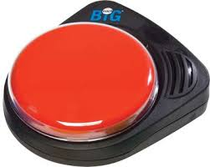
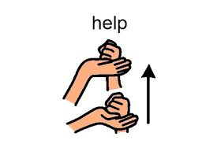
Functional Communication Training (Step Two)
Determine alternate ways for client to communicate
  Verbal
    Specific word or phrase
  Nonverbal
    Point to picture
    Hand picture to staff
    Press a switch (Big Mack, training button, etc.)
    Sign language
Select communication that requires similar effort to
challenging behaviors
  Behavior was screaming so may require one word
  Too much effort may mean staying with challenging behavior
  Approximations
Notes:
Disclaimer about Big Mack switch
Discuss effort for communication and approximations

Slide 7
Identify Communication Options
Behavior | Consequence | Function | Alt. Communication
Head banging | Music video is turned on | Tangible | Use switch to say ‘music please’
Throwing food on floor | Dinner is removed | Escape | Point to all done card
Screaming | Staff help with task | Attention | Tap staff on the shoulder

Slide 8
Functional Communication Training (Step Three)
Practice new form of communication with client consistently and repeatedly before any independent expectations
Head banging resulted in music video being turned on
  Provide lots of encouragement and functional rewards (turning on music video) for the new/desired behavior (pushing switch)
  Eliminate access to functional rewards (turning on music video) for the previous challenging behavior
Create scheduled and planned practice sessions
  Discuss practice ahead of time
  Multiple times per day with highly preferred activities
  Make practice fun! Engaging!

Slide 9
Quick Demo
Head banging results in access to music videos
Practice:
  Introduce microswitch
  Client press switch, gets praise and then brief access to music video
  Music video paused
  Verbal or nonverbal reminder of what is needed to access video again
  Continue routine

Slide 10
Online Resources
Video: Description of FCT and verbal examples
Video: Introduction and samples with picture cards
Video: FCT: Asking for Help
FCT Training PDF

Slide 11


Case presentation
Presenter: Nytasha Truog

