Slide 1
ID/DD and Sexuality
Blake Stephenson, LISW, BCBA

Slide 2
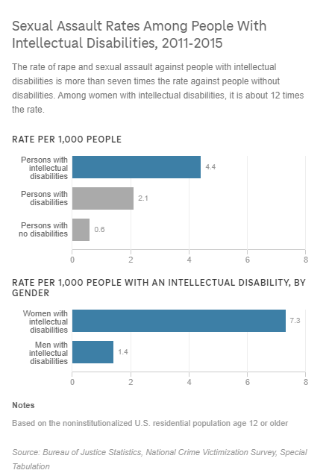
ID/DD and Sexuality
Some Quick Facts
Data suggest that any individual with ID is seven times more likely to experience sexual assault than someone with out ID (Byrne, 2017; Shapiro, 2018)
  12 times more likely if that individual identifies as female
Prevalence increases from mild to severe levels of intellectual disability and decreases in profound levels.
Most prevalent abuser profiles are often a peers, caregivers, and/or family members

Slide 3
ID/DD and Sexuality
Overview
What is sexuality?
  set of behaviors characterized by physical, emotional, and social interactions (Breuss and Greenberg, 1984)
  More than just sexual acts and behaviors – its understanding who you are as a personal and the way we feel about our body
How does it develop
  Biological
    Genetics and neuro-endocrinal factors
  Psychological/Social
    Individual temperaments and attraction
    Peers and Parents
    Cultural/Religious/Societal/Political influences
Notes:
By playing attention to A and C we are able to find patterns. Common consqeunces often lead to a general understanding of function

Slide 4
ID/DD and Sexuality
Overview
Education
  Formally happens in adolescence … then formally stops
    Individual and environmental experiences continue, often allowing individuals to form their own unique understanding(s)
  Lack of education for individuals with ID/DD
WHY?!?

Slide 5
ID/DD and Sexuality
Sex Ed for ID
Historical ableist and infantilized view of individuals with ID
  Embarrassed
  Neglected
  Institutionalized
  Penalized
  Sterilized
Educations Gaps
  Lack of empirically valid methods for teaching this topic
  Lack of training for caregivers/staff
  General embarrassment about the topic

Slide 6
ID/DD and Sexuality
Rights vs Risk
Challenging dynamic that often impedes education and supports
  Lack of decision-making capacity
  Lack of experience and skills
    often lead to restrictions that impede the ability to gain these experiences and skills
  Concerns about sexual exploitation and other negative consequences (e.g. jail, loss of placement, etc)
How do we balance?

Slide 7
ID/DD and Sexuality
Meeting the need
There is no specific model or approach that is empirically validated and recommended to support individuals with ID in their sexuality journey
Complicated balance of:
  Protection
  Empowerment
  Comprehensive, individualized education based on patient’s needs and level of functioning
Very important to promote positive attitudes about sexual expression for the patient
  Caregivers and staff are essential to this by having an accepting and positive attitude about these topics when they come up
  The more comfortable and safe a patient feels with you, the more apt they are to discuss and share
Notes:
By playing attention to A and C we are able to find patterns. Common consqeunces often lead to a general understanding of function

Slide 8
ID/DD and Sexuality
So what do I do?
Know your professional and personal scope
Start with the basics!
  Can the individual:
    Name and identify basic body parts by their correct name
      What about slang terms?
    Demonstrate a basic understanding of that body part’s function?
    Complete basic personal hygiene routines related to sexual/reproductive health
      More than cleaning up. Should also include self-examination pending the individuals age and level of functioning
  These topics are often overlooked
Notes:
By playing attention to A and C we are able to find patterns. Common consqeunces often lead to a general understanding of function

Slide 9
ID/DD and Sexuality
Okay, so now what…
Private vs Public
  What does this mean, where does it apply, what does it apply too?
    Parts of one’s body
    Location, location, location
    Specific behaviors/actions (not always intimate ones!)
Arousal and masturbation
  Sexual feelings, thoughts, touching
    The sequence of events
  Masturbation
    To teach or not to teach…
    Understand cultural/religious dynamics
  Pornography
    Appropriate and safe searches
    Avoiding exploitation
Notes:
By playing attention to A and C we are able to find patterns. Common consqeunces often lead to a general understanding of function

Slide 10
ID/DD and Sexuality
The finer, more complex details
Know your professional and personal scope
Orientation and identity
  Different types of sexual orientations
  Difference between sex and gender
Relationships
  What are healthy sexual relationships and what can they look like?
    More than just monogamous
  Communication and boundaries
Notes:
By playing attention to A and C we are able to find patterns. Common consqeunces often lead to a general understanding of function

Slide 11
ID/DD and Sexuality
Exploitation and Abuse
  Topics that should be intertwined throughout the education process
  Understanding the role of emotions with these topics and the population we are working with
Consent
  Tricky topic
  Strong understanding and focus on this
  Legal definition(s)
    Often complicated but tend to focus on age, capacity, freely given, clearly communicated

Slide 12




Questions?
Blake Stephenson, LISW, BCBA
blake-stephenson@uiowa.edu
uihc.org

