Slide 1

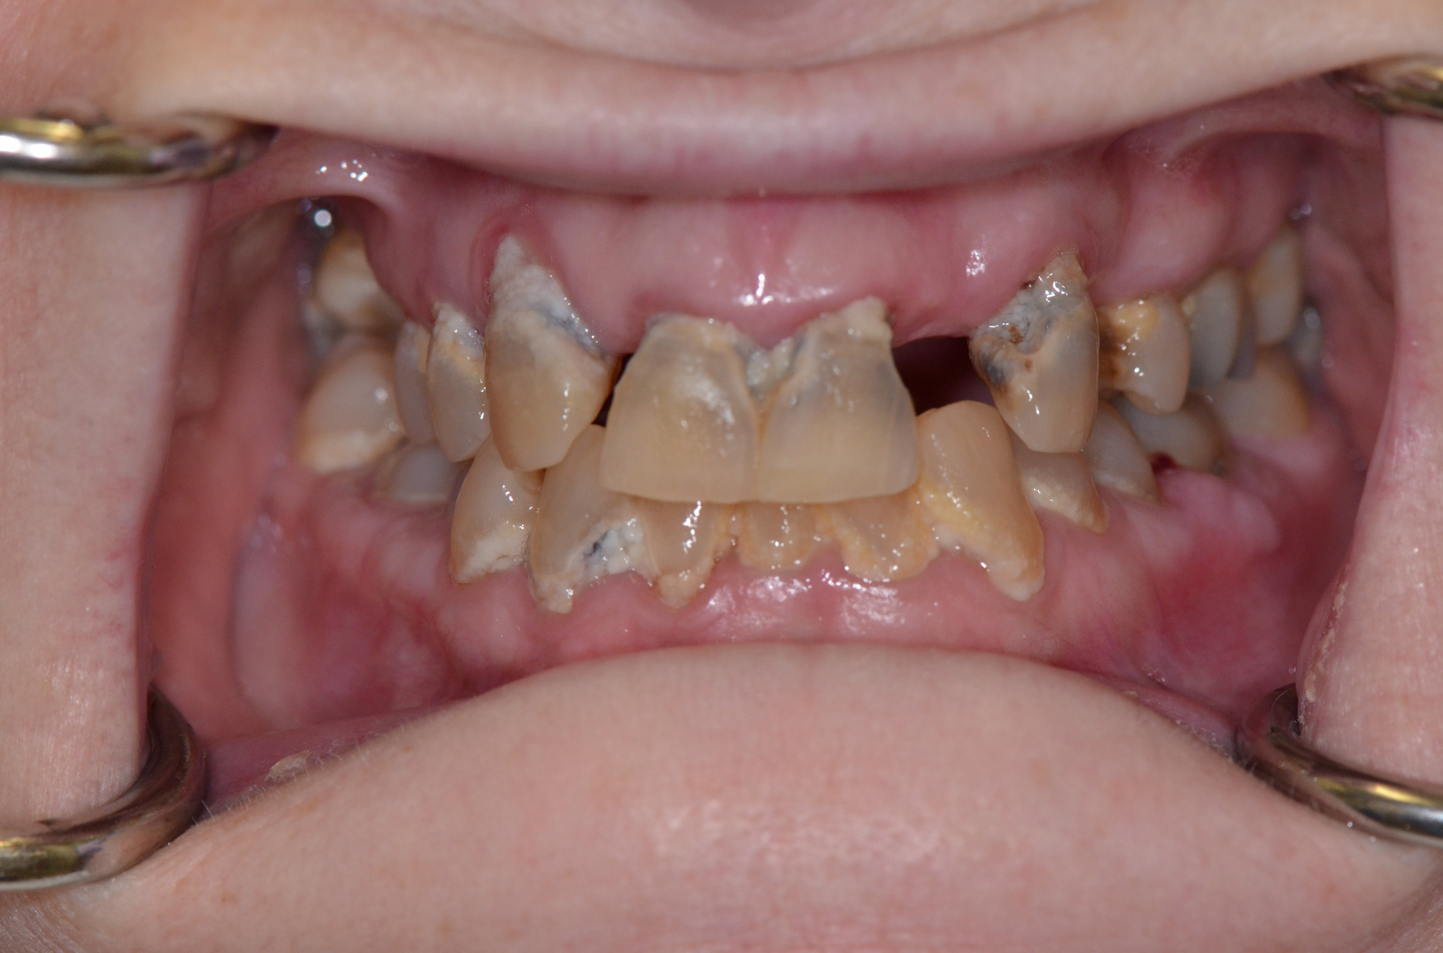
Oral health for adults with special health care needs
Leonardo Marchini, DDS, MSD, Phd
Professor and Chair
Department of Preventive and
Community Dentistry

Slide 2
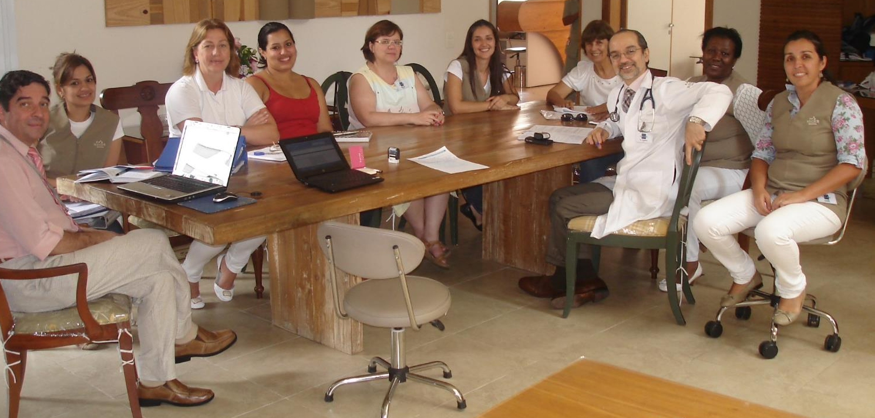
The interdisciplinary team

Slide 3
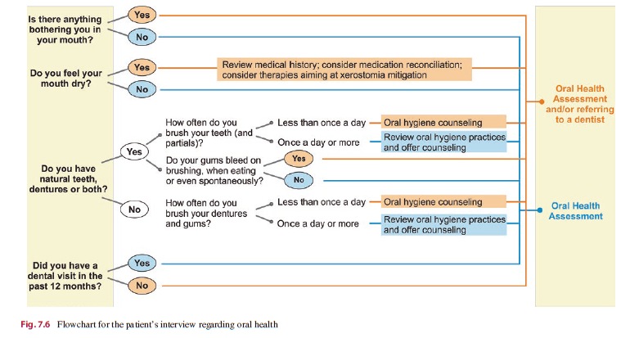
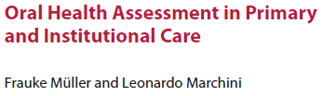
2020

Slide 4
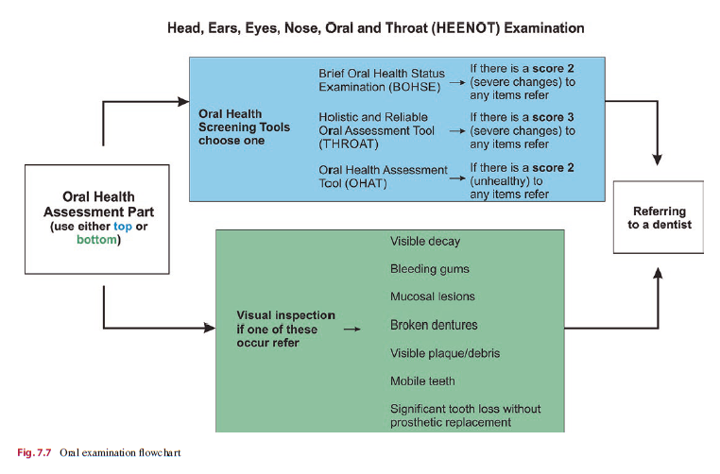
2020

Slide 5

Overcoming Barriers to Good Care
Behavioral challenges
Basic Communication Techniques
Be patient, respectful, gentle
Use patient’s name
Always smile
Keep eye contact, preferably at patient’s eye level
Approach from the front, move slowly
Introduce yourself
Use plain language and short sentences
Provide only one instruction each time
Briefly explain what you are doing and why you are doing it, repeat as necessary
Be polite, provide encouragement and positive feedback
Pixabay/sasint

Slide 6

Overcoming Barriers to Good Care
Behavioral challenges
Communication Techniques
Task breakdown
Breakdown an activity into small steps. Instead of saying “Please, brush your teeth”, one should say:
Please, get your toothbrush
Now, open your toothpaste
Now, add a small amount of toothpaste to the toothbrush
Please, brush your front teeth
Now your back teeth
And so on.
Pixabay/metsi

Slide 7

Overcoming Barriers to Good Care
Behavioral challenges
Communication Techniques
Rescuing
A second caregiver enters the situation and deliver care to the patient as the first caregiver leaves or steps back
Pixabay/geralt

Slide 8
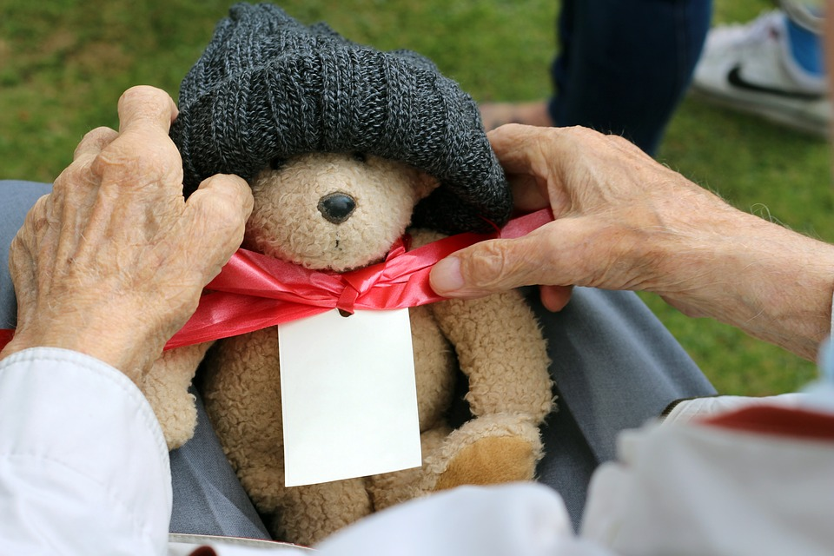
Overcoming Barriers to Good Care
Behavioral challenges
Communication Techniques
Distraction
The patient can be distracted by singing a favorite song, by holding a favorite item (a blanket, a pillow, a doll, etc.), by telling a story/joke, by watching a TV show, or by doing any other appropriate favorite activity.
Pixabay/JSchley

Slide 9
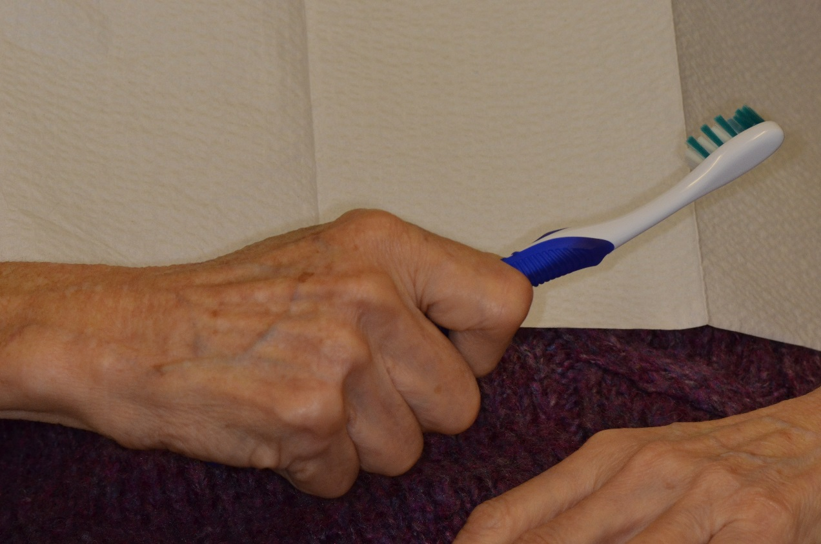
Overcoming Barriers to Good Care
Behavioral challenges
Communication Techniques
Bridging
Have the resident holding a toothbrush or any other oral care related item as the caregiver brush his teeth with another toothbrush

Slide 10
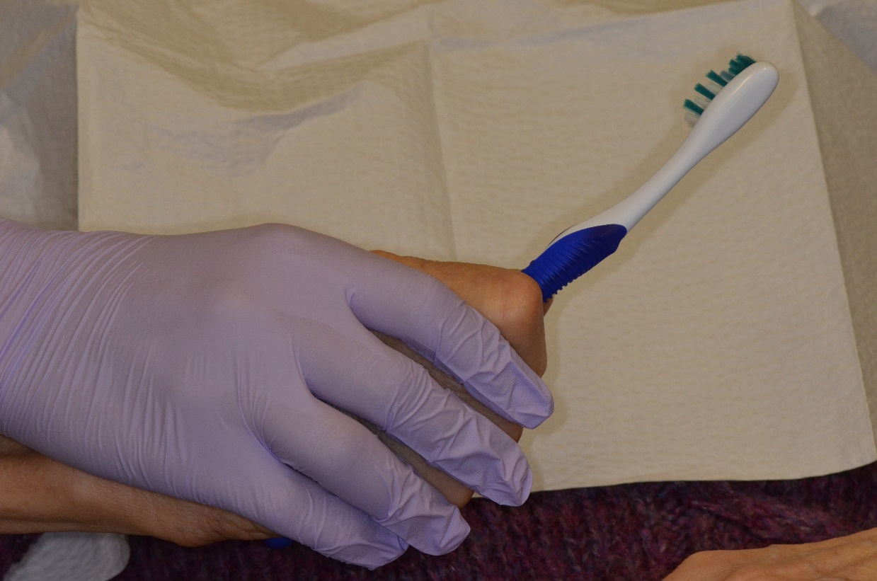
Overcoming Barriers to Good Care
Behavioral challenges
Communication Techniques
Hand over hand
Have the patient holding a toothbrush and then a caregiver place his hand over patient’s hand and guides the toothbrushing

Slide 11
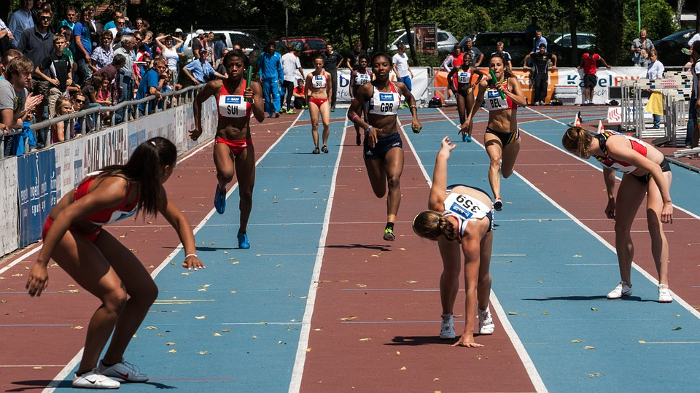
Overcoming Barriers to Good Care
Behavioral challenges
Communication Techniques
Chaining
A caregiver starts an oral health care activity and then let the patient finish it
Pixabay/domeckopol

Slide 12
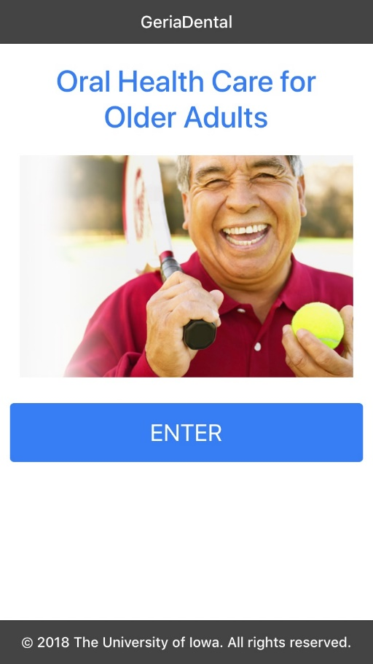
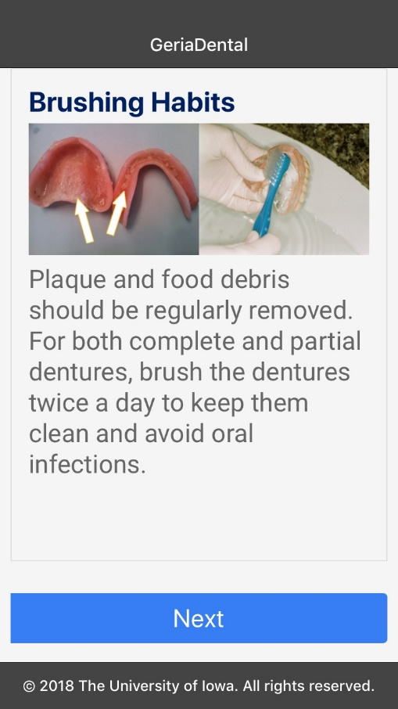
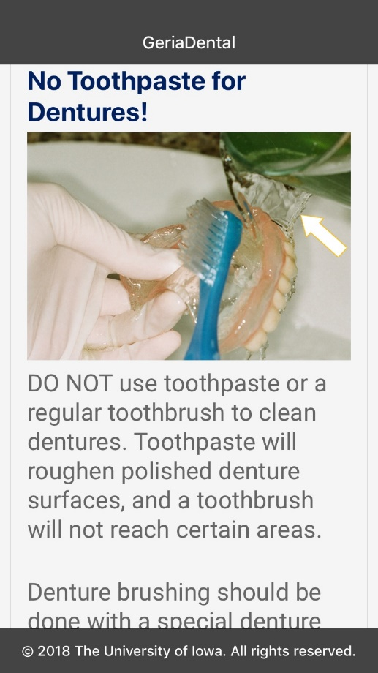
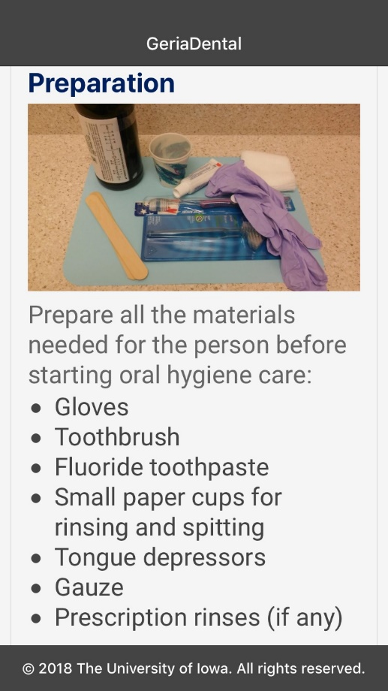

The GeriaDental app offers expert tips from geriatric dentists and hygienists to help you provide high quality oral health care for older adults.

Slide 13
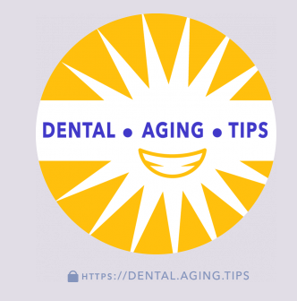
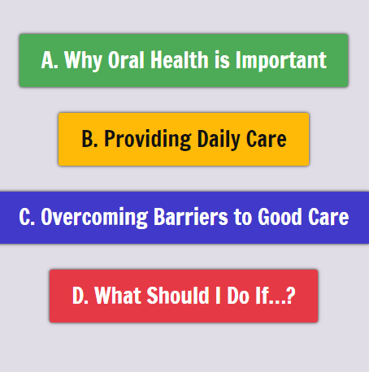

Slide 14
Thank you for your attention!
leonardo-marchini@uiowa.edu

