Slide 1


Visual Schedule Basics
Jen Kuhle, PhD, BCBA-D
Welcome to

Slide 2
Agenda
General Overview
Schedule Options
Building Schedule
Medical Considerations
Questions

Slide 3
What is a schedule?
Communicates the sequence of upcoming events or activities.

Slide 4
Goals of schedules
Consistency | Predictability | Accountability
Stability Basic needs are being met Help to reduce anxiety or navigate stressors Trauma-informed | Know what is to be expected Help to address anxiety about unknowns | Both client and direct support staff Agreement that when certain things occur then other more desirable things will occur

Slide 5
Types of schedules
Schedule type will be based on need of the client. Incredibly flexible intervention!
  Consider intellectual functioning, preferences, activity level, etc.
  Options:
    Picture schedule
    Written schedule
    Photographed schedule
    First-then schedule

Slide 6
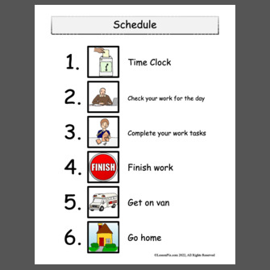
Picture Schedule
Portion of the day
Limited detail
Focus on activity, not time
Cartoon(ish) pictures

Slide 7
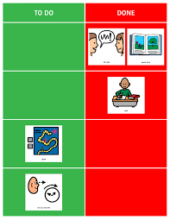
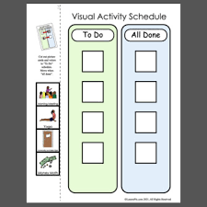
“To Do” Versions of Schedules

Slide 8
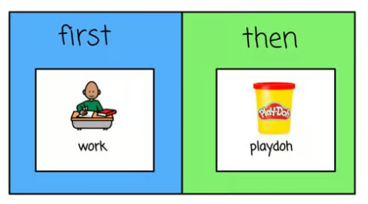
First then schedule
Start with hard task and move towards something preferred
May require task to be broken up into smaller bits
Can help to build momentum towards bigger or more involved tasks

Slide 9
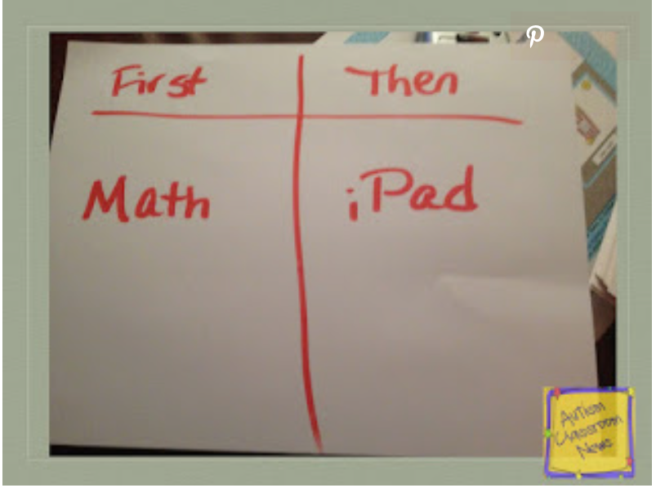
Written Schedule
Brief in Description
Clear Expectations
Words Only

Slide 10


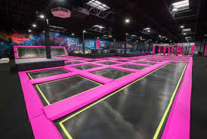

Photo Schedule
Use actual pictures from the people/places/activities
Can take more time to assemble
May be preferred for adults

Slide 11
Task analysis
Break down of complex skills into smaller steps
Schedule within a schedule
May not need to teach every step within TA

Slide 12
Schedule considerations
length
flexibility
MISC.
Full day
Portion of the day (morning, afternoon, evening)
Specific activity (morning routine, dinner)
First-then (something non preferred followed by preferred)
Single schedule or multiple
Identify areas where choice can be offered (e.g., breakfast, activities)
Schedule choice activities into day
What is required vs. not required
How much input from client?
How quickly can schedule be assembled each day?
Does it need to be transportable?
Laminated or protected?
Who is responsible for updating pictures or images?
Where will it be located?

Slide 13
Medical Considerations
Identify the medical needs of the client
May be anchor points for the schedule
  Medications
  Therapies
  Appointments
  Any other interventions that are part of their medical plan

Slide 14
Utilization of Schedule
Ensure schedule is complete and built before introducing it to client
Determine where to place the schedule. Look for high traffic areas for the individual.
Engage in the schedule each day, period, etc.
Schedules are not helpful if simply hung up and no additional interaction occurs.

