Slide 1


Trauma Informed Care
Blake Stephenson, LISW, BCBA
Welcome to

Slide 2
Trauma Informed Care
Blake Stephenson, LISW, BCBA
Notes:
Sara – slides 1-3

Slide 3
What is Trauma?
No universal definition of trauma (Menschner & Maul, 2016)
Professions tend to create their own based on the clinical experiences.
Examples include:
Physical, sexual, and emotional forms of abuse
Denial of critical care/neglect
Experiencing or witnessing violence
Poverty and systemic discrimination
Natural disaster victim
Traumatic loss
Notes:
Blake: slides 4-12

Slide 4
What is Trauma?
Big “T” Trauma
Reaction to an acute, life-threatening, event/situation (e.g., war, natural disasters, violent crime, serious car accident)
Little “t” Trauma
Reaction to an ongoing/reoccurring situation that causes distress, fear, adverse responses (e.g., financial hardships, breakups, job loss)
Typically, less severe
Vicarious Trauma
Ongoing process of change resulting from witnessing/hearing about others’ pain and suffering.

Slide 5
Why Trauma-Informed Care?
Childhood trauma increases risk of serious health problems (Felitti et. al., 1998; Shonkoff et al., 2012)
Increased likelihood chronic lung, heart and liver disease
Increased likelihood for mental health challenges
Increased likelihood for substance abuse challenges
A trauma-informed approach to care acknowledges the need to have a complete picture of a patient’s life situation — past and present — in order to provide effective health care services with a healing orientation.
Adopting trauma-informed practices can potentially improve
patient engagement,
treatment adherence,
health outcomes,
as well as provider and staff wellness
Trauma-informed care shifts the focus from “What’s wrong with you?” to “What happened to you?”
Notes:
Blake: slides xx-xx

Slide 6
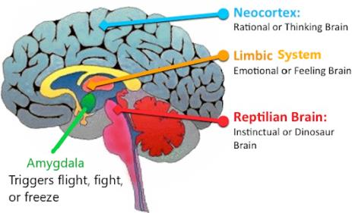
Trauma and the Brain
Brain Stem -- “Reptilian Brain:”
Oversees vital bodily functions
Hearing
Eye/body movements
Voluntary motor function
Motor control
Sensory analysis
Breathing and heart rate
The home of the Freeze, Fight, or Flight response
Highly attuned threat detection system
Notes:
Blake: slides xx-xx

Slide 7
Trauma and the Brain
Limbic System
Formed after birth, made up of several different brain structures
Works closely with the brainstem – creates our emotions and drives physical responses to them
Vital role in memory formation and recall
Amygdala
Fear receptor of the brain – houses unconscious memories (implicit memory)
Important role in helping process and regulate emotions
Responsible helping us act on the Flight, Fight, Freeze trigger sent from the brain stem
Hippocampus
Home of short-term memory/rational thinking (cause and effect thinking)
Receives signal from amygdala and then releases cortisol to calm and regulate the brain
Notes:
Blake: slides xx-xx

Slide 8
Trauma and the Brain
Neocortex
Comprised of several major brain structures, each with their own functions. Helps make people, people (e.g. abstract thinking, morals & values, etc)
Frontal: Executive functioning (planning, judgements, impulse control)
Parietal: Sensory processing and integration
Occipital: Vision
Temporal: Memory, mood regulation, understanding social cures
Notes:
Blake: slides xx-xx

Slide 9
Trauma and the Brain
What Actually Happens?
TRAUMATIC EXPERIENCE/STIMULI…is detected and sends signal to brain
ALARM ACTIVATES
Amygdala receives the signal and communicates with the rest of the brain to act accordingly
BRAIN AND BODY REACT…
flight, fight, freeze
Brain gets “hijacked” and limbic systems struggles to regulate
Notes:
Blake: slides xx-xx

Slide 10
Trauma and the Brain
Brain plasticity
The brain can change in response to social and environment experiences (e.g., learning)
Adverse changes to the brain post-traumatic experience are not permanent.
Neuropathways can be re-written and new behaviors can be taught/learned

Slide 11
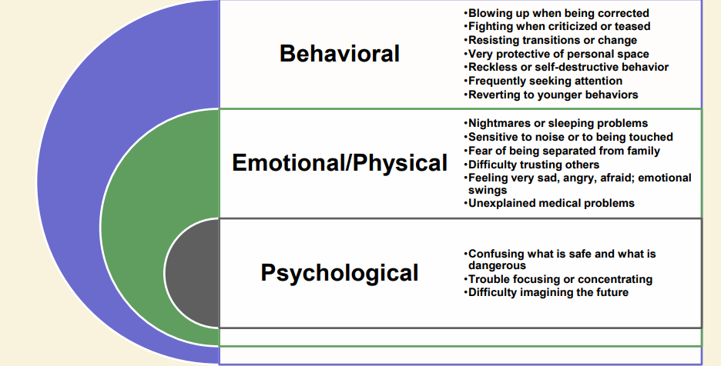
Signs of a Trauma Response
Factors that increase traumatic impact:
Early occurrences
Being silenced/not believed
Blame and Shame
Perpetrator is a trusted caregiver

Slide 12
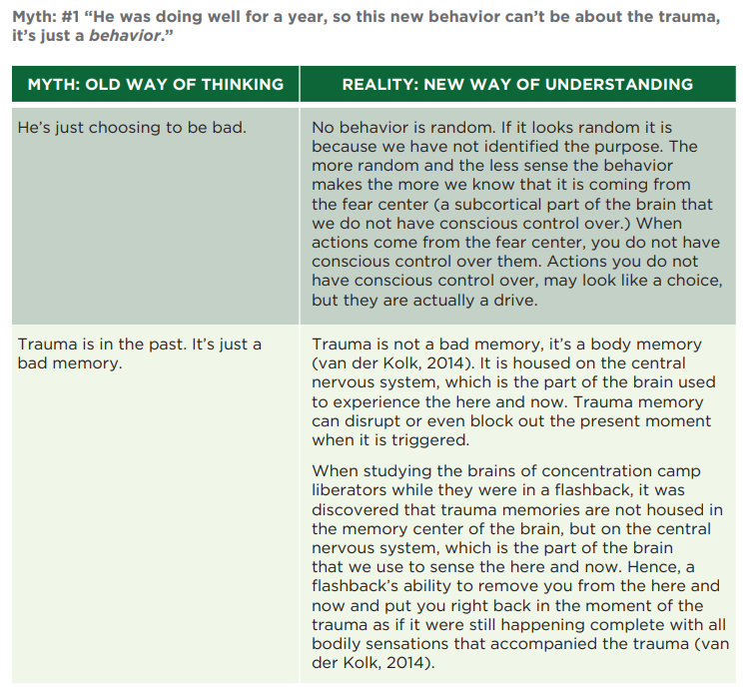
Trauma Myths the brain can resolve

Slide 13
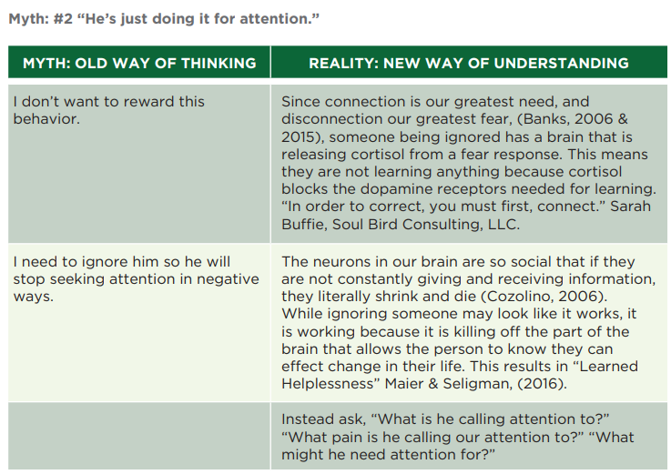
Trauma Myths the brain can resolve

Slide 14
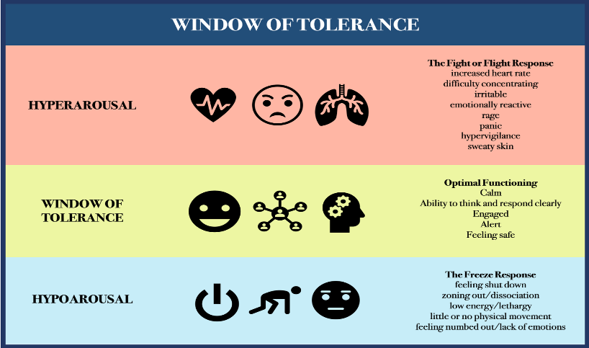
Notes:
Again this narrowness relates to executive functioning challenges assocaoited with asd (i.e. regulation, perspective taking, etc.) Tie in sensory systems in the hyper and hypo sections

Slide 15
Adverse Childhood Experiences (ACEs)
CDC-Kaiser Permanente ACE study
Original study: 1995 - 1997 (17,000 employees)
Childhood experiences + current health status and behaviors
Relationship between
exposure to abuse and household dysfunction experiences in childhood
health risk behavior and disease in adulthood
https://www.ajpmonline.org/article/S0749-3797(98)00017-8/fulltext
Notes:
Sara: slides 13-xx
The CDC-Kaiser Permanente adverse childhood experiences (ACE) study is one of the largest investigations of childhood abuse and neglect and household challenges and later-life health and well-being.
The original ACE study was conducted at Kaiser Permanente from 1995 to 1997 with two waves of data collection. Over 17,000 Health Maintenance Organization members from Southern California receiving physical exams completed confidential surveys regarding their childhood experiences and current health status and behaviors.
More detailed information about the study can be found in the links below or in the article, “Relationship of Childhood Abuse and Household Dysfunction to Many of the Leading Causes of Death in Adults,”.
Please note: The original CDC-Kaiser dataset is not available to the public. Kaiser owns the data and data collection is ongoing (e.g., prescription drug use, medical status of original participants). However, there is an optional ACE Module on the Behavioral Risk Factor Surveillance System (BRFSS) that many states have administered. These data are available for download from BRFSS.
Open All

Slide 16
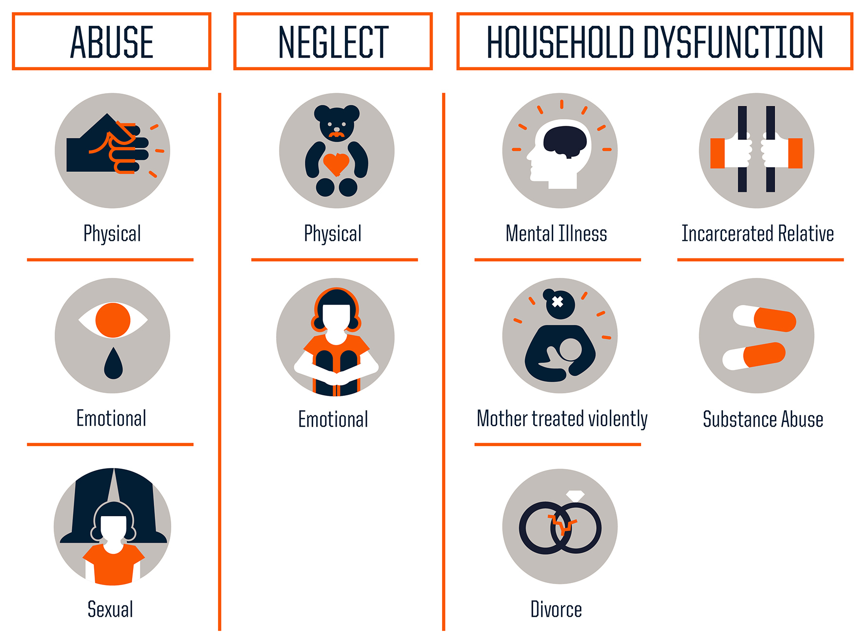

Slide 17
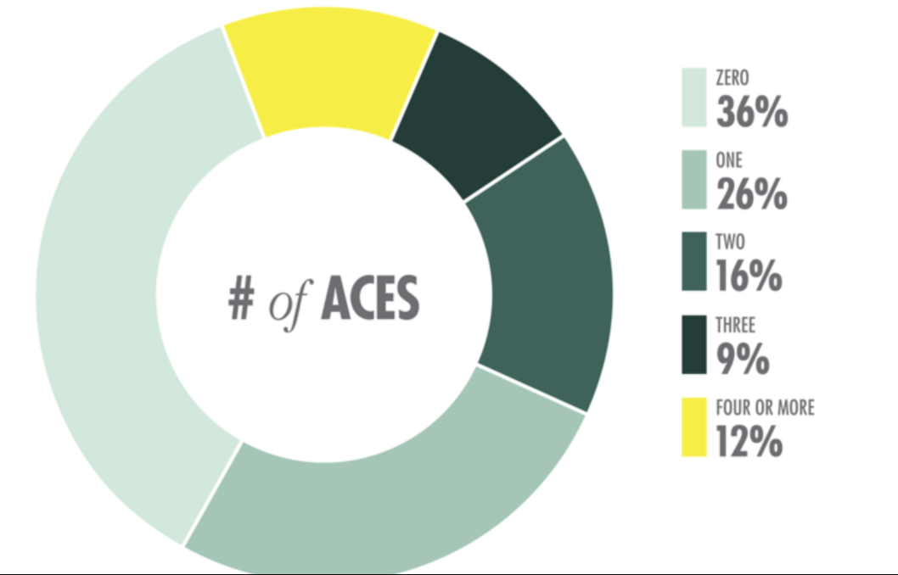
Original Study Findings
Aces Too High Infographics

Slide 18
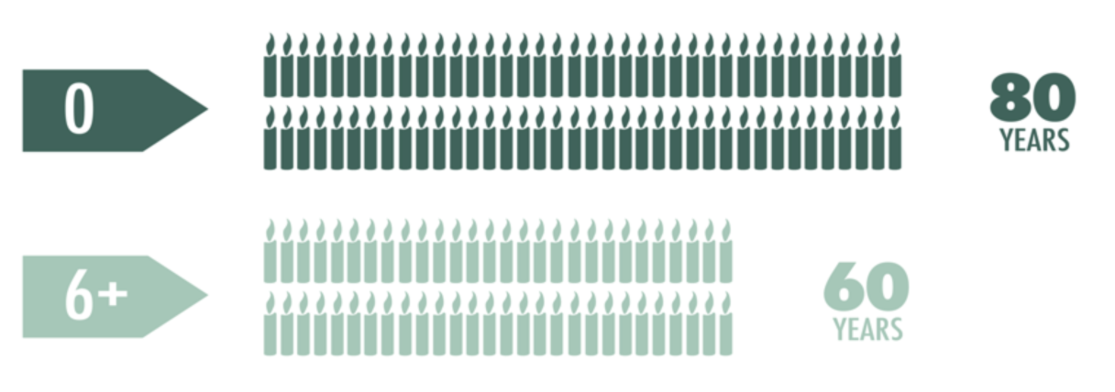
People with 6+ ACEs died nearly 20 years earlier on average than those without ACEs
Aces Too High Infographics

Slide 19
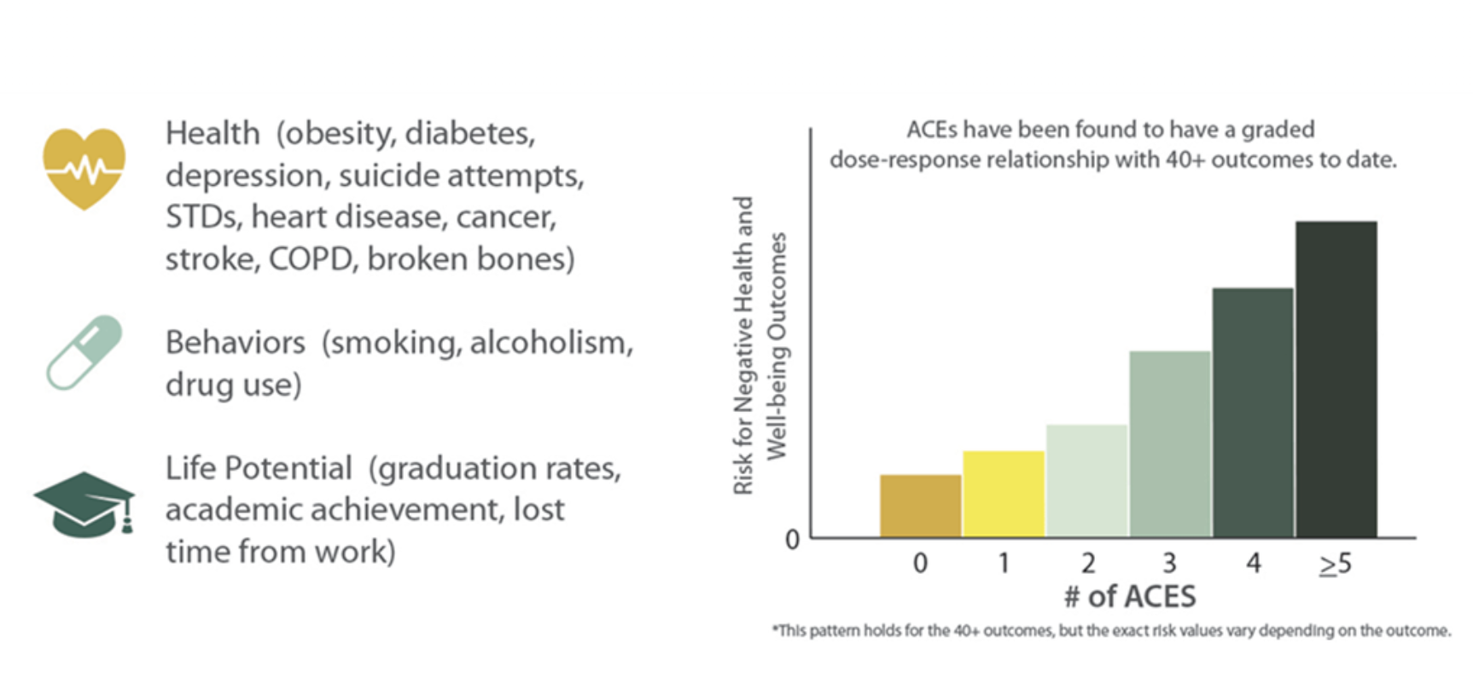
ACEs can have a lasting effect on…
CDC
Notes:
https://www.iowaaces360.org/uploads/1/0/9/2/10925571/acesreport2020.pdf

Slide 20
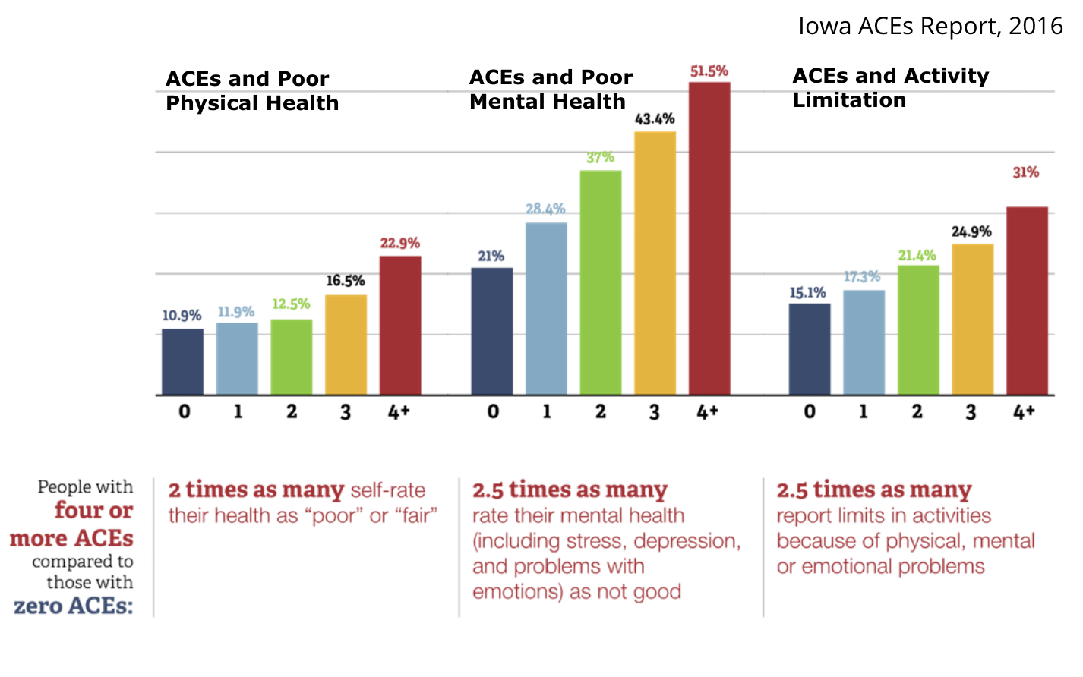
ACEs in Iowa
Iowa ACES 360

Slide 21
Trauma-Informed Practice
Significant barriers in treating individuals dually diagnoses with intellectual disabilities and PTSD
Lack of diagnostic clarity for PTSD
No reliable and valid instruments for clearly establishing PTSD diagnose.
Lack of evidence-based practices and research
Severity of ID can impact abilities to cognitively process trauma and the success of treatment as a whole
Current Clinical Approaches
Psychotherapy
EMDR
CBT, TF-CBT
ACT
Medication Management
Environmental Changes
What do these look like???

Slide 22
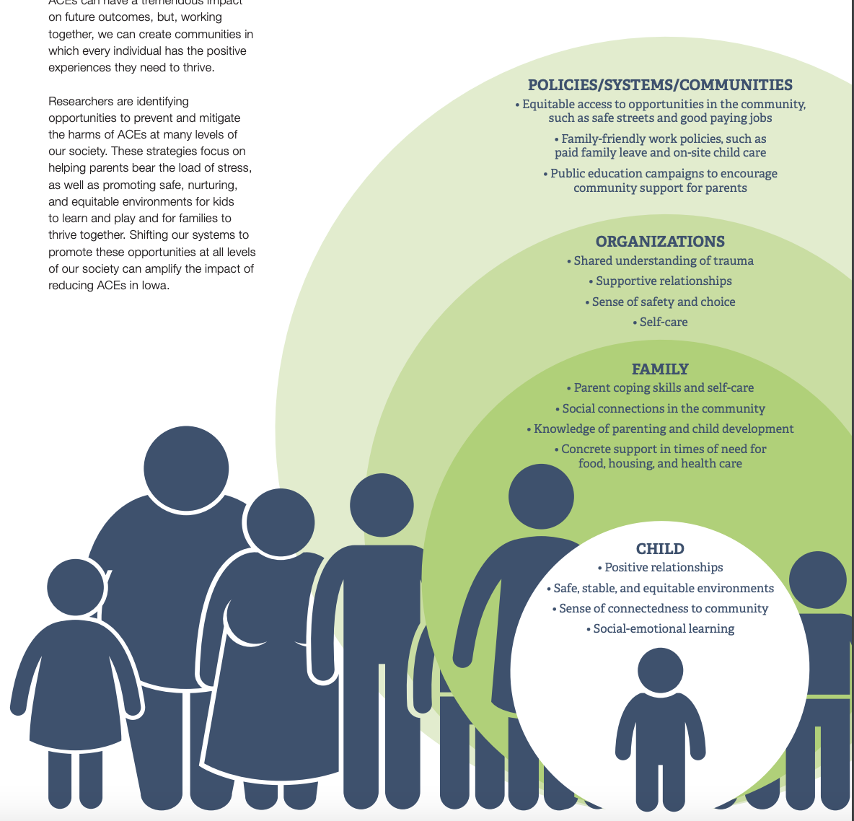
Protective Factors
Warm, supportive caregivers
Positive relationships
Safe, stable environments
Social emotional learning
Notes:
ACEs can have a tremendous impact on future outcomes, but, working together, we can create communities in which every individual has the positive experiences they need to thrive.
Researchers are identifying opportunities to prevent and mitigate the harms of ACEs at many levels of our society. These strategies focus on helping parents bear the load of stress, as well as promoting safe, nurturing, and equitable environments for kids to learn and play and for families to thrive together.
Shifting our systems to promote these opportunities at all levels of our society can amplify the impact of reducing ACEs

Slide 23
Burnout & Secondary Traumatic Stress: Co-travelers
Burnout
Work-related hopelessness and feelings of inefficacy
Secondary traumatic stress (STS)
Work-related secondary exposure to extremely or traumatically stressful events
Both share negative affect
Burnout is about being worn out
STS is about being afraid
What do these manifest in yourself/your team?

Slide 24
