Slide 1


A Sampler of Visual Supports
Susan Smith, LMHC, LBA
Welcome to

Slide 2
Benefit of Visual Supports
Individual styles. Some people learn better and respond better to “seeing” than to “hearing.”
Visual supports can travel between staff and between environments, which works toward consistency.
Decrease dependence on another person being present to provide vocal prompts.
Visual supports can preserve relationships if the individual is sensitive to over prompting.”

Slide 3
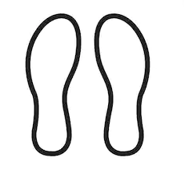
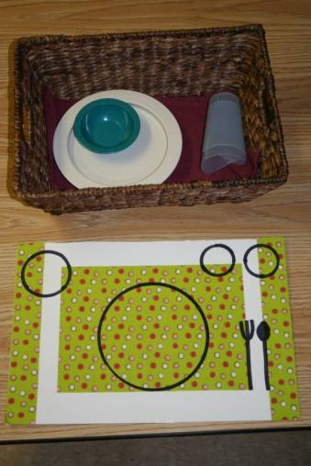
Placement Graphics
Drawings, diagrams, or tracings can be used to help the learner remember where something goes.
Putting something “where it belongs” can be very reinforcing to the person, so this strategy may work in a variety of settings.

Slide 4
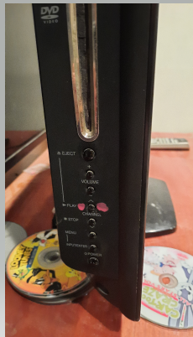
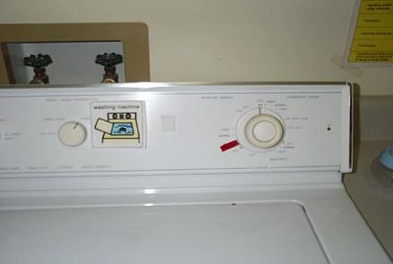
Visual Cues
Marking “Play” on TV/CD Player

Slide 5
(HOUSE ADDRESS)- Washer / Dryer Schedule
Sunday | Monday | Tuesday | Wednesday | Thursday | Friday | Saturday
Morning: Staff wash: Ben’s clothes | Morning: | Morning: Staff wash: Ben’s clothes | Morning: John wash: John’ sheets | Morning: Staff wash: Ben’s clothes | Morning: John wash: White hamper John’ clothes | Morning: Staff/Michael wash: Michael’s clothes
Afternoon: | Afternoon: John wash: White hamper John’ clothes | Afternoon: | Afternoon: Staff/Michael wash: Michael’s clothes | Afternoon: | Afternoon: Staff wash: Andrew’s clothes | Afternoon:

Slide 6
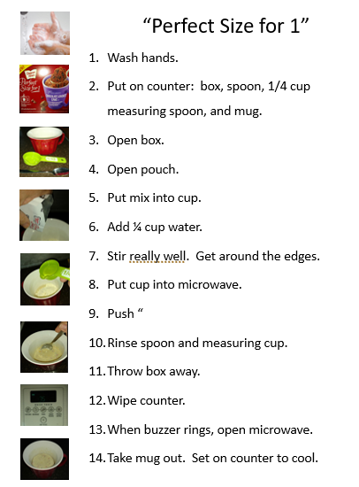
Visual prompting for a cooking goal.
Promoted autonomy.
Portion was aligned with dietary guidelines.

Slide 7
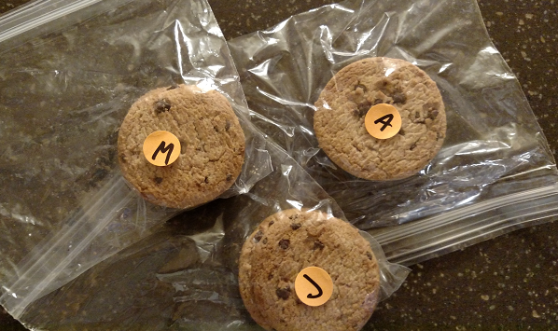
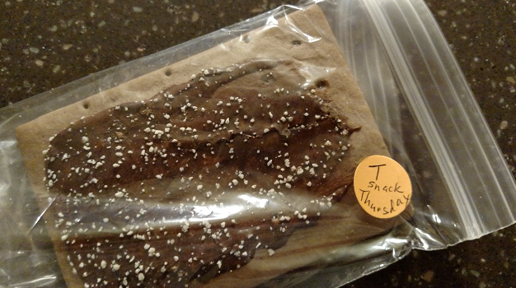
Food Boundaries – By Person or by Meal

Slide 8
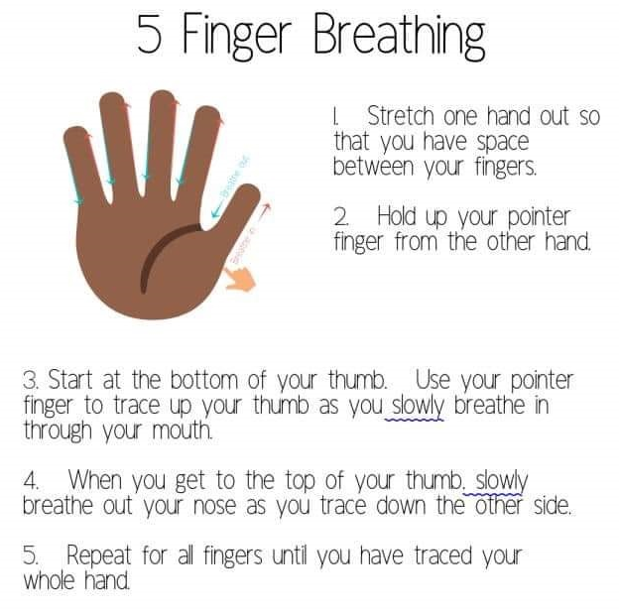
Handouts which provide visual cues enhance the effectiveness of therapeutic strategies.

Slide 9
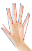
Handout describing strategy promotes generalization across people and environments.
Things I can do when
(fill in)
Take a shower
Graphic Organizer
Could use words or pictures
Could use more/less smaller circles
Could be hand drawn to simplify. Or, use a template shared by everyone.
For people who understand “why”, could also use “Why I should ___” in the big circle, and reasons in the smaller ones (e.g. to earn money; to work toward__; etc.)
Potential IIP, especially is multiple organizers were created and rotated on various days.
Could also be mentioned in BSP, when precursor behaviors occur, “Ask John ‘what is one thing you could do when (e.g. it is too noisy; you feel like this; you’re disappointed; etc.’”)

Slide 10
Where were you? What were you doing?
START
HERE
What were other people doing?
How were you feeling?
BEHAVIOR
How did you feel immediately after?
What was a long-term consequence?
Behavior
Chain
Analysis

Slide 11
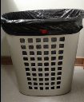
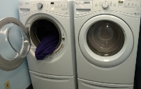
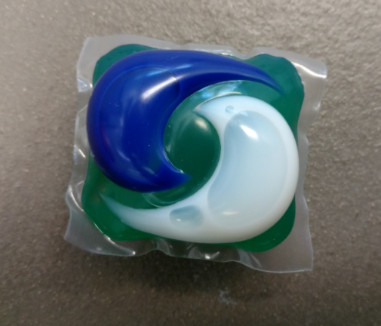
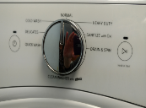

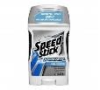






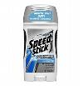

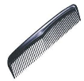
Scripts
1. Brush teeth
2. Wash face
3. deodorant
4. Brush hair
5. Floss teeth

Slide 12
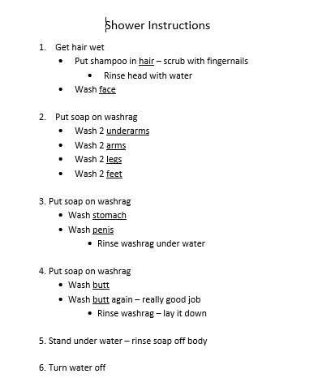
Cover w/sheet protector. Hang in shower.
Introduce with additional prompting, fade to visual.
Promoting independence in the shower.
May decrease probability of unnecessary touch by caregivers.

Slide 13
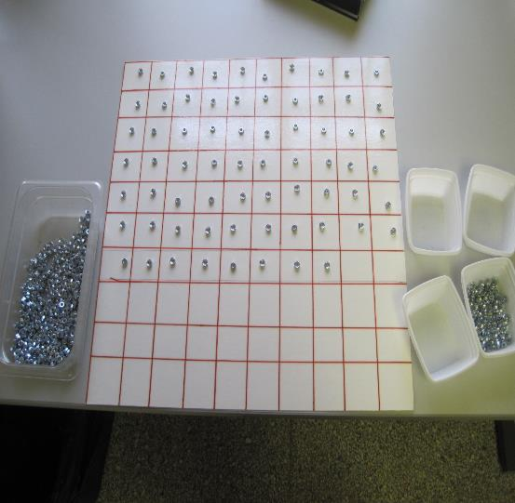
Visually structured activity to compete with less desirable behaviors, e.g. skin picking and/or when staff are occupied assisting another person.
IN-HOME ACTIVITIES

Slide 14
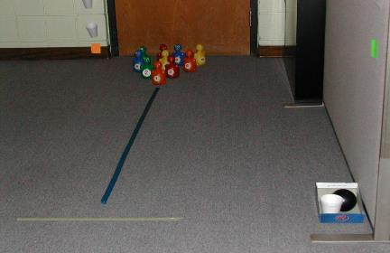
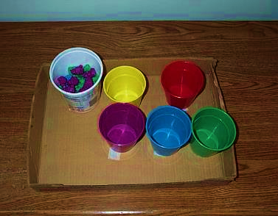
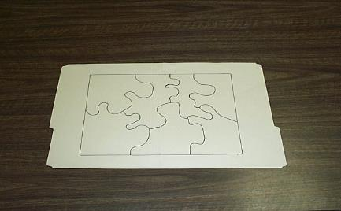
In-Home Activities

Slide 15
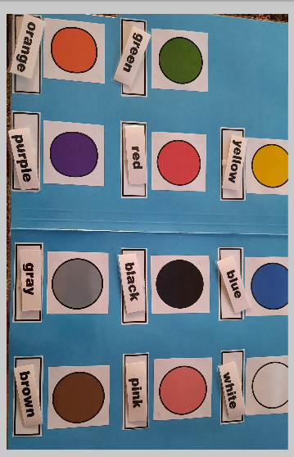
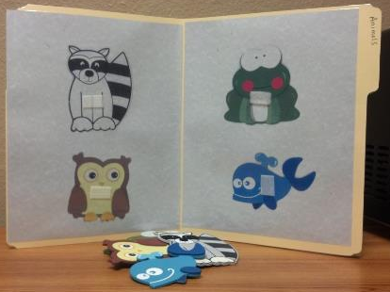
In-Home Activities
“File Folder Activities”
Use themes that match the person’s interests and skill set.
Work great in a structured “work-system.”

Slide 16
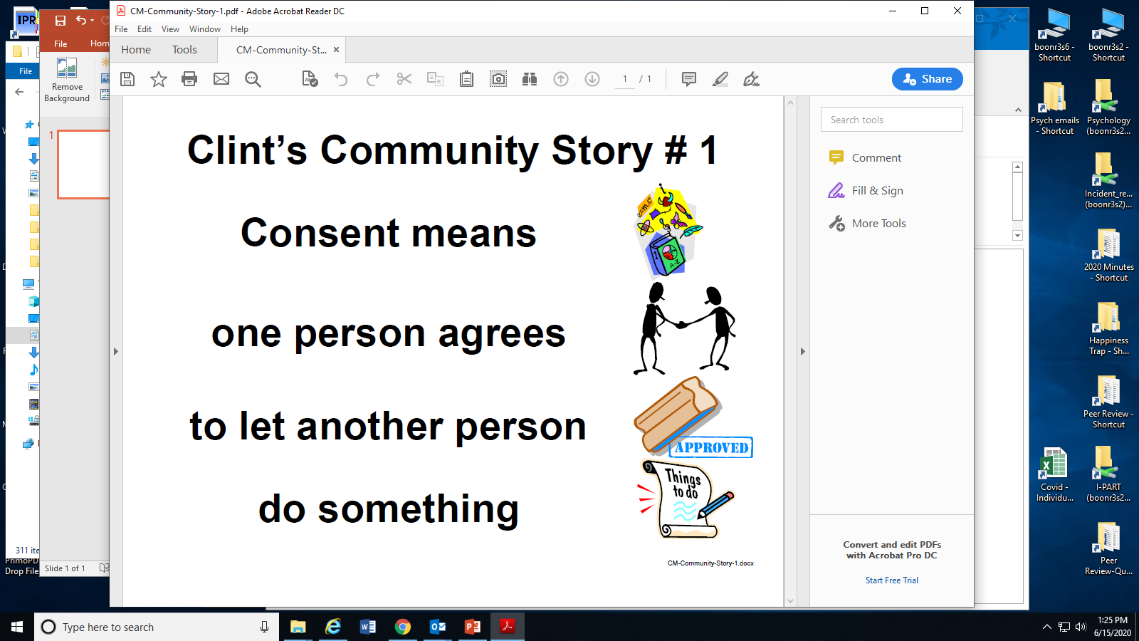
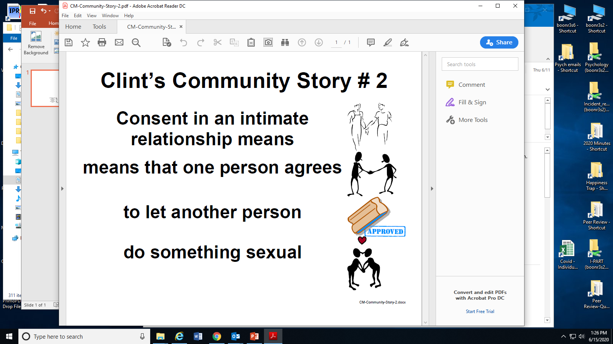
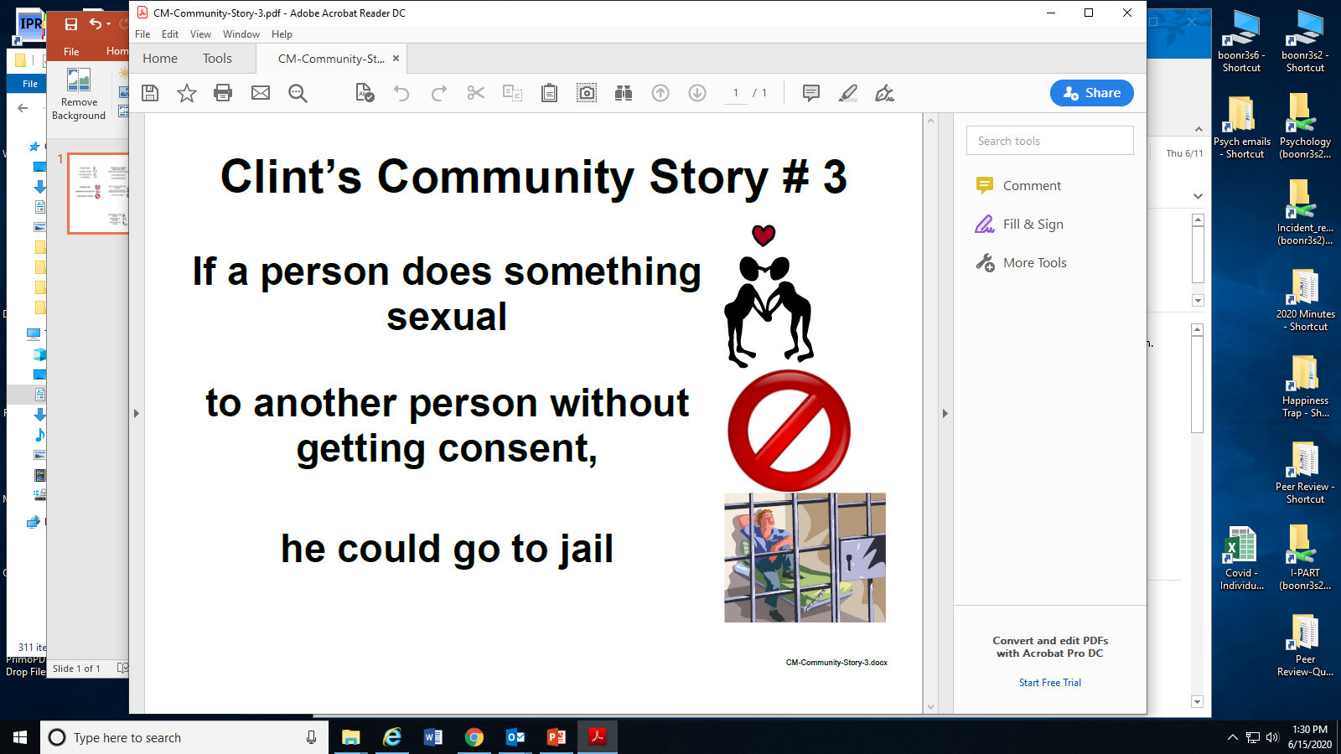
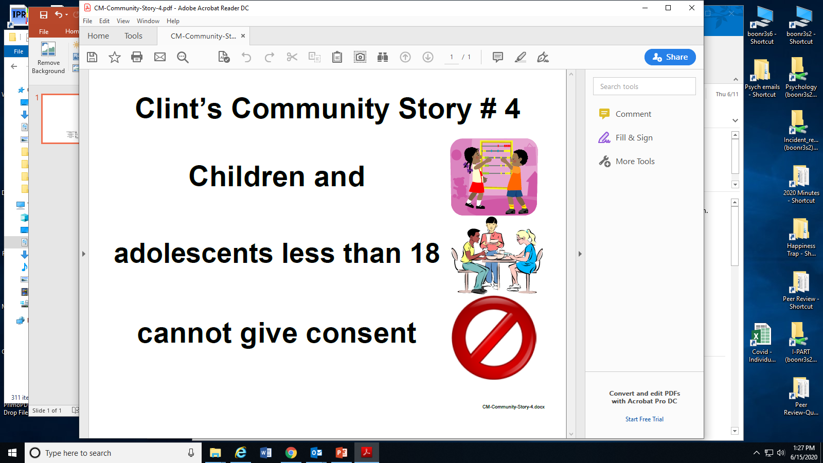
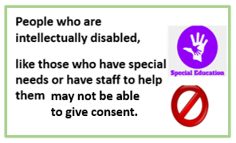
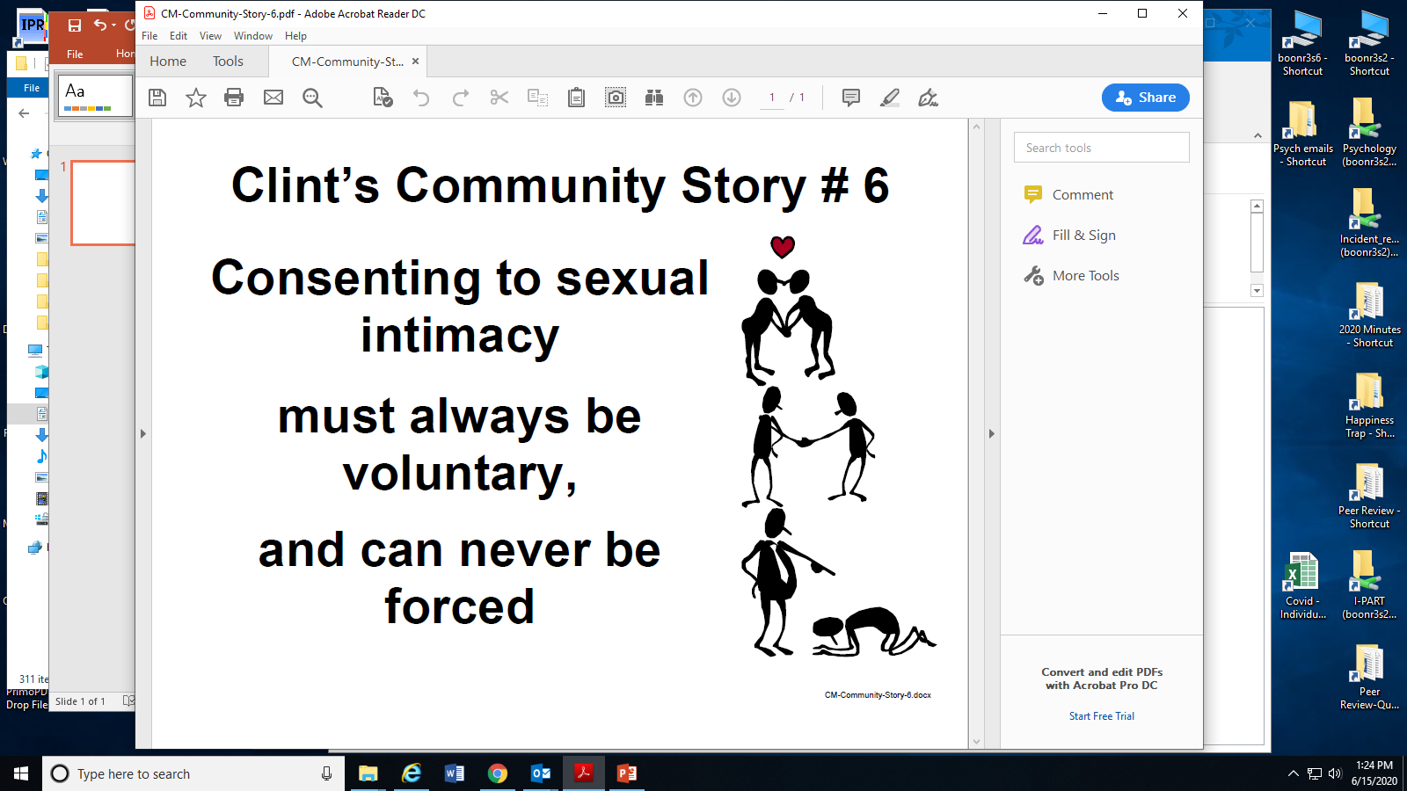
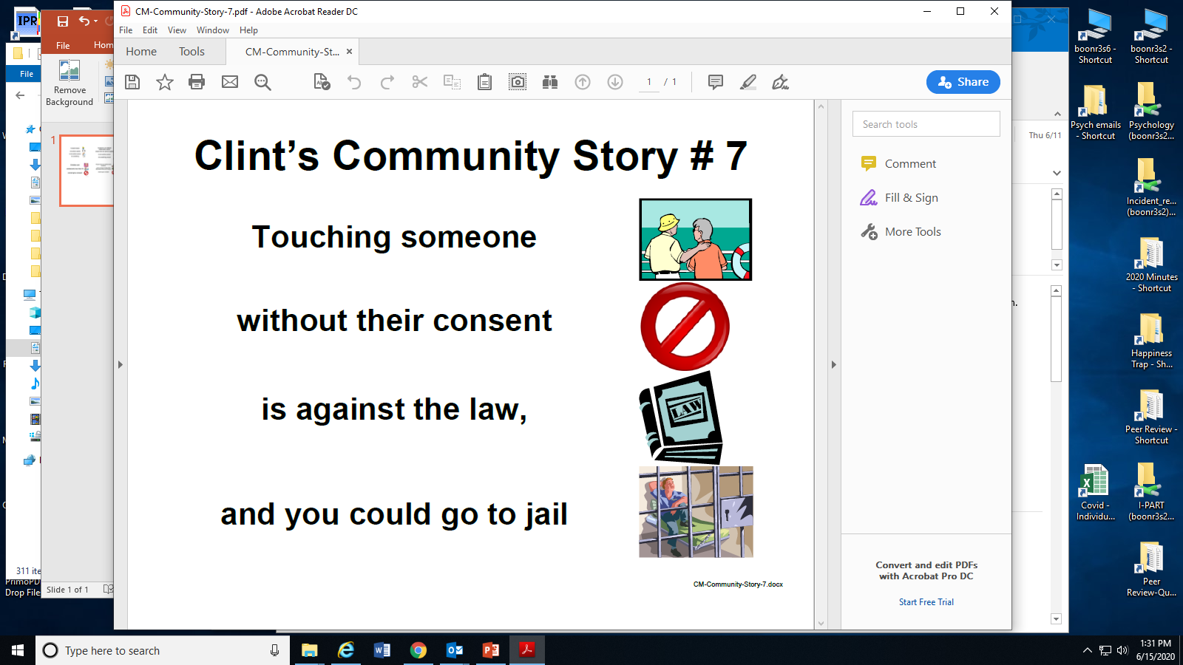
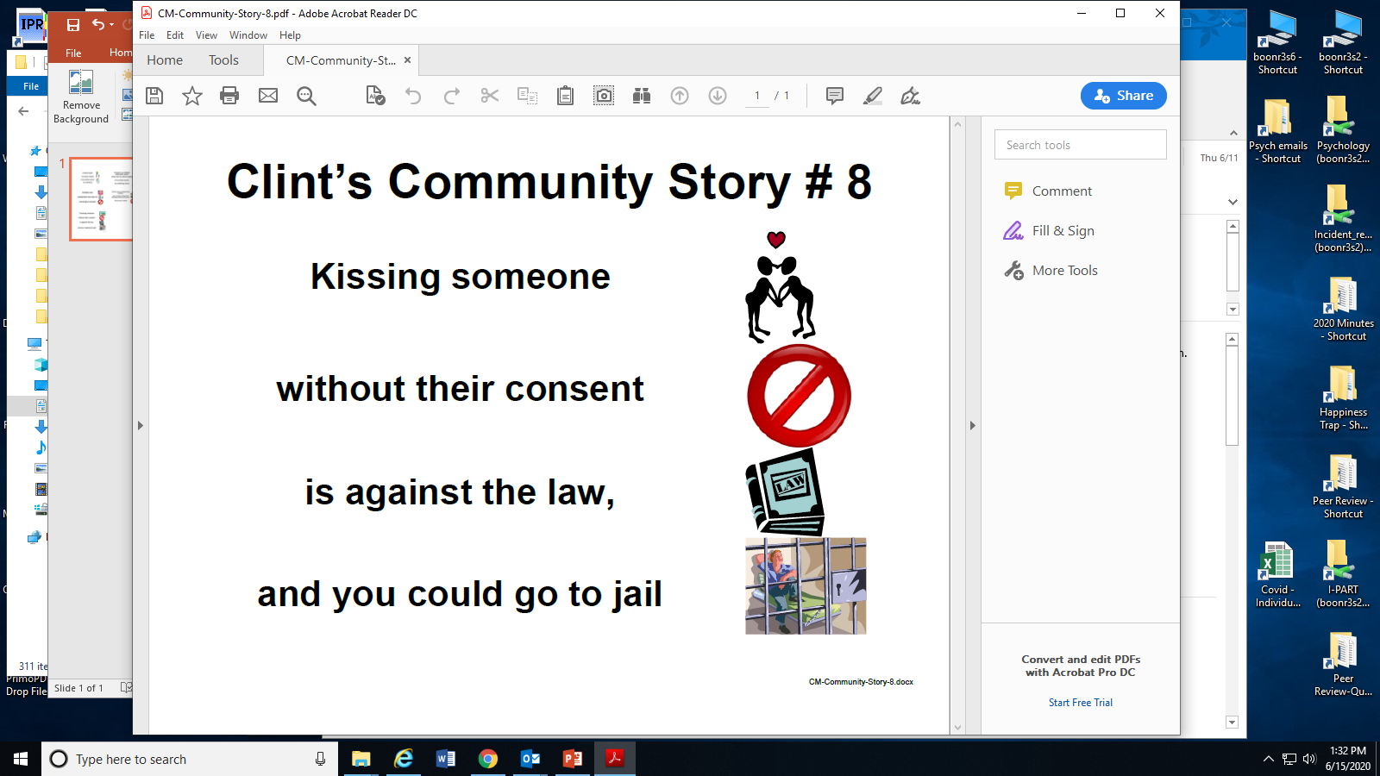
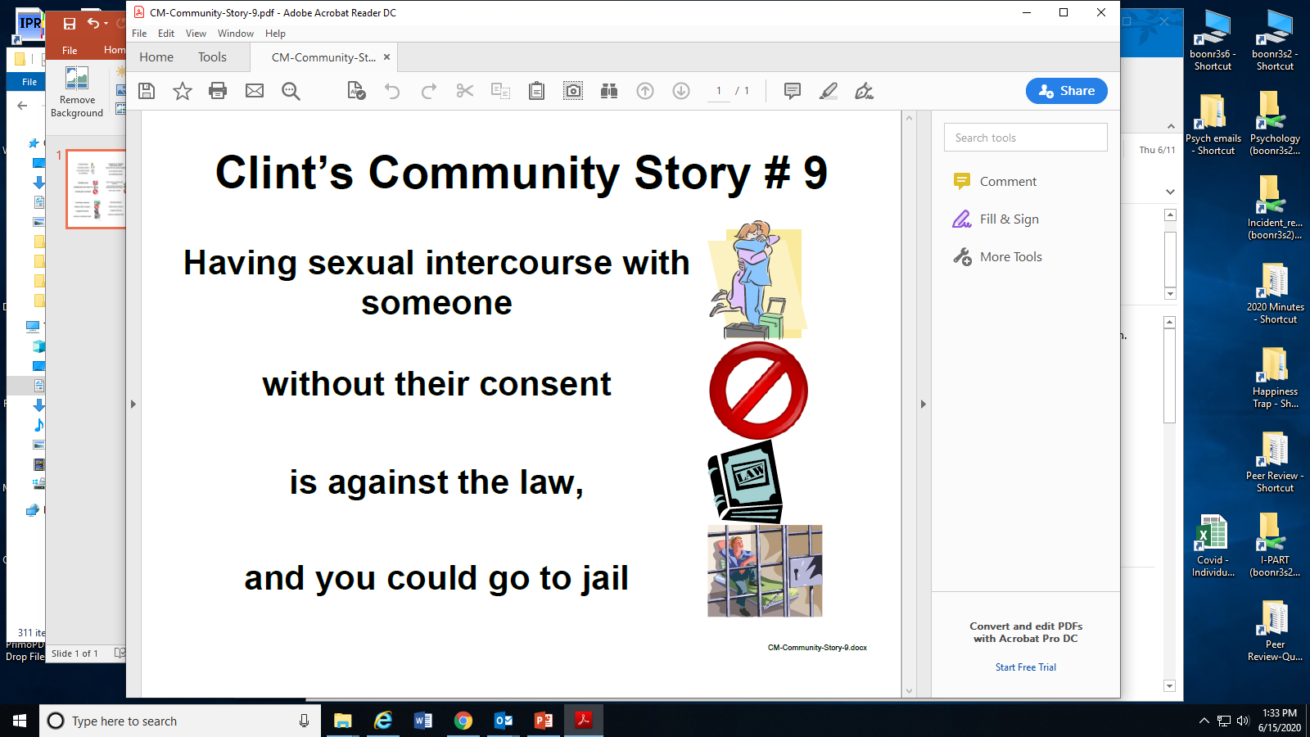

Slide 17
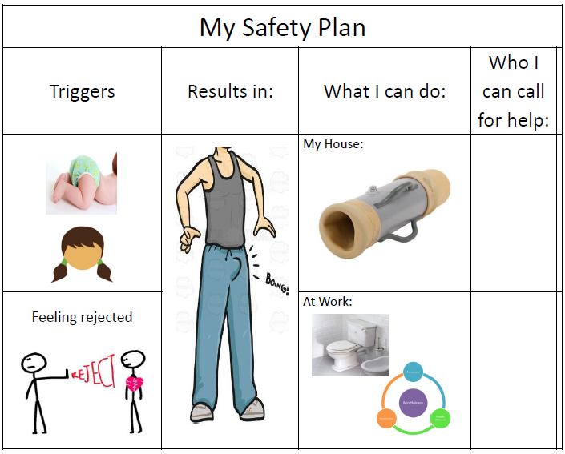

Slide 18
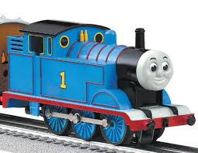
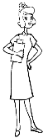
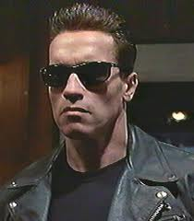

Using Interests to Motivate the Learner
James brushes his teeth every night. When he’s finished, he reads a book.
James can brush and read a book, too!
When The Terminator
sees his favorite nurse, he waves and tells her “Hello.”
Joey can wave at his nurse and say “Hello”, too!
Hello

Slide 19
I-TABS Iowa’s Technical Assistance and Behavior Supports Susan.smith@hhs.iowa.gov

