Slide 1


Provider Prevention and Support Services - I-START
Tiffany Liska,
Program Director at Elevate
Welcome to

Slide 2


Provider Prevention & Support Services
Notes:
Hello-
My name is Morgan Dettbarn and I am the Assistant Program Director with Provider Prevention & Support Services.
This can be a mouthful. Our Director, Tiffany Liska, has graciously granted us the permission to go by Provider Supports to shorten it up a little and make it a little easier to remember.
We are currently contracted through Elevate Housing Foundation in Waterloo. And receive grant funding through the Department of Health and Human Services
A few of you may be familiar with the previous ISTART program. We are the same team, offer similar supports, and remain nationally certified through the National START program out of New Hampshire.

Slide 3


Our Referral Requirements
Eligibility Requirements:
Intellectual Disability
Enrolled and Receiving ID Waiver or Habilitation Funding
Documented behavioral health challenges
Members between the ages of 6-17, must live in a residential-based supported community living setting.
Notes:
I want to review our eligibility requirements for services, prior to getting into the dynamics of our services.
READ bullet points.
Give examples of behavioral health challenges.
Examples of agencies that provide residential-based supported community living settings are:
* REM, Hope Haven, Systems Unlimited

Slide 4
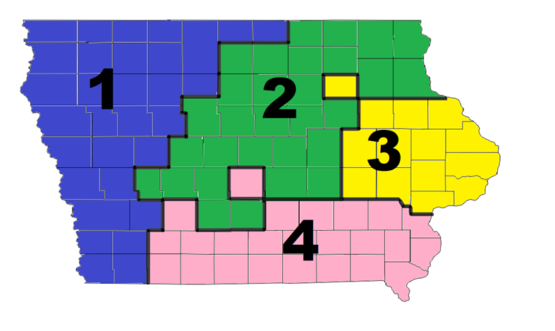

Introductions
Thomas Hengeveld, Coordinator
Tiffany Liska, Director
Amy Novak, Coordinator
Karla Chestnut, Clinical Team Lead
Jennifer Logan-Lorenz, Coordinator
Morgan Dettbarn, Clinical Program Director
Paige Reinking, Clinical Team Lead
Casey Wells, Clinical Team Lead
Tiffany Tran, Coordinator
Jennifer Church, Coordinator
Regina Regine, Coordinator
Notes:
Starting with me, KC, JL, CW, TT, RR, JC, MD, PR, TH

Slide 5

Our Purpose
To provide support to system members providing care to individuals with intellectual disabilities, co-occurring mental health diagnoses, and complex behavioral health needs.
Unique service
Aid in Managing Crises
Positive Psychology
Provide Training
Tied to National Resources
Notes:
What is the purpose of Provider Supports?
READ bulleted paragraph
Throughout the presentation I am going to share how we are a
Unique service
Our training and ability to offer preventative interventions
Our ability to aid in managing crisis
As well as:
Sharing insight on the positive psychology model and how it impacts the work we do.
Our ability to provide trainings
And how we are tied to national resources

Slide 6
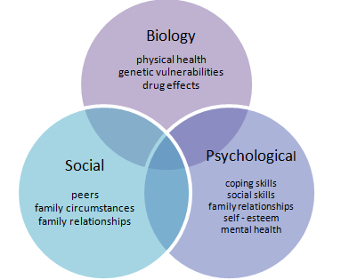
Unique Service
Primary focus is on the system of support
Specialized team
Consultation services provided by:
University of Iowa
Dr. Armstrong
Person-centered care approach
Everyone is part of the team
We meet frequently
Moves to a proactive vs reactive approach
Frequency determined by the acuity levels
Notes:
The service that provider supports implements is a unique service in a way that our primary focus is on the system of support. This indicates that we are a systems-based program. Though an individual is specifically referred to services, 9 times out of 10 we are meeting without the client due to the nature of the conversations that we are having and the questions that we ask. We want to avoid triggering a crisis for the individual.
We are a specialized team. Meaning all our team members have gone through 18 weeks of training through our national START team.
Primarily focusing on the:
IDD population,
systems work, and co-occurring mental health diagnoses. Another major aspect of our team’s training focuses on the
utilization of emergency services
and how to communicate with emergency personnel.
Our coordinators and clinical team leads receive ongoing oversight through administrative and clinical supervision. Every active case undergoes, a minimum, of an intensive quarterly review as part of our supervision model.
Our team, including our coordinators, have full access to and are encouraged to consult with our contracted Psychologist through the University of Iowa and our Medical Director contracted through Station MD out of New Jersey.
Requirement through the national start team that we have access to a medical doctor and psychologist for consultation to ensure full picture thinking and adequate support for the complex individuals and systems that we support.
Though we primarily meet outside of the client’s presence. We incorporate a person-centered care approach by always taking into consideration the individuals and system’s values and preferences.
Example that a referral would never be completed unless the individual was in agreeance to the service.
Every recommendation and support provided is intentional and is carefully thought out. It’s important to note that if you identify a coordinator or anyone on the provider supports team making a recommendation that you feel is out of their scope of practice, that the recommendation did in fact, come from someone who is an expert.
Reference biopsychosocial model
Intertwined in the supports we provide (conversations, recommendations, etc.)
This model ensures that all aspects of the individuals health and well-being is being considered.
Example: toothache vs. psychosis

Slide 7

Aid in Managing Crises
Proactive Planning Helps to Prevent Crisis
Our ……YOUR Crisis Plans
Crisis Supports
Prior to crisis occurring
Active planning for crisis
While a crisis is happening
Access to our support line and resources
After the crisis happens
Crisis follow-up
Training
Notes:
Provider supports is a secondary crisis service.
Aid in managing crisis rather than providing direct crisis service to the individual.
As stated in the previous slide, our goal is to proactively plan for crisis. This is accomplished through the utilization of what we call the crisis plan.
This plan is YOUR plan, not our plan.
This is why it is so important that all system members are joined so that a plan can be created and implemented to really fit the needs of the system.
Our goal is to have common language amongst the systems documents.
Example: trained on CPI want to ensure that we are utilizing CPI language.
You’ll see listed on the slide, a condensed version of what our crisis supports will look like throughout different stages.
READ bullet points
A major component of proactive planning and crisis supports is the training that our coordinators offer to the system on the crisis plan.
Trainings on the crisis plan are expected to happen on a regular basis. Especially at first as this is an ever-changing document and information needs to be shared when it’s learned.

Slide 8
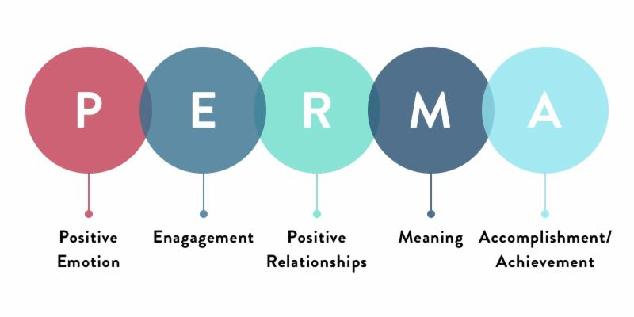

Positive Psychology
We want EVERYONE living a +1 lifestyle
Focus on burnout, turnover, and limited resources
Create an empathetic view
Identify areas of happiness
Person-centered approach
Strengths of the member served
Desire/Goals the member has
Promote overall positivity
Notes:
The positive psychology model is one of STARTS guiding principles.
Scientific study of strengths that enables individuals and communities to thrive
A major core concept of positive psychology is PERMA
READ picture
Theory of well-being that attempts to discover what enables human flourishing and puts a person in their flow.
Driving force of encouraging a plus 1 lifestyle through happiness, health, personal fulfillment, meaning and wellbeing
We want everyone living a plus 1 lifestyle, not only the individual themselves, but system members as well.
Data shows that when system members are experiencing a plus 1 life that this decreases burnout, turnover, and provides more opportunity to access appropriate resources.
Decreasing the level of burnout allows for the creation of an empathetic view toward the individual supported and promotes the identification of areas for happiness and promotes a person-centered approach.
Strengths of members served
Desire/goals the member has
Promotes overall positivity

Slide 9

Provide Training
FREE Training
Customized training to meet your needs and/or the needs of the member
Individualized training
Small or large groups
One-on-one training
Multiple training
Monthly training opportunities
Notes:
Within the START model and our grant.
Provider supports has the capacity to provide free trainings.
We can customize any training topic to fit your agency needs and the needs of members supported.
Depending on the topic, a coordinator, CTL, myself, and or even our clinical director can provide the trainings.
Customized to group sizing
Availability to adjust training times based on schedules
Clinical education training (CET)
Every 2nd Wednesday of the month
Held virtual
Didactic (general training topic related to the case being discussed)
De-identified case consultation in a virtual community setting
Attendees come from different backgrounds (case managers, direct support staff, supervisors, therapists, police officers, etc.)
National Online Training Series
Held virtual
Pre-recorded by a START national team member
Hosted by provider supports
Occurs every 4th Wednesday until the month of September.

Slide 10
National Resources
The Center for START Services
Experts in the field of complex behavioral health needs for individuals with intellectual and developmental disabilities
All members of the Provider Supports team are or will be Certified by the Center for START Services
Consultation Services
www.centerforstartservices.org
Notes:
Here you will see our access to national resources.
READ SLIDE
Consultation services:
Station MD
U OF I
NATIONAL TEAM

Slide 11
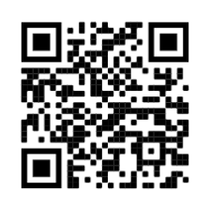
Make a Referral
Email: ProviderSupports@elevateccbhc.org
Website: www.elevateccbhc.org
Phone: 641.525.0401
Eligibility Requirements:
Intellectual Disability
Enrolled and Receiving ID Waiver or Hab Funding
Documented behavioral health challenges
Members between the ages of 6-17, must live in a residential-based supported community living setting.

Slide 12
Any Program Related Questions:
Contact:
Morgan Dettbarn, MSW Assistant Program Director
E: mdettbarn@elevateccbhc.org
P: 319-348-3668
Tiffany Liska, MA Program Director
E: tliska@elevateccbhc.org
P: 319-464.0642

