Slide 1
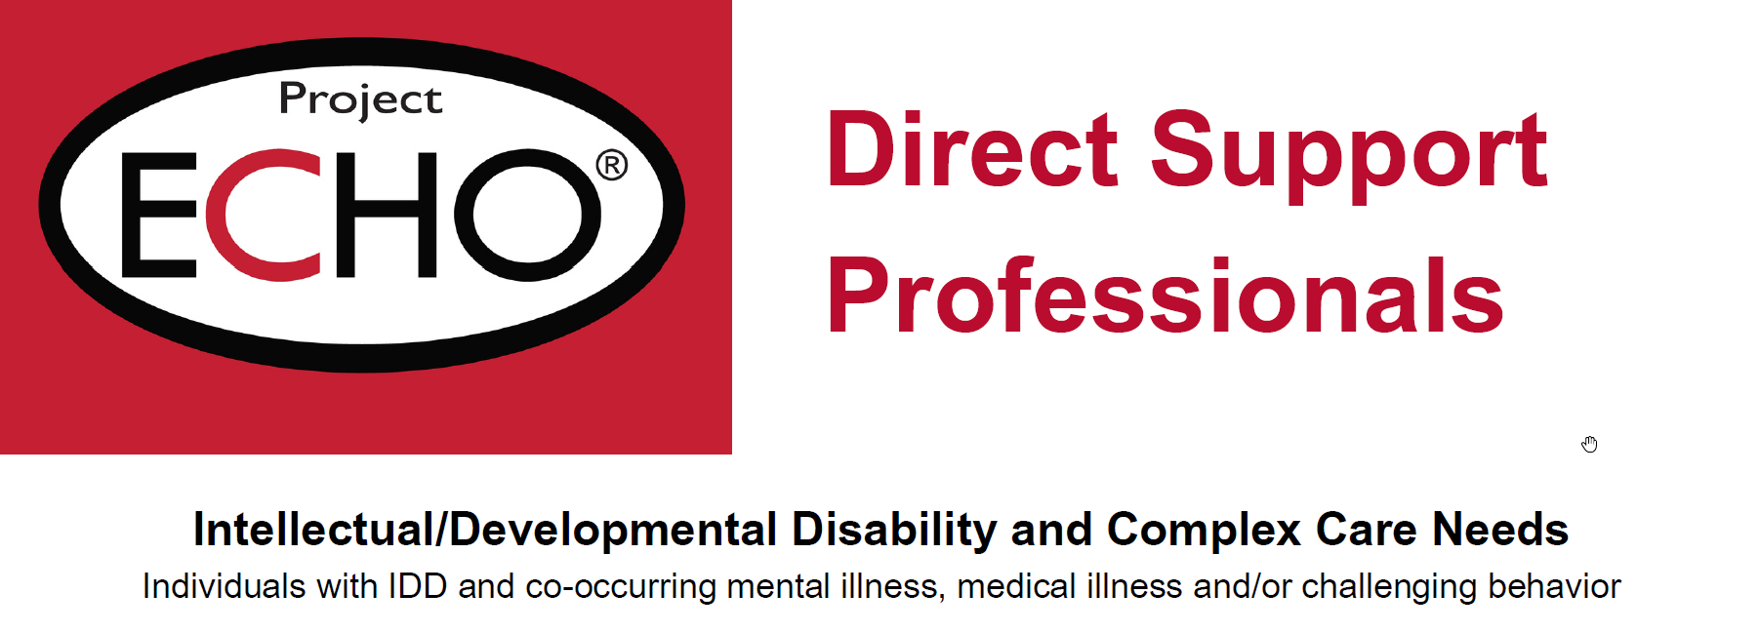

Medical Cannabis
Jodi Tate, MD

Slide 2
Overview
How to get it?
How does it work?
Does it work?
Is it safe?
Should we use it?

Slide 3
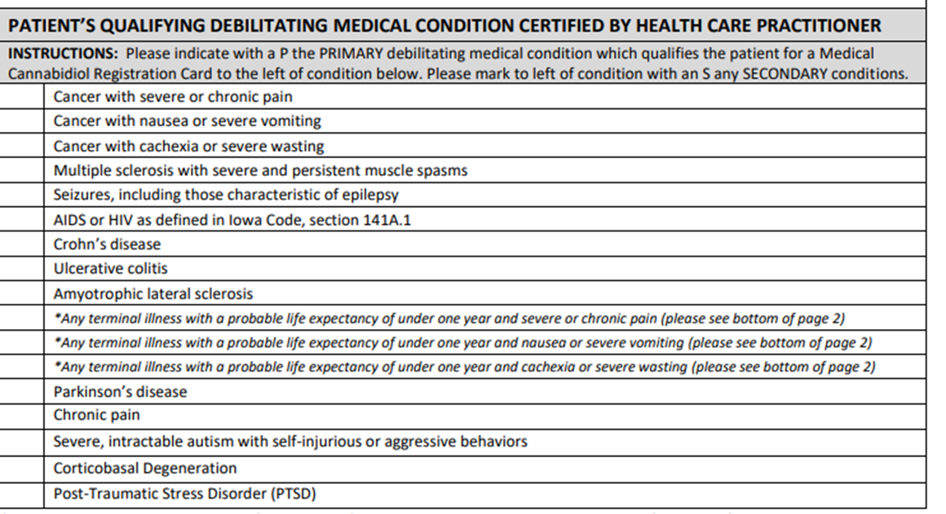
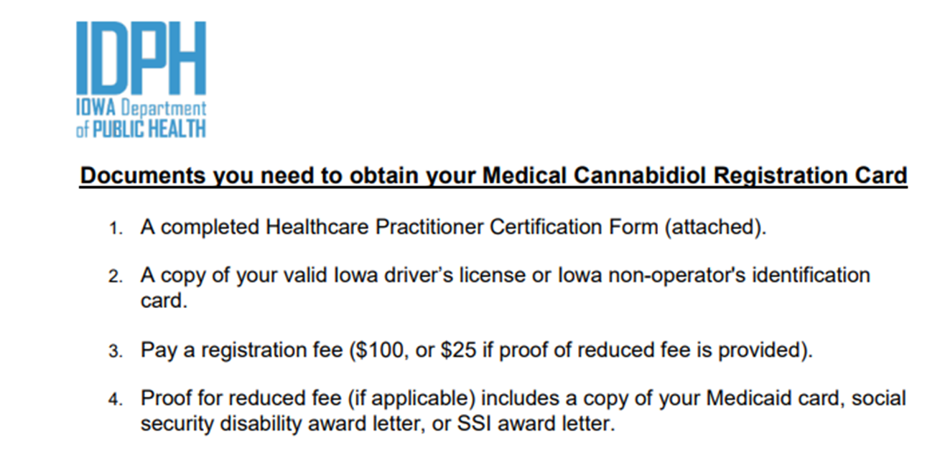

How to get it?
Medical Cannabis | Health & Human Services
Notes:
37 pages of administrative code

Slide 4
How does it work?

Slide 5
Too many terms!
Cannabis = a plant. Cannabis = marijuana
Cannabinoids = chemical compounds made in cannabis (a plant).
Lots of cannabinoids, 2 most common
THC (tetrahydrocannabinol)
CBD (cannabidiol)
PHYTOcannabinoids (phyto = plant)
But.. it was discovered that our bodies also make cannabinoids
Anandamide and AG
ENDOcannabinoids (endo = ‘within’)
And then we discovered how to make synthetic cannabinoids
FDA Approved medications: Epidiolox (seizures); Dronabinol/Marinol (nausea/vomiting)
Synthetic cannabinoids
EndoCannabinoid System (ECS)
A complex system in our bodies that maintains balance of many physiological systems (sleep, appetite, cognition,
stress, immune system, etc)
All cannabinoids interact with this system
Notes:
ine what is in these products without reagent testing because masking agents, such as tocopherol (or vitamin E acetate that causes vaping-associated pulmonary injury), eugenol, and fatty acids, are added to confound identification. Just as the synthetic cannabinoid(s) used differ between each synthetic cannabinoid product sold, so do the other contents of the counterfeit product.
Counterfeit black market cannabis products
[edit]
See also: Lacing (drugs) § Cannabis
Cannabis buds sold on the street may be adulterated.Counterfeit cannabis-liquid (c-liquid) for e-cigarettes: Synthetic
Epidiolex (cannabidiol) – seizures – is from plants…Lennox-Gastaut syndrome and Dravet syndrome = CBD
Marinol - THC

Slide 6
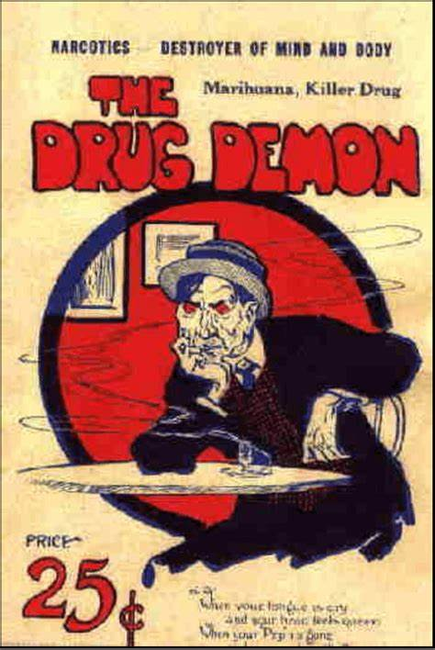
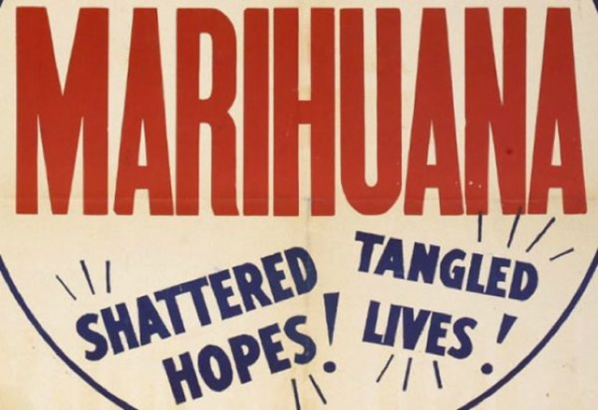
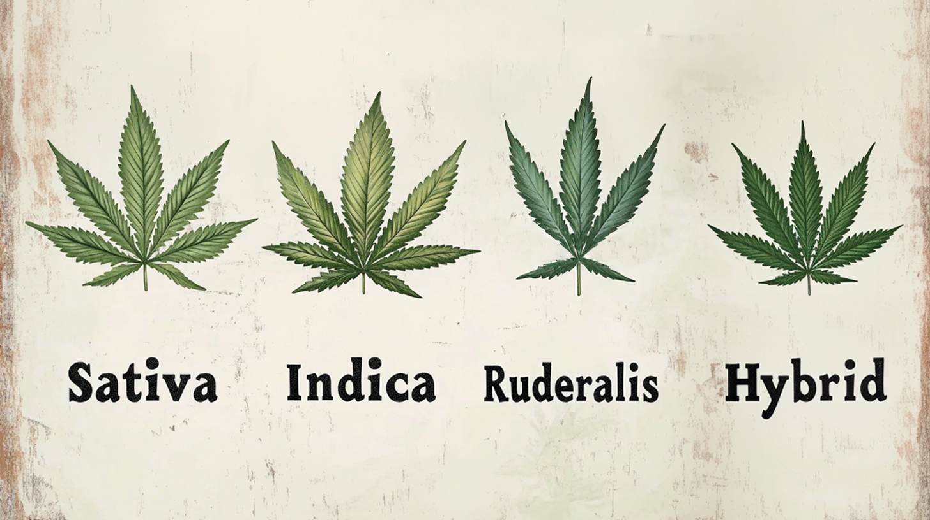
Brief History
Prior to 1930’
Sold by pharmaceutical companies
1930’s
Henry Anslinger – Commissioner of Federal Bureau of Narcotics
Xenophobia
Marijuana Tax Act
1973
THC identified
Synthetic cannabinoids created which helped us figure out how it works in body
1980’s
Endocannabinoid System (ECS) identified – how cannabinoids work!
Oldest evidence of human use in China 2700 years ago
In 1753, classified as Cannabis Sativa
3 main species but lots of hybrids
Notes:
Oldest evidence of human use 2700 year ago in western China
Cannabis – well know plan
1753 – classified cannabis sativa.. Sativa = cultivated
Origination 27 million years ago
Cannabis evolved throughout the world
Warmer climates = bigger plants = more THC
Colder climate = smaller plants = less THC
3 species = sativa, indica and ruderallis
Few decades = created plants with high THC and grow indores = creation of hybrids with mixture of sativa and indica. Generation of interbreeding. High THC, balance, high CBD
Warmer = bigger plants = more THC
Colder = smaller plants = less THC
Cannabis sativa = marijuana has been around for a LONG time
First record can be traced back to Chine 5000 year ago.. Used to relief cramps and pain
THC (tetrahydrocannabinol) – identified in 1974
Main psychoactive component of ~70 Phytocannabinoids identified in the plant
Discovery in 1974 lead to synthetic cannabinoids with similar structure to phytocannabinoids.. Which lead to identification of ECS in 1980’s
This system was disc

Slide 7
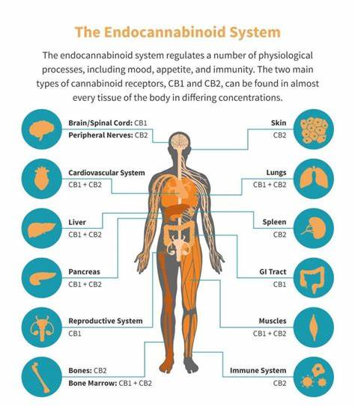
EndoCannabinoid System (ECS)
Air traffic controller our of bodies
Maintains homeostasis/balance in our bodies
Key Modulators for
Mood/anxiety
Behavior
Appetite
Sleep
Cognition
Neuroplasticity
Seizure
Immune system
Notes:
Nervous system, cardiovasculat system, digestive system… discovered in late 1980s = ECS.
ECS has receptors (binding sites) almost everywhere.. Unlike other systems.
ECS receptors are called – cannabinoid receptors – CB1 and CB2
CB1 = nervous system
CB2 = everywhere else.
Cannabinoids are chemicals that bind to the CBR in the ECS.
They are names after the cannabis plan because the first cannabinoid idenfied by researchers came from cannabis.
The ECS was discovered by tracking TCH to see how it attached to body.
Our bodies make
Discovered in late 1980’s
Important in maintaining homeostatic in our body
ECS= air traffic control tower of body. Maintanes balance!
Our body makes endocannabinoids on demand when needed.. They bind to target receptor and then processes get turned on in body
The endocannaboinoids our body makes are broken down fast
THC isn’t broken down fast.
THC and CBD bind to sites in ECS.
CBD doesn’t turn on CB1 receptors – it blocks them so doesn’t cause euphoria… also can block eurphoric of THC if given together.
CBD turns on CB2 receptors --

Slide 8
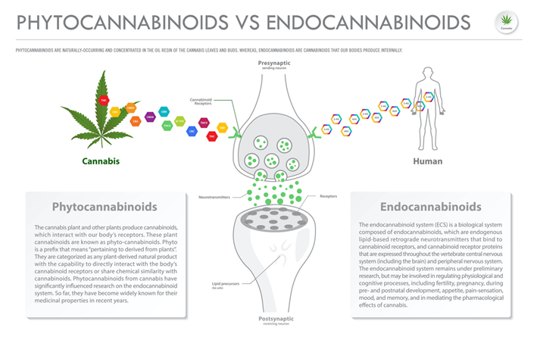
EndoCannabinoid System (ECS)
Air traffic controller our of bodies
Maintains homeostasis/balance in our bodies
Main functions
Mood/Anxiety
Appetite
Sleep
Immune system
Lots more!
Notes:
Nervous system, cardiovasculat system, digestive system… discovered in late 1980s = ECS.
ECS has receptors (binding sites) almost everywhere.. Unlike other systems.
ECS receptors are called – cannabinoid receptors – CB1 and CB2
CB1 = nervous system
CB2 = everywhere else.
Cannabinoids are chemicals that bind to the CBR in the ECS.
They are names after the cannabis plan because the first cannabinoid idenfied by researchers came from cannabis.
The ECS was discovered by tracking TCH to see how it attached to body.
Our bodies make
Discovered in late 1980’s
Important in maintaining homeostatic in our body
ECS= air traffic control tower of body. Maintanes balance!
Our body makes endocannabinoids on demand when needed.. They bind to target receptor and then processes get turned on in body
The endocannaboinoids our body makes are broken down fast
THC isn’t broken down fast.
THC and CBD bind to sites in ECS.
CBD doesn’t turn on CB1 receptors – it blocks them so doesn’t cause euphoria… also can block eurphoric of THC if given together.
CBD turns on CB2 receptors --

Slide 9
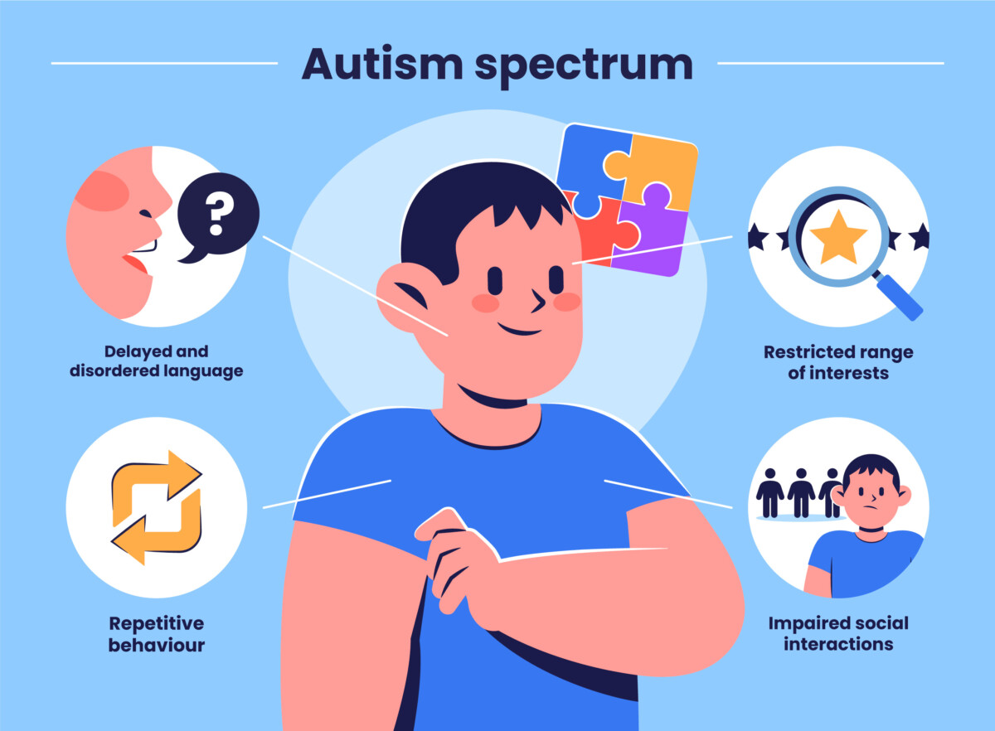
Autism and the ECS
Evidence to suggest that endocannabinoids are reduced in individuals with Autism
This reduction may be responsible for core symptoms of Autism
So…maybe phytocannabinoids (THC/CBD) can help treat core symptoms of Autism
Core Symptoms of Autism
No med to treat core symptoms
2 FDA Approved meds to treat irritability in ASD = Risperdal, Abilify

Slide 10
Does it work?

Slide 11
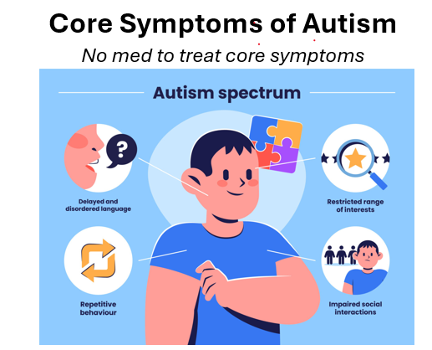
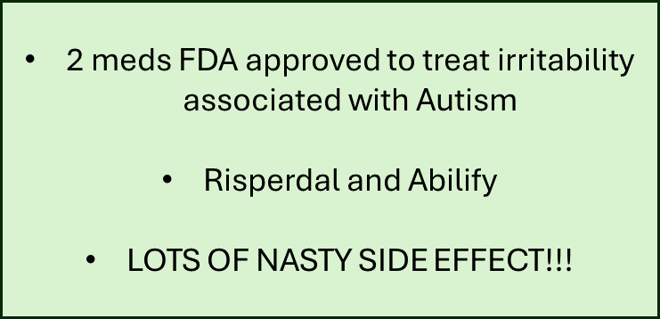
Research
9 studies to date – all positive
Individuals with ID excluded from studies
Improvements
Social interaction
Language
Cognition
Sensory sensitivity
Sleep
Mood
Attention
Challenging behavior (SIB, aggression)
Irritability, anger and restlessness
Notes:
An Open Label Study of the Use of Dronabinol (Marinol) in the Management of Treatment-Resistant Self-Injurious Behavior in 10 Retarded Adolescent Patients

Slide 12
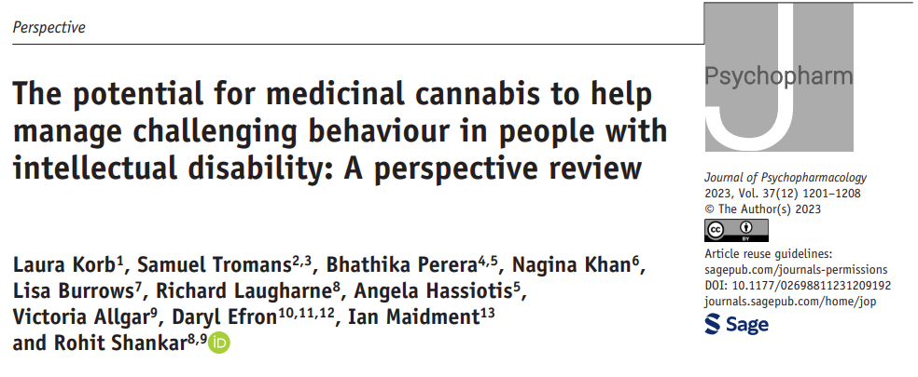
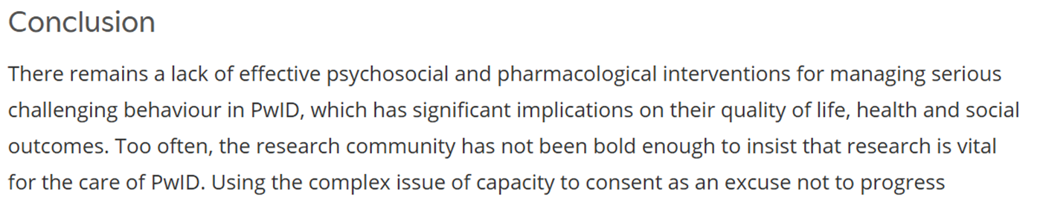

Intellectual Disability
1 positive study
10 kids
ID and challenging behavior
Synthetic THC
Dronabinol (Marinol)
Notes:
Open label of 10 kids with ID and SIB –
An Open Label Study of the Use of Dronabinol (Marinol) in the Management of Treatment-Resistant Self-Injurious Behavior in 10 Retarded Adolescent Patients

Slide 13
Is it safe?

Slide 14

Is it safe?
Quality
Not standardized
Not sure what you are getting
Side effects
Generally, well tolerated
Sleep disorders
Restlessness
Nervousness
Change in appetite
Diarrhea
Aggression/agitation
Decrease cognition
Psychosis and Cannabinoids
Relationship exits
Increase risk of developing psychosis/schizophrenia
Use in youth and family history of schizophrenia

Slide 15
Should we use it?

Slide 16
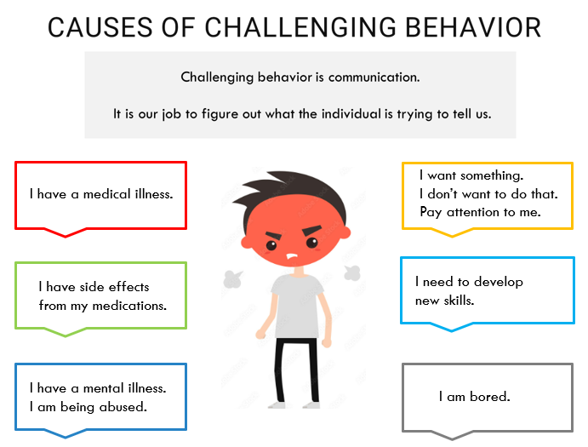
Should we use it?
Yes
No
Maybe
Depends
All risk/benefit ratio
What are we treating??

Slide 17

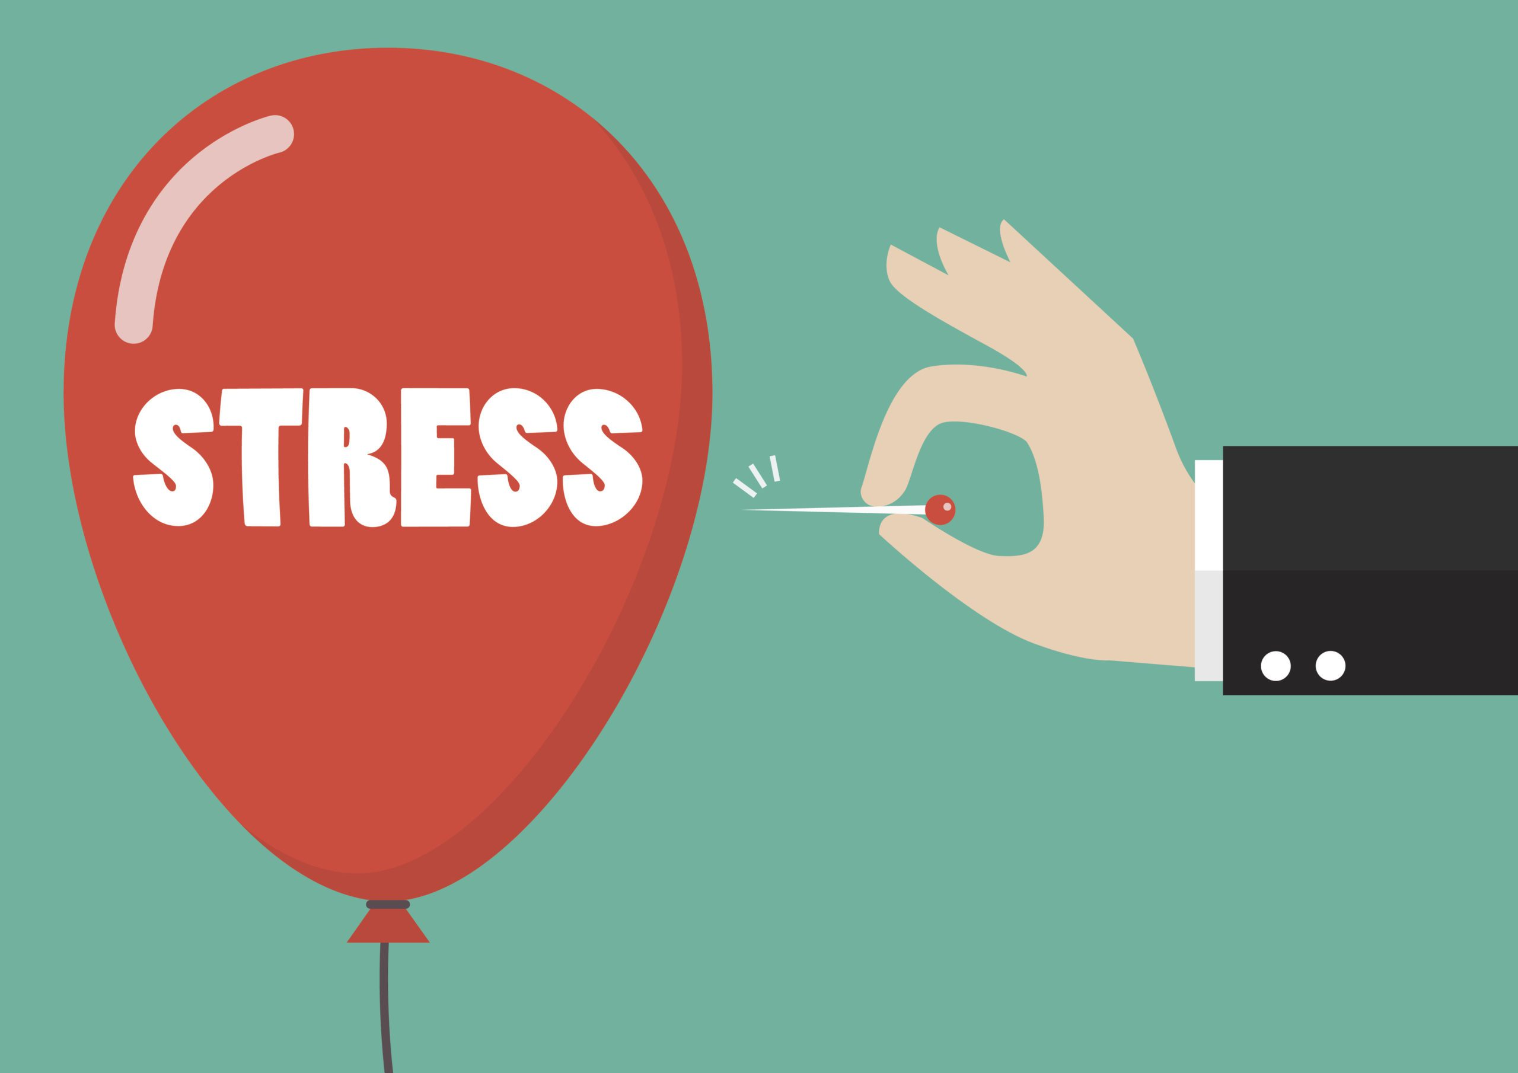
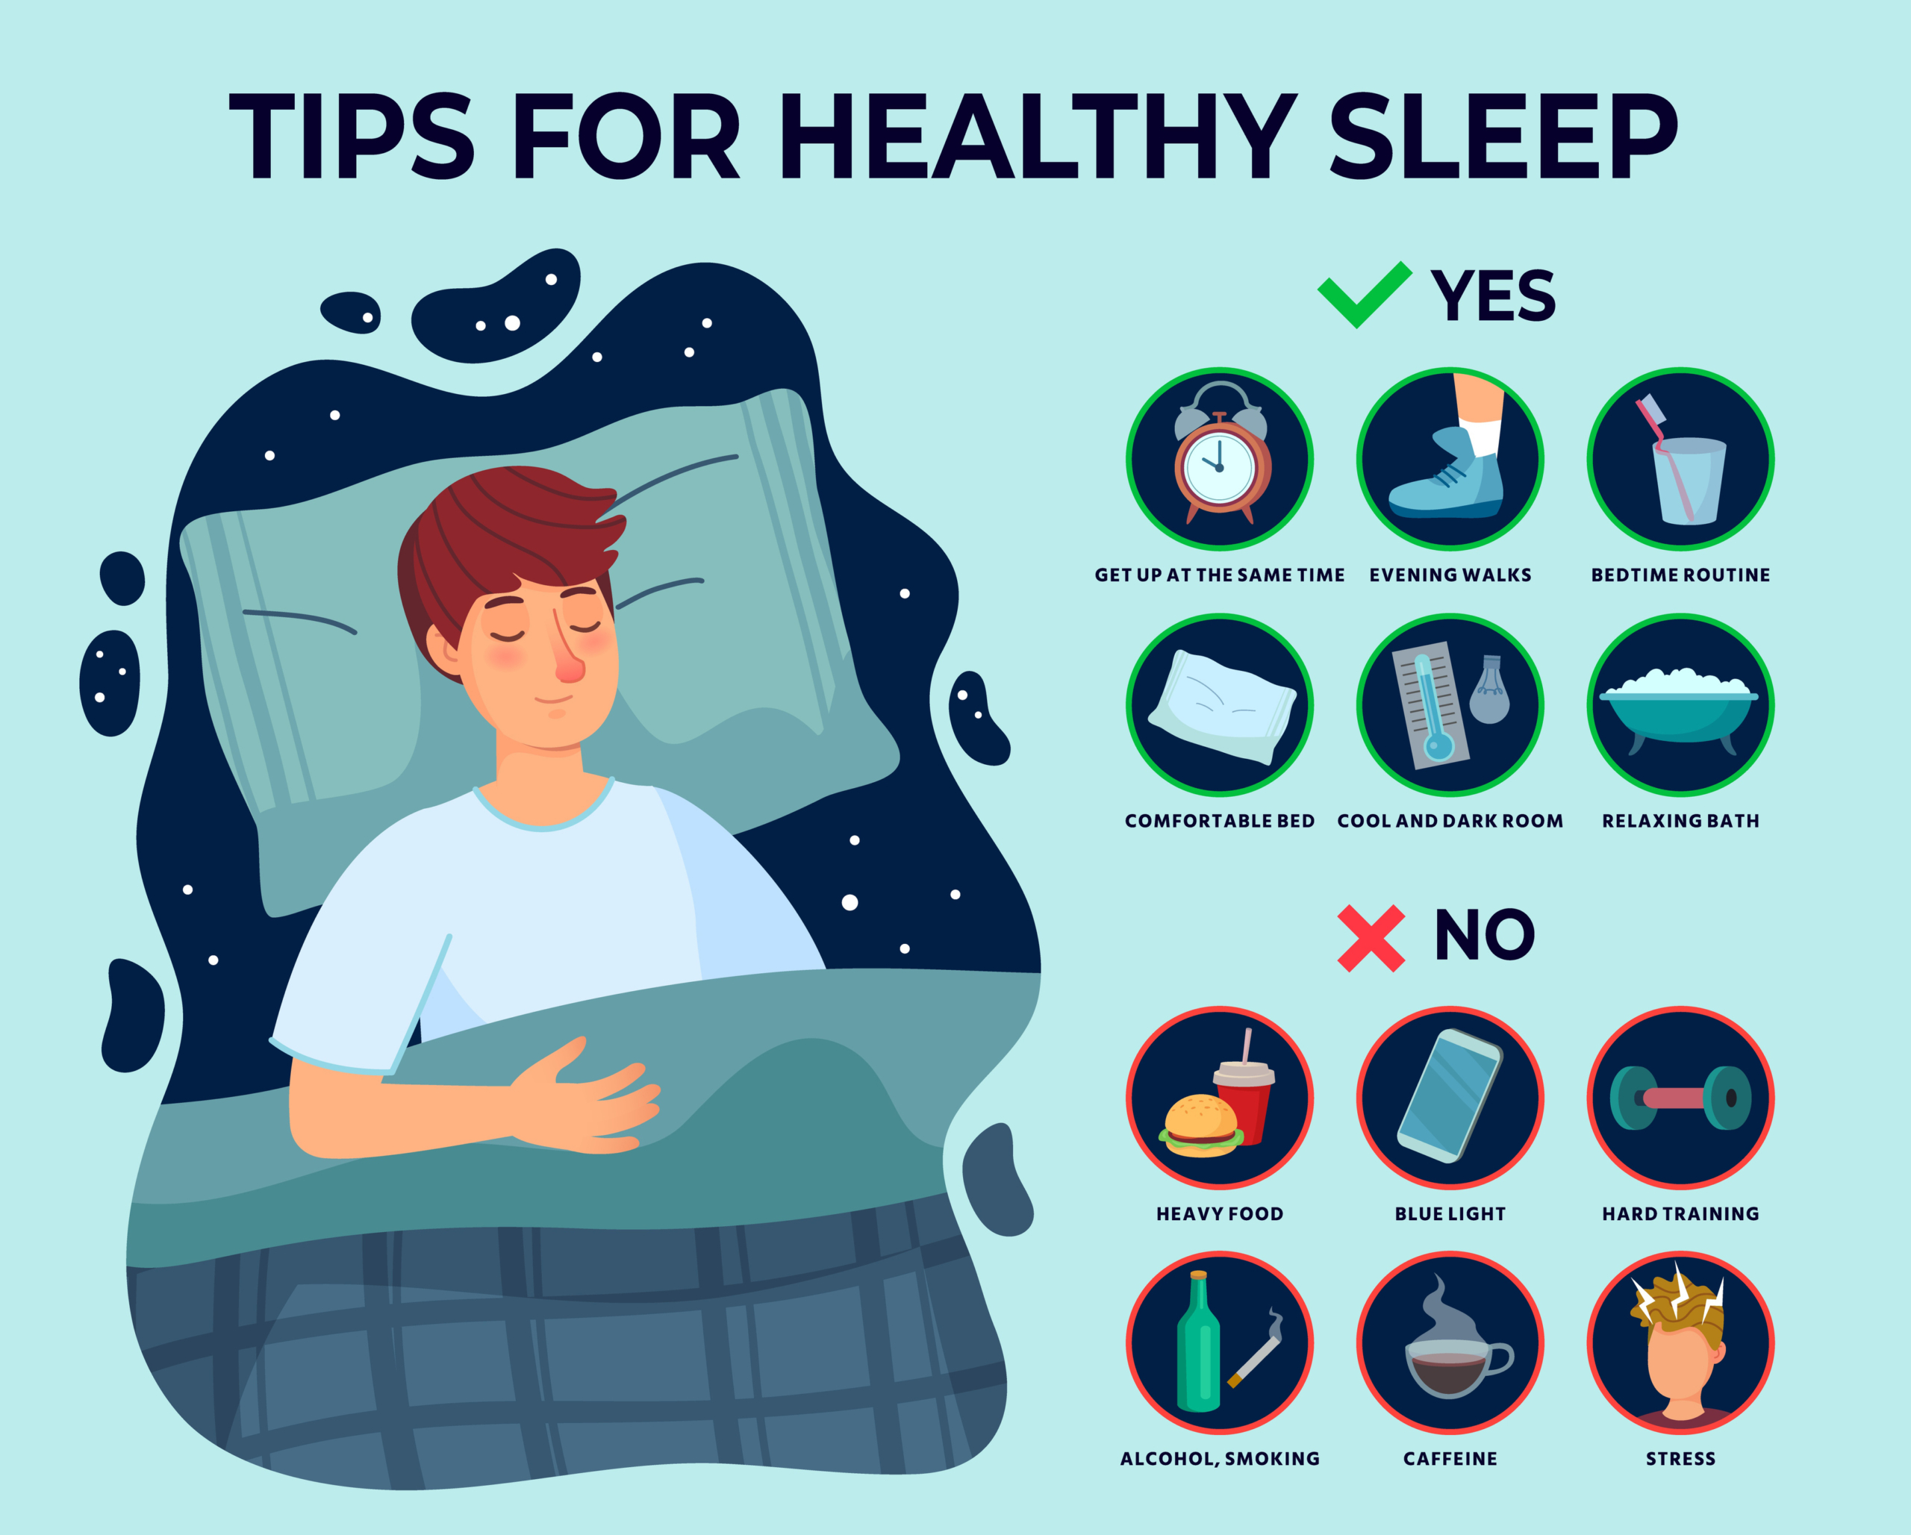

The EndoCannabinoid System (ECS) works better if we….

Slide 18
Summary
How to get it?
Medical Cannabis | Health & Human Services
How does it work?
EndoCannabinoid System (ECS)
Does it work?
Probably
Is it safe?
Probably
Should we use it?
Sometimes
Need to know what we are treating

Slide 19
References
Zou, S., & Kumar, U. (2018). Cannabinoid receptors and the endocannabinoid system: signaling and function in the central nervous system. International journal of molecular sciences, 19(3), 833.
Holdman, R., Vigil, D., Robinson, K., Shah, P., & Contreras, A. E. (2022). Safety and Efficacy of Medical Cannabis in Autism Spectrum Disorder Compared with Commonly Used Medications. Cannabis and cannabinoid research, 7(4), 451–463. https://doi.org/10.1089/can.2020.0154
Silva, E. A. D., Junior, Medeiros, W. M. B., Torro, N., Sousa, J. M. M., Almeida, I. B. C. M., Costa, F. B. D., Pontes, K. M., Nunes, E. L. G., Rosa, M. D. D., & Albuquerque, K. L. G. D. (2022). Cannabis and cannabinoid use in autism spectrum disorder: a systematic review. Trends in psychiatry and psychotherapy, 44, e20200149. https://doi.org/10.47626/2237-6089-2020-0149
Aran, A., Eylon, M., Harel, M., Polianski, L., Nemirovski, A., Tepper, S., Schnapp, A., Cassuto, H., Wattad, N., & Tam, J. (2019). Lower circulating endocannabinoid levels in children with autism spectrum disorder. Molecular autism, 10, 2. https://doi.org/10.1186/s13229-019-0256-6
Inglet, S., Winter, B., Yost, S. E., Entringer, S., Lian, A., Biksacky, M., Pitt, R. D., & Mortensen, W. (2020). Clinical Data for the Use of Cannabis-Based Treatments: A Comprehensive Review of the Literature. The Annals of pharmacotherapy, 54(11), 1109–1143. https://doi.org/10.1177/1060028020930189
Korb L, Tromans S, Perera B, et al. The potential for medicinal cannabis to help manage challenging behaviour in people with intellectual disability: A perspective review. Journal of Psychopharmacology. 2023;37(12):1201-1208. doi:10.1177/02698811231209192
Leinen, Z. J., Mohan, R., Premadasa, L. S., Acharya, A., Mohan, M., & Byrareddy, S. N. (2023). Therapeutic Potential of Cannabis: A Comprehensive Review of Current and Future Applications. Biomedicines, 11(10), 2630. https://doi.org/10.3390/biomedicines11102630
Kruger, T.; Christophersen, E. An open label study of the use of dronabinol (Marinol) in the management of treatment-resistant self-injurious behavior in 10 retarded adolescent patients. J. Dev. Behav. Pediatr. 2006, 27, 433. [Google Scholar] [CrossRef]
Efron, D., & Taylor, K. (2023). Medicinal Cannabis for Paediatric Developmental, Behavioural and Mental Health Disorders. International Journal of Environmental Research and Public Health, 20(8), 5430. https://doi.org/10.3390/ijerph20085430

