Slide 1
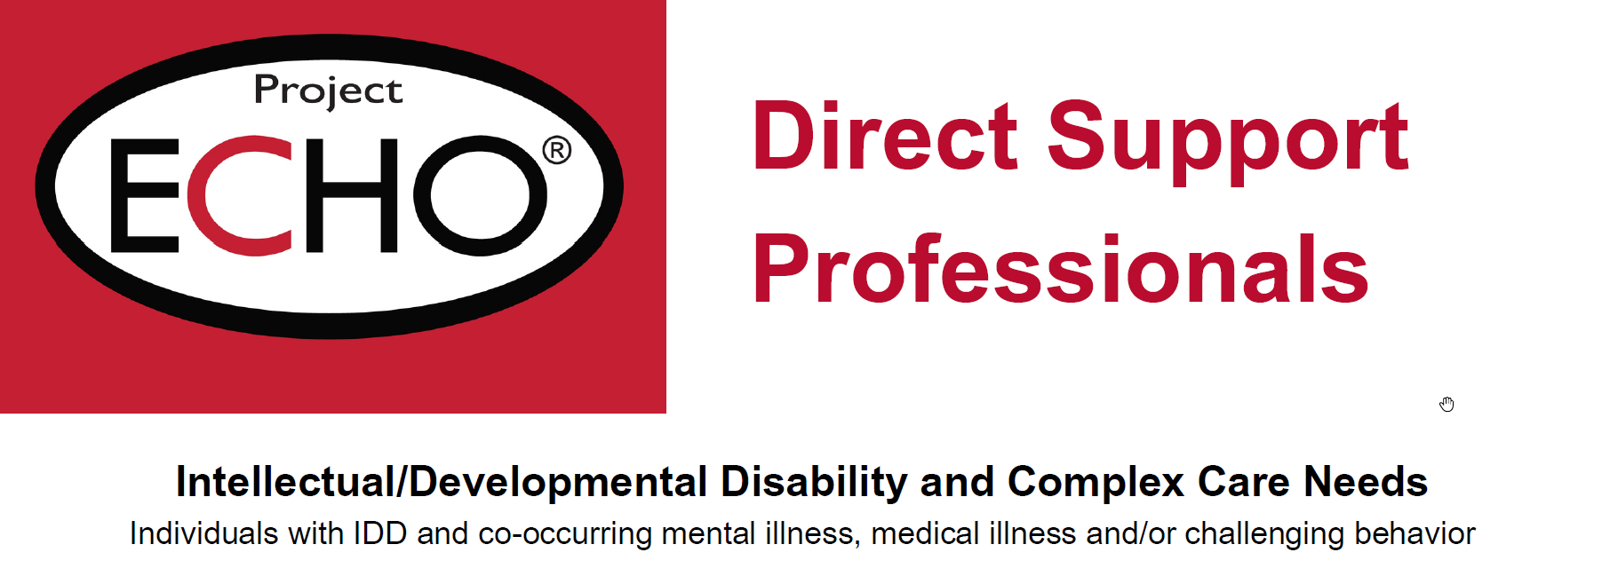

How to Deliver Positive Reinforcement
Jen Kuhle, PhD, BCBA-D
Iowa Health Care
Welcome to

Slide 2
What is reinforcement?
A consequence that strengthens the behavior or increases the likelihood that it will happen again.
  Reminder: consequence is anything that comes after or in response to the behavior. Helps determine the function of behavior.
Reinforcement can build both desirable and non-preferred behaviors
If a non-preferred behavior continues to occur, there is something that is reinforcing
  Must continue to examine consequences
Goal of positive reinforcement is to increase pro-social, desired behaviors
Notes:
Pay attention to the environment, our responses

Slide 3
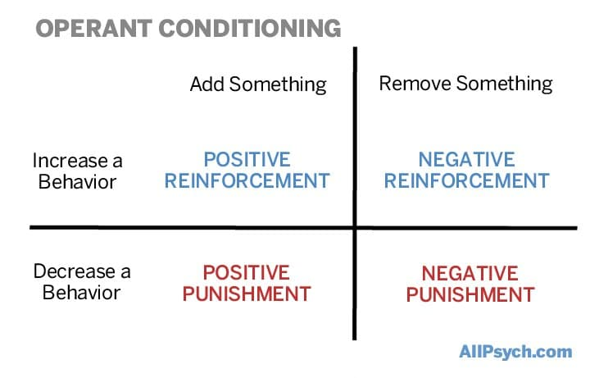
Reinforcement vs punishment
Notes:
Positive reinforcement is about adding something to the environment

Slide 4
TYPES of Reinforcers
Token – items given that can be turned in for something more valuable
  Earning tokens or points for brushing teeth and can “purchase” with later
Tangible – specific items (candy, food, soda, toys)
  Being kind to housemates earns soda
Privilege/Activity – going to store, seeing a movie, etc.
  Cleaning garage and can now stay up past curfew to see new movie
Social – attention, conversation, praise, approval, high five, hugs
  Enthusiastic conversation after getting out of van and returning to Day Hab

Slide 5
General REINFORCER Principles
Should be individualized, based on individual preferences
Reinforcement should be immediate and consistent
Identify specific behaviors
New behaviors will take time to develop
  Exercise model
If unsuccessful consider frequency and type of rewards being used
Notes:
Can’t reinforce behavior one time and expect change to be present. Think exercise analogy—training for a marathon or losing weight. Won’t make the goal in 20 minutes

Slide 6
SOCIAL most effective
Praise is Free!
Immediate
Specific
Genuine
Proximity
Nonverbal
Notes:
Enthusiastic and Genuine

Slide 7
Common pitfalls
Infrequently provided
Requiring too much to “earn”
Flipped responses
  Neutral for positive and big response for behaviors
Not matched to individual
Emotional responding
Vague earning criteria
Notes:
Emotional responding: they did something to be earlier so not going to respond

Slide 8
Pitfall Examples
Token – items given that can be turned in for something more valuable
  Earning tokens for brushing teeth and can “purchase” with later
  Providing token for “having a good day”
Tangible – specific items (candy, food, soda, toys)
  Being kind to housemates earns soda
  Getting access to iPad or music after blow up to calm down
Privilege/Activity – going to store, seeing a movie, etc.
  Cleaning garage and can now stay up past curfew to see new movie
  Screaming match in the kitchen and then going for a drive with staff to relax
Social – attention, conversation, praise, approval, high five, hugs
  Enthusiastic conversation after getting out of van and returning to Day Hab
  Lengthy 1:1 conversation following fight with roommate about making different choices

Slide 9
Tips & tricks
Identify the positive opposites
  What do we want to see?
  Can help eliminate the use of no, stop, don’t
  Easier to reinforce a behavior than absence of behavior
  Provides clarity about what is expected
Try to engage in 3-5x praise compared to critique or correction
  For every one corrective statement, provide three statements
Be gentle with yourself and client, all learning new skill

