Slide 1


Fatal Five
Craig Escude, MD, FAAFP, FAADM
President of IntellectAbility
Welcome to

Slide 2

The Fatal Five Plus
Presented by:
Craig Escudé, MD, FAAFP, FAADM
President, IntellectAbility
All photos 2025 Rick Guidotti,
Positive Exposure. All rights reserved.

Slide 3

Craig Escudé, MD, FAAFP, FAADM
Board-Certified Fellow of the American Academy of Family Physicians and the American Academy of Developmental Medicine
Over 20 years of experience caring for people with mental illness and intellectual and developmental disabilities
Medical Director of Hudspeth Regional Center in Whitfield, MS – Retired 2018
Founder of DETECT
President of IntellectAbility
Author of Clinical Pearls in IDD Healthcare and the Curriculum in IDD Healthcare
Host of the IDD Health Matters Podcast

Slide 4

Fatal Five Plus
Aspiration
Bowel Obstruction
Seizures
Dehydration
Sepsis
+ GERD
All photos 2025 Rick Guidotti,
Positive Exposure. All rights reserved.

Slide 5
Aspiration
Breathing food or fluid into the airway

Slide 6

Aspiration
A high cause of death in people with IDD
Influenced by many factors
Individual management and staff training are critical!
Identifying root cause is vital!
Can be caused by food going in or out of the stomach

Slide 7
Aspiration
Acute
Large quantity of aspirated material
Can result in death
Smaller quantity
Pneumonia
Recurrent
Frequent pneumonia
Wheezing

Slide 8
Aspiration – Subtle Signs and Symptoms
Cough - especially with eating or drinking
Refusal to drink thin liquids
Resistance in eating or drinking
Recurrent pneumonia
Reactive airway disease

Slide 9
Aspiration - Causes
Constipation
GERD
Reclined positioning
Liquid diet
Dysphagia
GI dysmotility
Sedation
Medications
Illness

Slide 10
Aspiration - Prevention
Positioning
Feeding techniques
Feeding evaluation
Thickening Liquids
Food texture/size
Test - Modified barium swallow
PEG Tube
Volume/Time
J-Tube
J-Tube/PEG

Slide 11
Bowel Obstruction
Blocking of movement through the GI tract from scar tissue, lack of movement (peristalsis) or constipation or foreign body

Slide 12
Bowel Obstruction
Major cause of death in the community
Inability to communicate pain or other symptoms
Over-reliance on bowel management medications
Influence of anti-cholinergic drugs
Failure to implement early intervention
Risk of repeat incidents is VERY high!

Slide 13
The Gastrointestinal Tract
It is impacted by…EVERYTHING
Medications
Stress
Physiology
Position
Nutrition/hydration

Slide 14
Constipation
Primary cause of “everything”
Fever
Anorexia
Vomiting
Seizures
Medication Intoxication
Decreased LOC
Pneumonia
Behavioral outbursts
Death

Slide 15
Constipation - Causes
Decreased GI motility
Immobility
Lack of sensation
Diet
Medications
Anti-Epileptic Drugs
Antipsychotics
Iron
Anti-cholinergics
Opiates
Pica
Common
May cause bowel obstruction

Slide 16
Constipation - Treatment
Diet
Fiber
Adequate fluid intake
Laxatives
MOM
Mg Citrate
Polyethylene glycol
Suppositories
Enemas
Manual dis-impaction

Slide 17
Q&A on
Bowel Obstruction

Slide 18
Seizures
An alteration in brain function resulting in changes in awareness, or function for a brief period of time

Slide 19
Seizures
Can be most severe and difficult to treat
Varying presentations
Status epilepticus prevalent
Sub-clinical status - rapid eye movements
Accurate seizure record VERY helpful in management

Slide 20
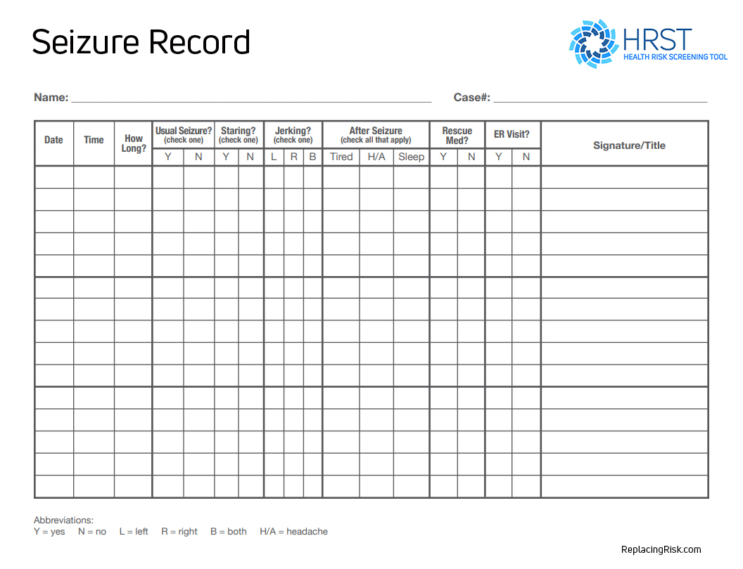

Slide 21
Seizures
Status epilepticus
Respiratory suppression
SUDEP - Sudden Unexplained Death in Epilepsy

Slide 22
Seizures- Precipitation Factors
Constipation
Infection
Medication compliance issues
Menses
Age
Shunt issues
May see change in LOC
Head Injury
Stroke
Hypoglycemia
Electrolyte Imbalance

Slide 23
Seizures
Seizure sequelae
Aspiration
Accidents

Slide 24
Dehydration
A harmful reduction in the amount
of water in the body

Slide 25
Dehydration
Vomiting
Limited intake
Limited ability to communicate thirst
Immobility to access fluids
Loss during intake
Medical conditions – DM
Staff awareness
Dysphagia
Drooling
If PEG Tube – inadequate amount of fluids provided
Draining PEG- Excess fluid loss without replacement
Follow electrolytes

Slide 26
Sepsis
Blood poisoning due to failure of the immune system to respond to infection

Slide 27
Sepsis
Also known as Blood Poisoning
Caused by an infection or its toxin spreading through the bloodstream
Occurs when large numbers of infections agents invade the bloodstream leading to bacteremia
Initial infection often comes from:
Burn, ulcer or open wound
Pneumonia
Urinary Tract Infection (UTI)

Slide 28
Sepsis is a Silent Killer
A “silent killer” whose early diagnosis could save thousands of lives each year
Should be treated aggressively
Very prevalent, costly disease with a high in-hospital mortality rate

Slide 29
Sepsis – Signs and Symptoms
High temperature
Rapid pulse
Chills
Low blood pressure
Mottling of the skin
Confusion and lightheadedness

Slide 30
Every hour that passes without treatment raises death risk by 10%
When in doubt, seek medical attention!

Slide 31
Gastroesophageal Reflux disease (GERD)
Back flow of partially digested food and acid into the esophagus causing pain and inflammation

Slide 32
Gastroesophageal Reflux disease (GERD)
Multiple causes of death
Massive GI bleed
Esophageal cancer
Aspiration of stomach contents

Slide 33
Common Signs Not Recognized
Pica
Hands in mouth
Agitation within 30 minutes of eating
Refusing meals
Agitation and restlessness in the middle of the night
Clinical signs: eroding hemoglobin, hematocrit and albumin (blood protein)
Unplanned weight loss regardless of intake

Slide 34
Diagnosis
PH monitor
Barium Swallow
Endoscopy
Oxygen Saturation decreasing at any time during or after mealtime

Slide 35
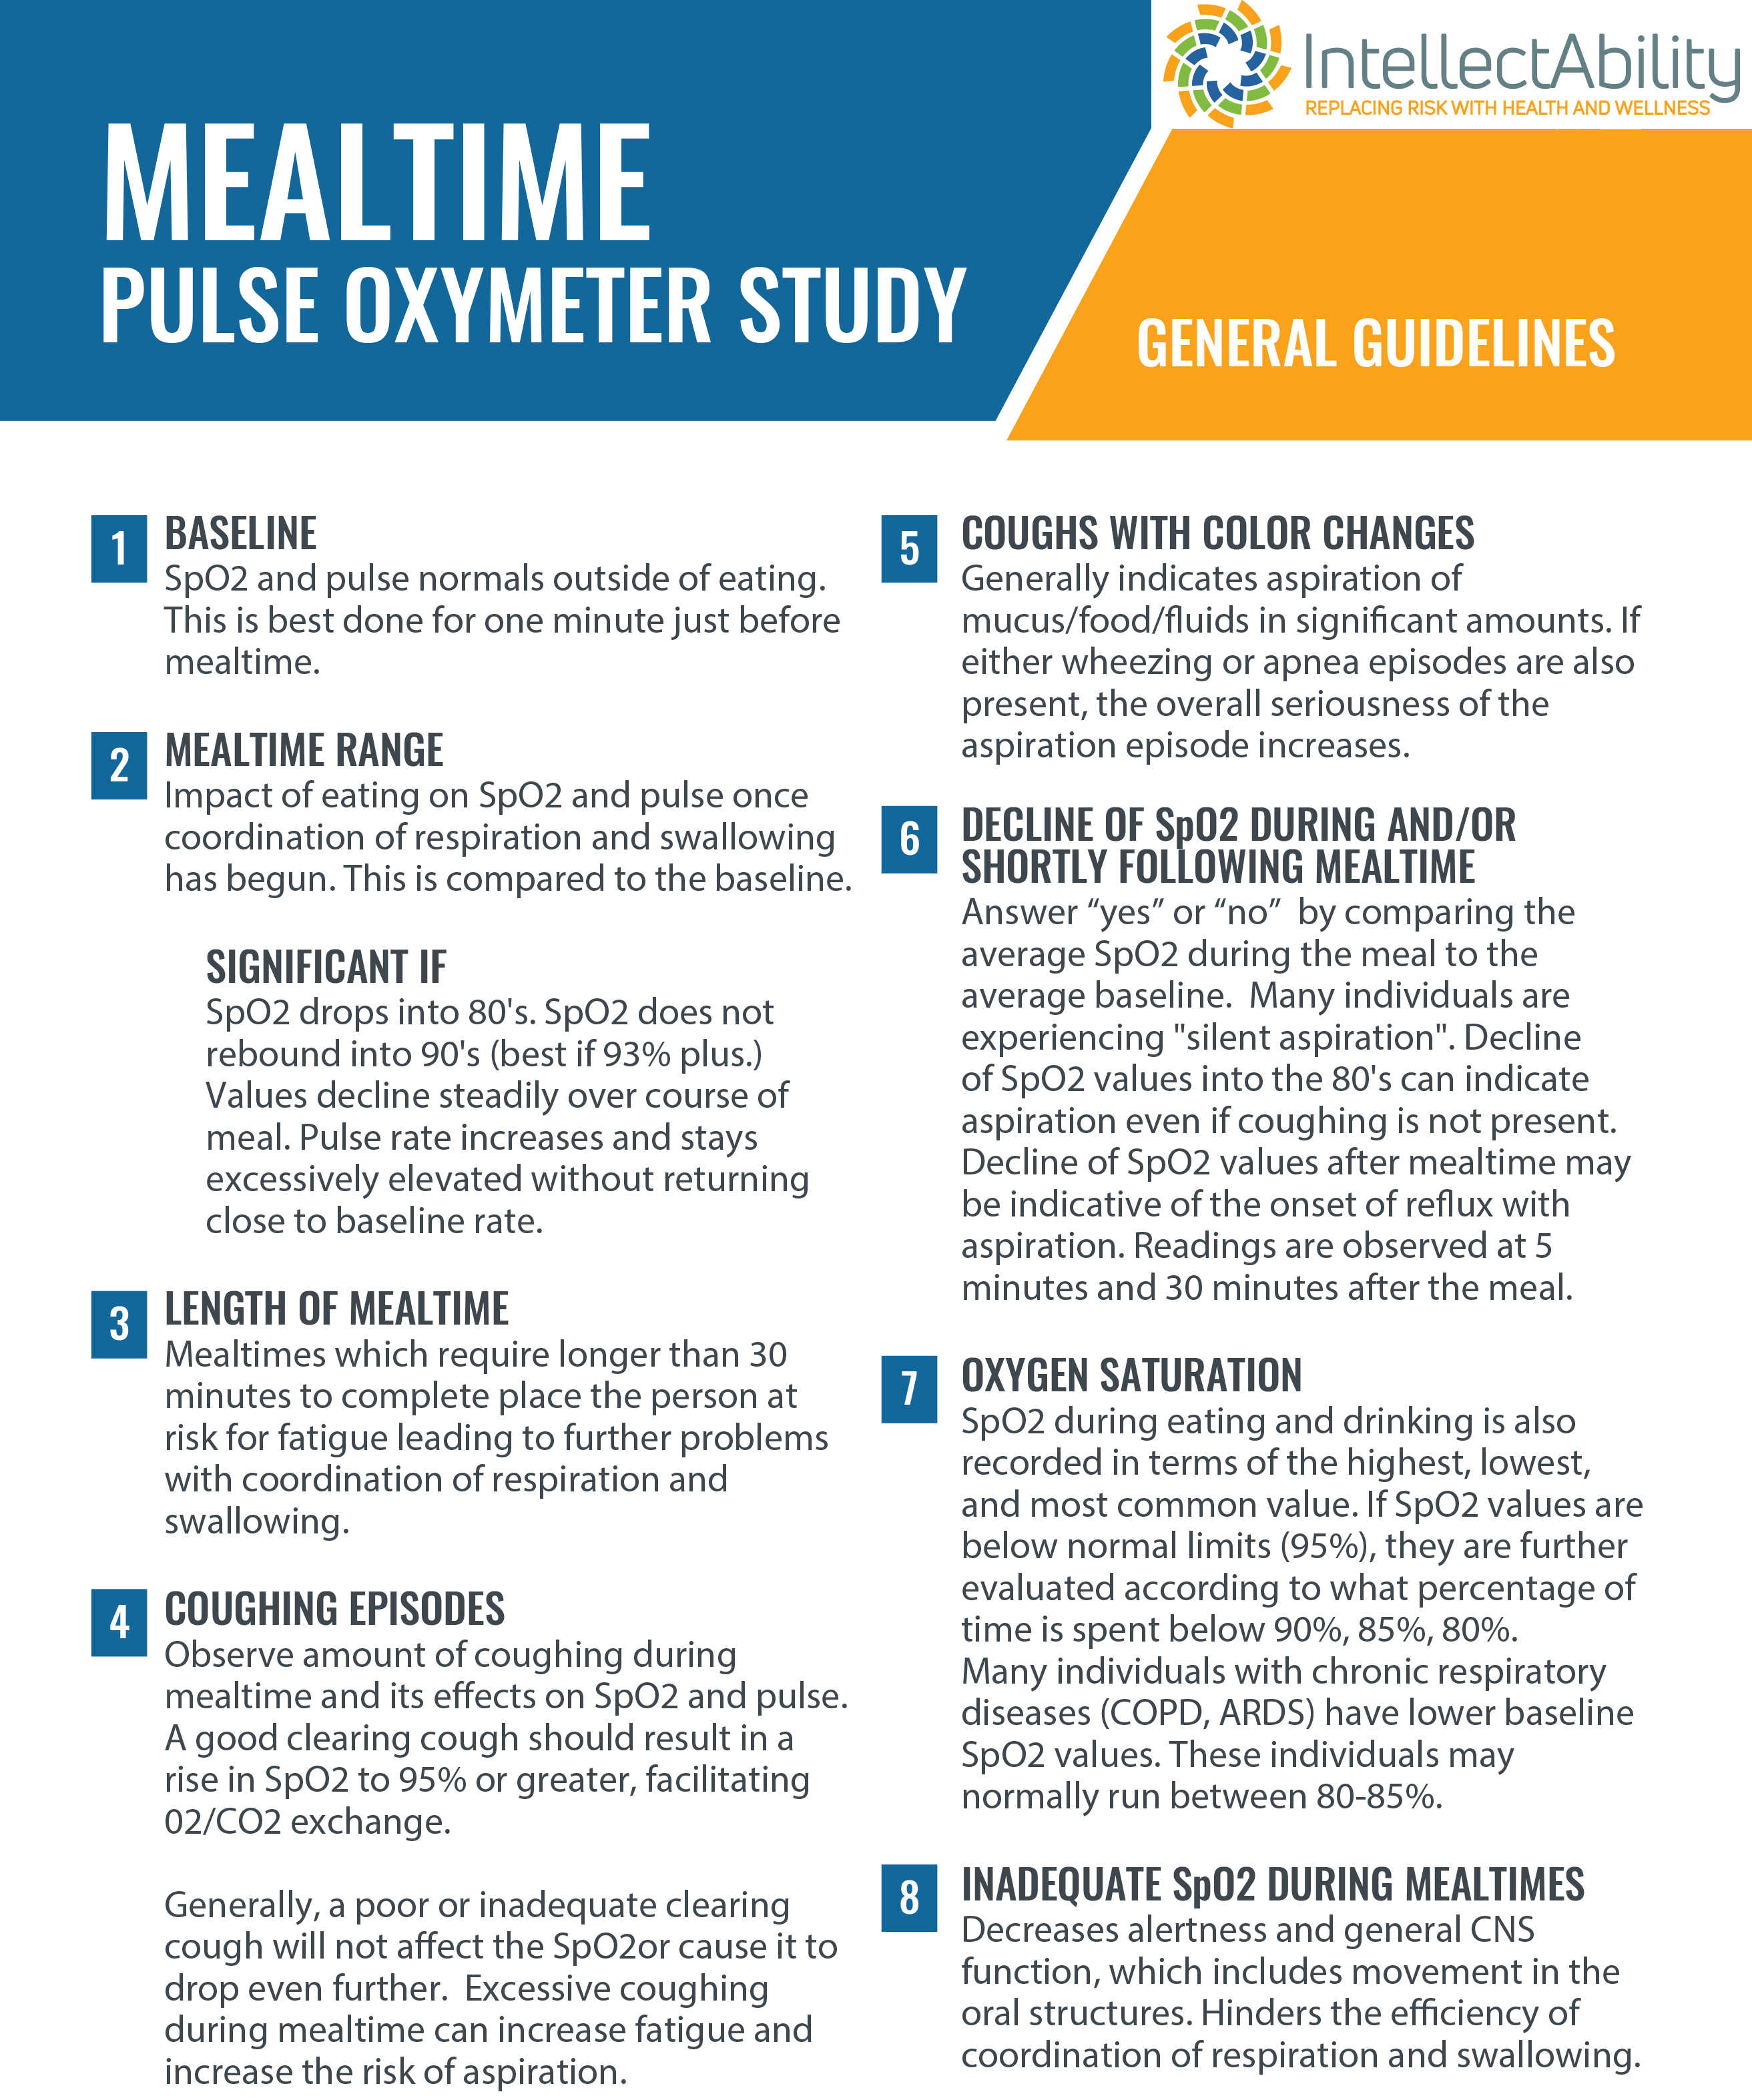
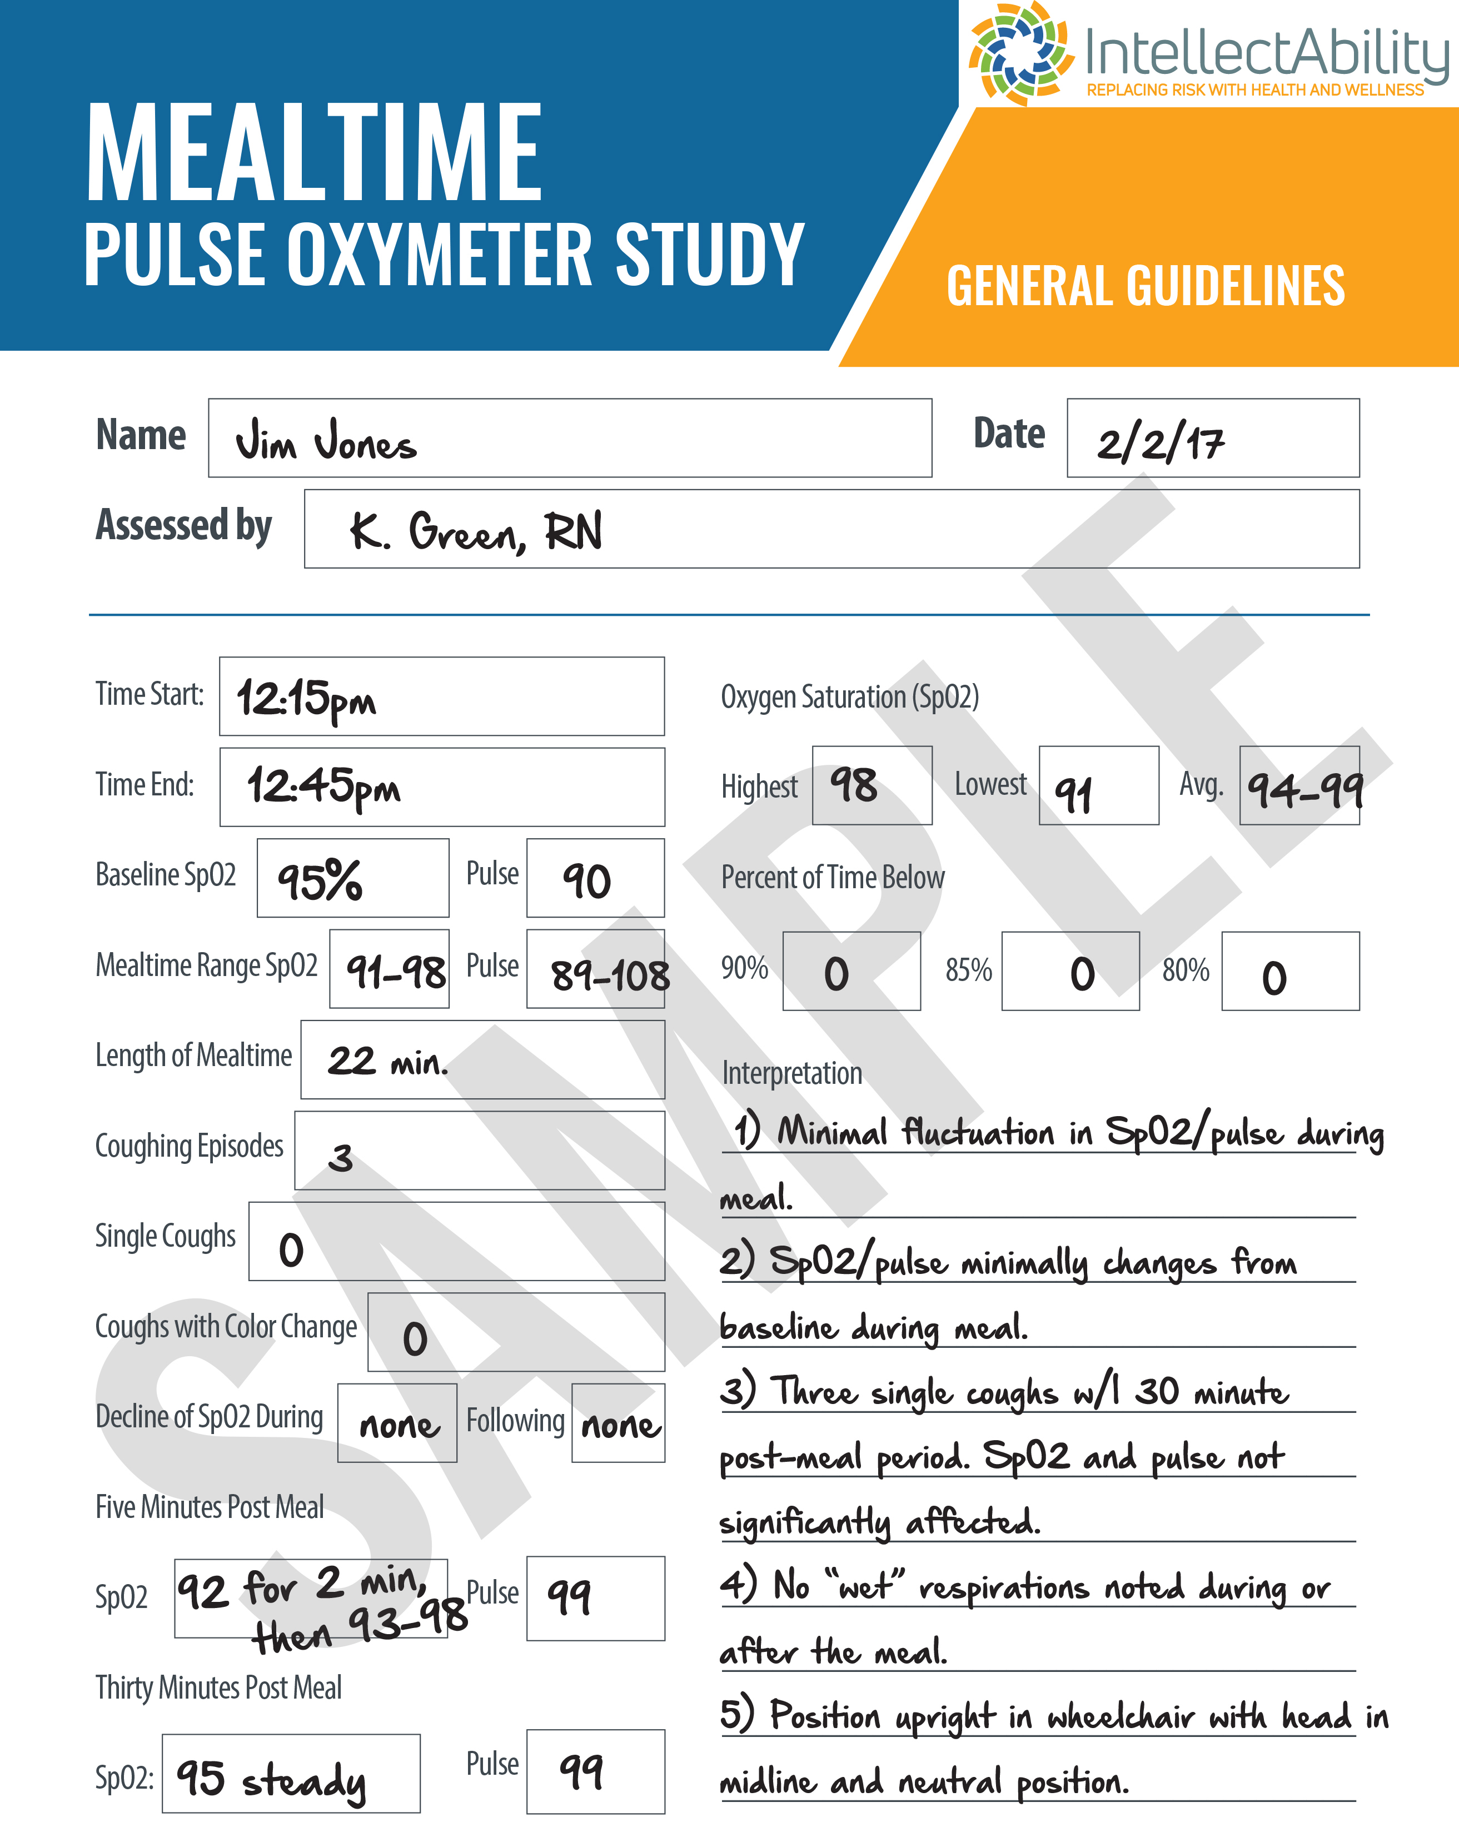

Slide 36
Fatal Five Plus
Aspiration
Bowel Obstruction
Seizures
Dehydration
Sepsis
+ GERD

Slide 37
Thank You!
Craig Escudé, MD, FAAFP, FAADM
Craig@ReplacingRisk.com

