Slide 1
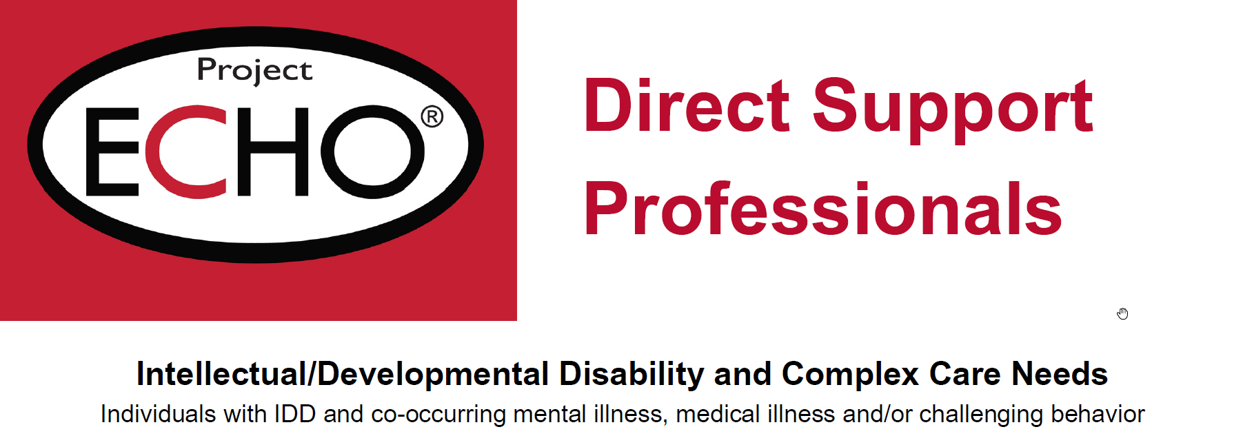

DBT presentation
Linda Schofield, CEO Lakes LifeSkills
Welcome to

Slide 2




DBT – DIALECTICAL BEHAVIORAL THERAPY
Dialectical – the existence of opposites. Two things, seemingly opposite, can exist at the same time
“I love you and I’m angry with you!”
“I understand how you feel and that was not ok.”
WE DON’T DO THERAPY! We learn core skills.

Slide 3
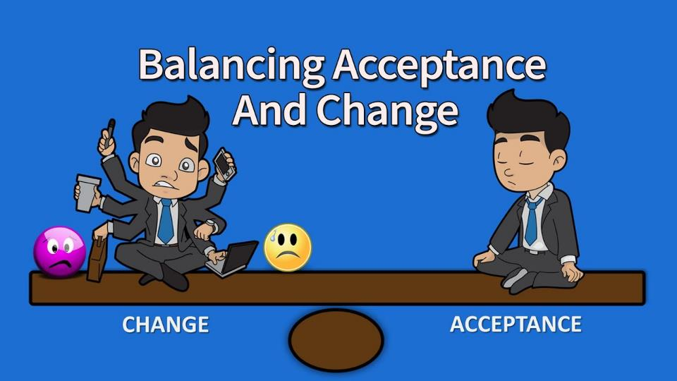

Slide 4
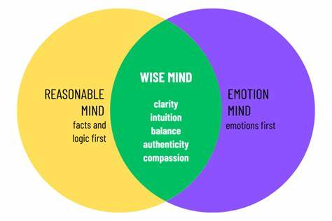

Slide 5
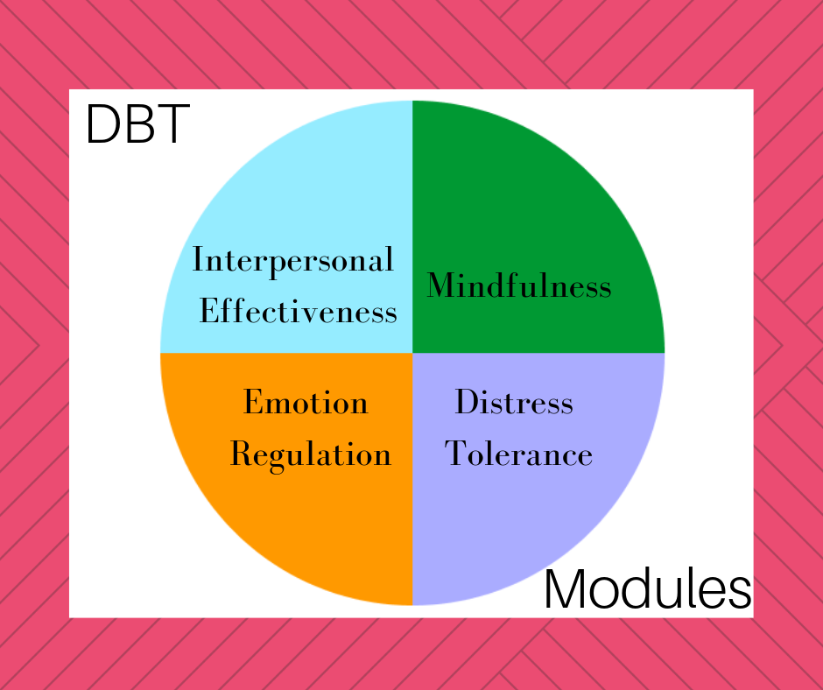

Slide 6
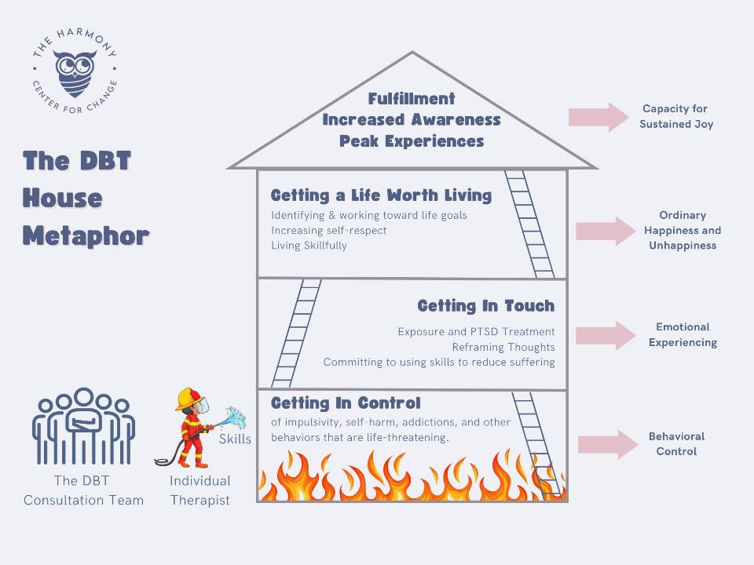
DBT

Slide 7
Here's how line staff can potentially benefit from DBT principles and skills:
Improved Relationships: DBT teaches interpersonal effectiveness skills that can help staff communicate more effectively with colleagues, supervisors, and clients. This can foster healthier work relationships and reduce conflict.
Enhanced Emotional Regulation: DBT equips individuals with strategies to manage intense emotions and reduce impulsivity, which can be valuable in dealing with work-related stress or difficult situations.
Increased Distress Tolerance: DBT focuses on building distress tolerance, which helps individuals cope with difficult situations without resorting to destructive behaviors. This can enable line staff to navigate challenging interactions or stressful work environments more effectively.
Improved Mindfulness: Mindfulness, a core component of DBT, can help staff become more aware of their thoughts and emotions, leading to greater self-control and better focus on the present moment.
Increased Resilience:
By learning to cope with stress and difficult emotions, staff become more resilient, better equipped to handle challenging situations and maintain a sense of well-being.

