Slide 1


Constipation in ID Population
Meghan Connett, MD- Iowa Health Care
Welcome to

Slide 2
Constipation can cause a wide range of symptoms, including:
Lethargy
Lack of interest in usual activities
Not wanting to eat
Sitting or lying with the knees brought up to the chest or curled in a ball
Abdominal guarding
Restlessness
Aggression without any apparent reason.
In addition to changes in behavior, I’ve noted other changes, including:
Low-grade fever
Vomiting
For a person with a seizure disorder, an increase in their seizure frequency.

Slide 3
Hematochezia or heme-positive stool = blood in the stool
Anemic or low blood counts on lab testing
Unexplained weight loss of ≥10 pounds
New onset of unexplained constipation
New obstructive symptoms (eg, bloating, distension, abdominal pain during stool passage)
Rectal pain
Family history of colon cancer or inflammatory bowel disease (Crohn’s and ulcerative colitis)

Slide 4
(Things to consider if a person is displaying new or concerning behaviors)
First, blame the drugs.
Does he/she have gastroesophageal reflux (GERD)?
Could the behavior be a seizure?
Is he/she aspirating?
What’s the etiology of the intellectual disability – does he/she have a syndrome?
Is his/her behavior different from usual?
How would we know if he/she is having pain?
How is he/she sleeping?
How’s the person eating? / Does the person have dental problems?
Is there a psychiatric disorder present?
New Behavioral Concern
Is the patient constipated?

Slide 5
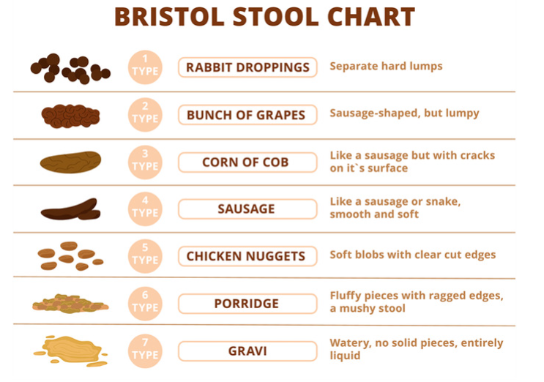
Constipation is a symptom-based disorder without standardized diagnostic criteria. Symptoms may include hard stools, excessive straining, infrequent bowel movements (<3 per week), a sense of incomplete evacuation, or the use of manual maneuvers to facilitate defecation. "Chronic" refers to symptoms lasting at least three months.

Slide 6
Meds
Bed
Fed
Assessing Causes of Constipation
What medications can cause constipation? What medications are they using for constipation?
What is diet like? Enough fiber? Rigidity around food choices?
How is mobility? Use of assistive mobility devices? How much exercise?

Slide 7
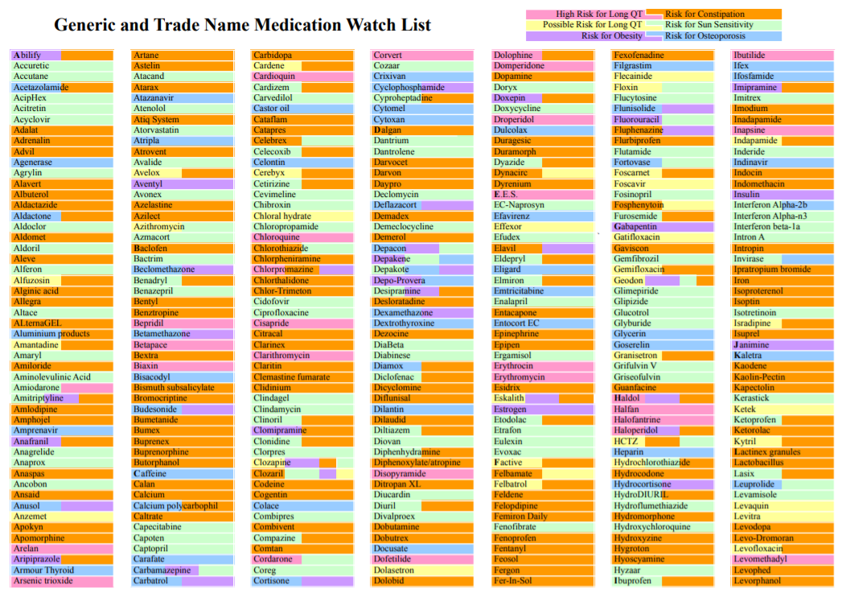
Meds

Slide 8

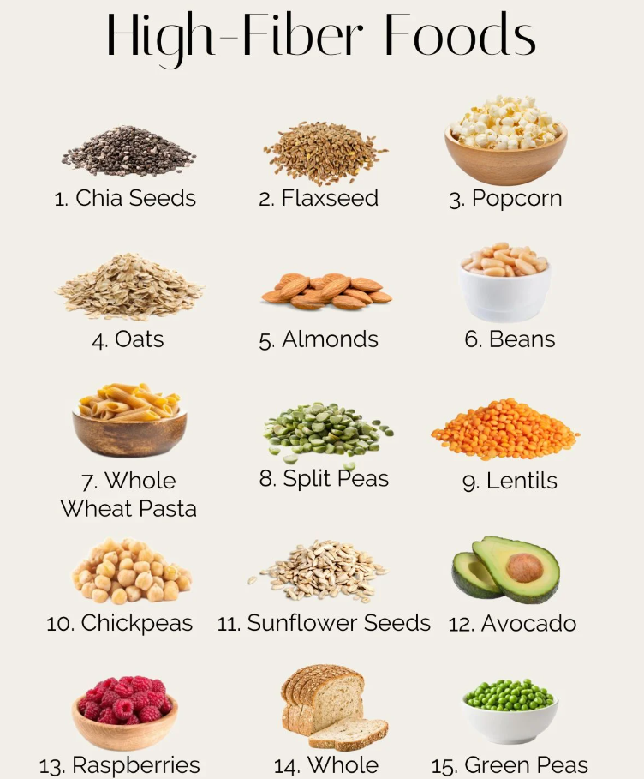

Fed
The recommended daily intake of fiber is 25 grams for women and 38 grams for men. For women over 50, the recommendation drops to 21 grams, and for men over 50, it's 30 grams.

Slide 9
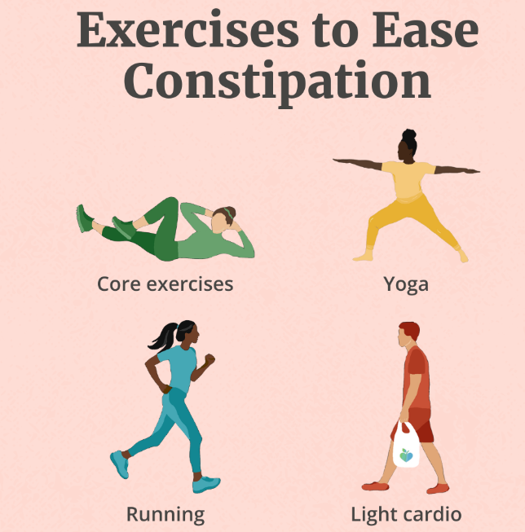
Bed

Slide 10
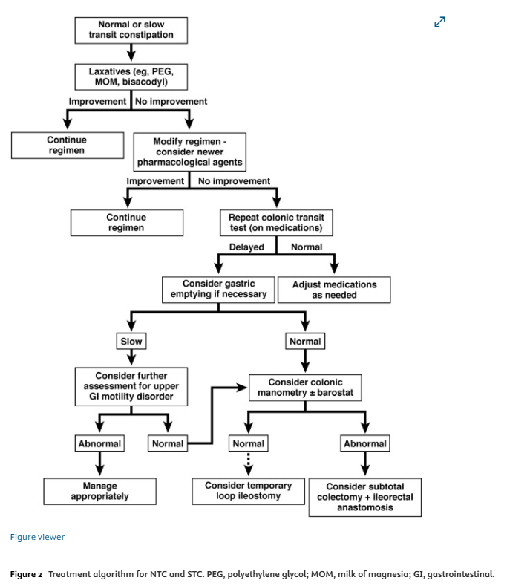



Slide 11
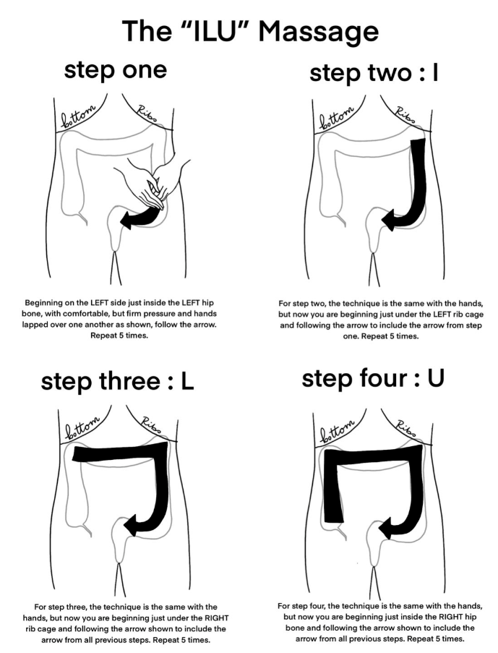

Slide 12
