Slide 1


Behaviors and Manifestations of Underlying Medical Conditions
Craig Escude, MD, FAAFP, FAADM
1

Slide 2

Connecting the Dots Between Adverse Behaviors and Treatable Underlying Health Conditions in
People with Intellectual and
PLACE IMAGE
HERE
Developmental Disabilities:
Presented by:
Craig Escudé, MD FAAFP, FAADM
All photos 2025 Rick Guidotti, Positive Exposure. All rights reserved.

Slide 3

PROGRAM DISCLOSURES
Neither the speaker nor the planning committee have had a financial relationship with any ineligible companies within the past 24 months. The speaker will not be discussing a product that is still investigational or not labeled for the use under discussion.

Slide 4

Craig Escudé, MD, FAAFP, FAADM
Board-Certified Fellow of the American Academy of Family Physicians and the American Academy of Developmental Medicine
Over 20 years of experience caring for people with mental illness and intellectual and developmental disabilities
Medical Director of Hudspeth Regional Center in Whitfield, MS – Retired 2018
Founder of DETECT
President of IntellectAbility
Author of Clinical Pearls in IDD Healthcare and the
Curriculum in IDD Healthcare

Slide 5
“Behaviors”
Often a reason for seeking psychiatric consultation
A common reason for psychotropic medication prescriptions
2/3 of people with IDD are on a psychotropic medication
1/3 have a psychiatric diagnosis
Deb S, Unwin G, Deb T. Characteristics and the trajectory of psychotropic medication use in general and antipsychotics in particular among adults with an intellectual disability who exhibit aggressive behaviour. J Intellect Disabil Res. 2015 Jan;59(1):11-25. doi: 10.1111/jir.12119. Epub 2014 Jan 22. PMID: 24450426.

Slide 6
Reasons for “Behaviors”
Underlying medical condition
Mental health condition
Environmental and social conditions
Abuse
Communication challenges
Normal expression of emotions
Not “that’s just what people with IDD do”

Slide 7

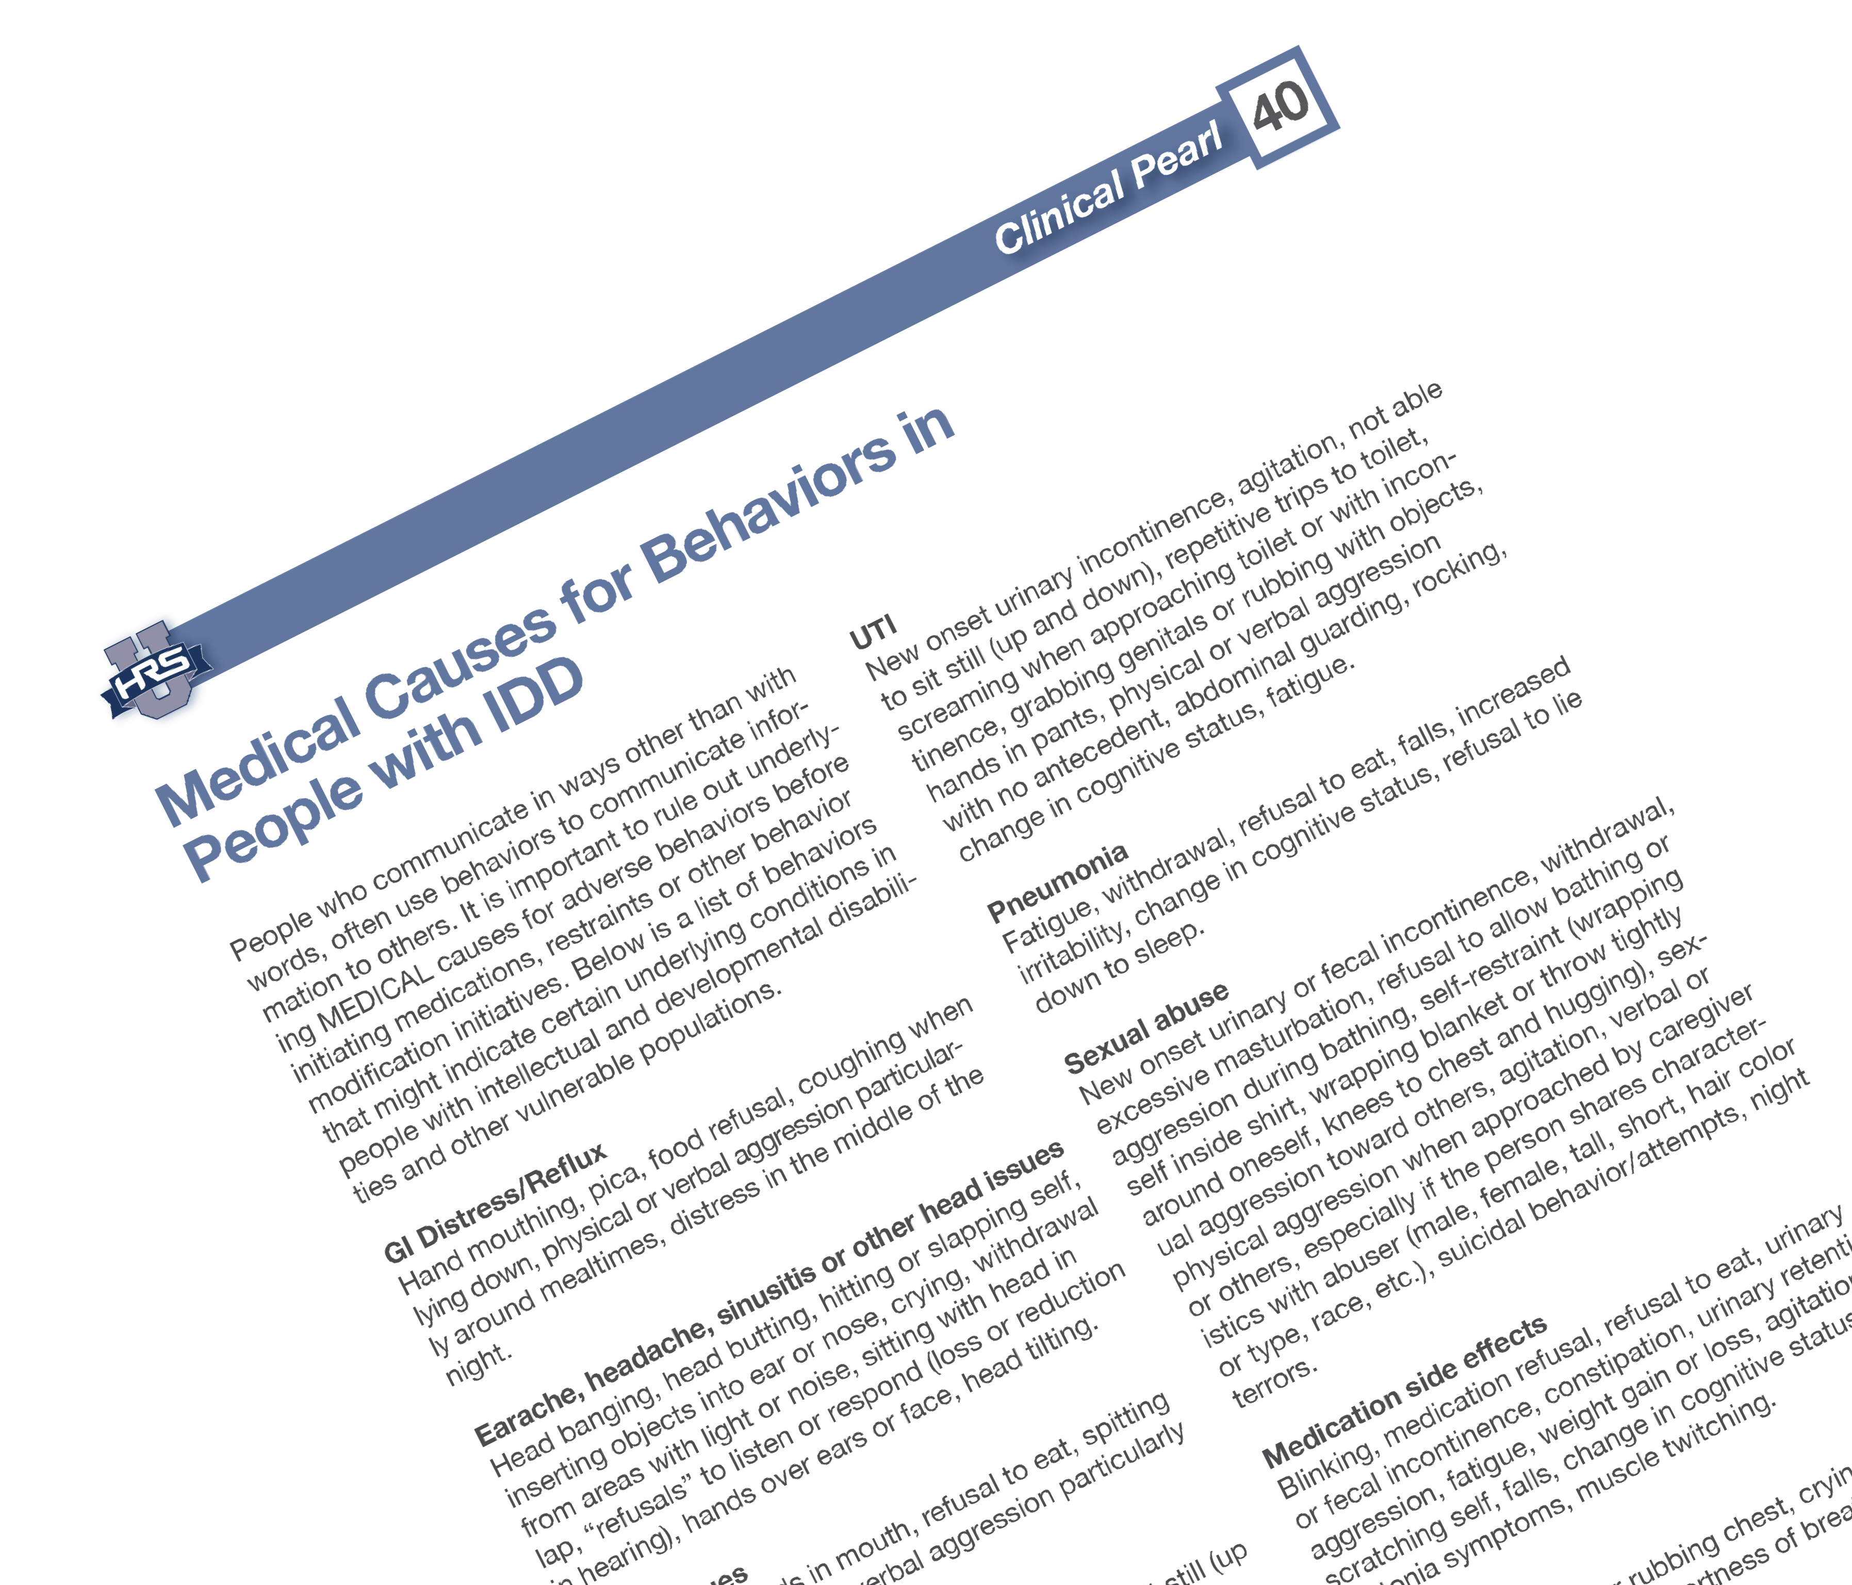
40. Medical Causes of Behaviors in People with IDD

Slide 8
Melissa
26-year-old female
Ambulatory
Independent with eating, dressing, grooming
Feeds herself a regular diet
Urinary incontinence
BM every 1-2 days on the toilet
Non-verbal with limited sign language and gesturing
Oriented to person, place and time
Pleasant and mostly cooperative

Slide 9
Melissa
Diagnoses:
  Moderate IDD
  Anxiety

Slide 10
Melissa
New onset of fecal incontinence Differential
Fecal incontinence with smearing
  1-2 times a month
Behavior analyst monitored
  Attention seeking behavior

Slide 11
Melissa
Frequency of fecal incontinence increased
Verbal and physical aggression noted
  Making loud noises at staff
  Threatening
  Shaking fist
  Invading other’s space
  Sexually acting out
Consultation

Slide 12
Melissa
Psychiatric evaluation
  Seroquel started
Anger and aggressiveness improved
Fecal incontinence continued Other Information

Slide 13
Melissa
Behavior noted to be worse preceding weekends she went home with her grandmother and for a couple of days after return
Grandmother related she noted no similar behavior at home

Slide 14
Melissa
Behaviors continued with addition of curling herself up in a recliner before grandmother picked her up to go home

Slide 15
Melissa
Psychiatric follow up
  Seroquel dose increased
Further discussion with GM revealed that when Melissa’s father visited at her grandmother’s house, anger and physical aggression toward her grandmother occurred after his visits.
Episodes were short-lived and GM did not think much about them

Slide 16
Melissa
Further investigation revealed …
Sexual abuse by her father
When father was no longer allowed to visit, all symptoms resolved
Seroquel was discontinued

Slide 17
Melissa – Take Home Points
Behavior is communication
A change in behavior often indicates an underlying issue
Knowing the baseline of a person is important
Use caution when treating behaviors with anti- psychotics
When behaviors do not resolve as expected or worsen, get more information

Slide 18
Behaviors Associated with Sexual Abuse
New onset urinary or fecal
Agitation
Verbal or physical aggression when approached by caregiver or others - especially if the person shares characteristics with abuser (male, female, tall, short hair, Caucasian, African American)
Suicidal behavior/attempts
Night terrors
incontinence
Withdrawal
Excessive masturbation
Refusal to allow bathing or aggression during bathing
Self restraint (wrapping self inside shirt, wrapping blanket or throw tightly around themselves, knees to chest and hugging)
Sexual aggression toward others

Slide 19
Sexual Abuse Statistics
A recent review of statistics by NPR and the US Department of Justice shows that people with IDD are sexually assaulted at a rate seven times higher than those of people without a disability.

Slide 20
Mary
25-year-old female began showing resistance to going to the cafeteria
Made a gagging sound when food presented to her
Episodic crying mostly at night

Slide 21
Mary - Exam
No acute findings

Slide 22
Behaviors Associated with GI Distress/Reflux
Hand mouthing
Pica
Food refusal
Coughing when lying down
Physical or verbal aggression particularly around mealtimes

Slide 23
J.C.
53-year-old male
Ambulatory
Independent with eating, dressing, grooming and toileting
Verbal
Loves magazines of any kind
No aggressive tendencies

Slide 24
J.C.
Diagnoses
  Moderate IDD
  Chronic allergic rhinitis
  Chronic sinusitis
  Psychotic disorder
  Anxiety disorder
  GERD

Slide 25
J.C.
New onset of physical aggression with staff
Stealing magazines from everywhere he went
Attacked staff if they tried to stop him
Put his head down in magazines but didn’t turn the pages

Slide 26
J.C.
In a period of increased purulent nasal discharge
Physician called and antibiotics and steroid dose pack were started

Slide 27
J.C.
Behavior
  Aggression continued but magazine stealing stopped
  More obsessed with horses than ever
  Aggression increased with noted property damage, hitting walls and head banging
Consultation

Slide 28
J.C.
Psychiatrist
  Haldol started
    Behavior changes
    Shaking
    Drooling
    Lethargy
    Confusion

Slide 29
J.C.
Local ER evaluation
Sent to tertiary care center
  Meningitis
  Sepsis
  Pneumonia
  Bilateral sinusitis with complete opacity of maxillary sinuses
Not able to breathe or eat well and had silent aspiration

Slide 30
J.C.

Slide 31
J.C. – Take Home Points
New behaviors should be taken as a form of communication
Just because someone has always had a particular condition does not mean that it could not lead to other complications
Use caution when treating behaviors with medications
Some side effects of medications can also be signs of a serious medical illness

Slide 32
Behaviors Associated with Head Pain
Head banging
Head butting
Hitting or slapping self
Inserting objects into ears or nose
Crying
Withdrawal from areas with light or noise
Sitting with head in lap
“Refusals” to listen or respond (loss or reduction in hearing)
Hands over ears or face
Tilting head to one side

Slide 33
Behaviors Associated with Medication Side Effects
Constipation
Refusal to eat
Aggression
Fatigue
Falls
change in cognitive status
Agitation
Medication refusal
Weight gain or loss
Scratching self
Tics, dystonic symptoms
Muscle twitching
Blinking
Urinary retention
Urinary or fecal incontinence

Slide 34
Patricia
49-year-old female
  Ambulatory with a normal gait
  Requires assistance with dressing
  Feeds herself, but “picky” eater
  Continent, normal B and B habits
  Non-verbal
  Aggressive at times
  SIB-bites right arm frequently

Slide 35
Patricia
Medical
  Profound IDD
Current Problem
  Swelling of the right side of her mouth
Consultation

Slide 36
Patricia
Dental exam
Dental abscess
Overall - chronically poor dentition
Decision made to have a full mouth extraction

Slide 37
Patricia
After extraction done
  NO MORE SIB
  NO MORE AGGRESSION
  EATING WELL
  SMILING AND GENERALLY HAPPY

Slide 38
Behaviors Associated with Dental Issues
Hitting self
Hands in mouth
Refusal to eat
Spitting out food
Physical or verbal aggression particularly around mealtimes

Slide 39
Chris
28 y/o profound IDD with spastic quadriplegia
Slow progression of lethargy, decreased level of alertness
Not eating
Becoming agitated and aggressive at times
Vomiting

Slide 40
Behaviors Associated with Constipation
Guarding abdomen
Rocking
Not able to sit still (up and down)
Hitting self in abdomen
Fetal position when lying
Knees drawn up to chest when sitting
Physical or verbal aggression without definite antecedent
Refusal to eat

Slide 41
William
19-year-old male with Profound IDD, loves attention and interaction with others
Dramatically falling to the ground
Spells of not listening
Episodes of talking very loudly for a several seconds
Falling asleep very suddenly

Slide 42
William
Thought to be exhibiting attention seeking behavior
Another staff saw it and felt a medical evaluation was indicated
Diagnosed with a seizure disorder

Slide 43
William – Take Home Points
Focal seizures can be difficult to diagnosis
Harder to diagnose if the person has limited ability to communicate “aura” symptoms
Important to notice, document and communicate subtle symptoms to help have an accurate diagnosis

Slide 44
Behaviors associated with Seizures
Disrobing
Increased agitation
Failure to “pay attention” in children or “daydreaming”
Sexually acting out
Physical or verbal aggression with no trigger
Repetitive or ritualistic type behaviors that are short lived
Rapid eye blinking
Tantrums
Falls
Sudden “sleep”
Random talking
Hard to “reach”

Slide 45
Sheila
28 y/o female
Becoming fidgety and could not seem to sit still even during her favorite TV show
Putting her hands in her pants
Become upset when assisted to the bathroom and would bite her arm

Slide 46
Sheila
Urinalysis
  TNTC WBC
  Culture positive for E.coli

Slide 47
Behaviors Associated with Urinary Tract Infections
New onset urinary incontinence
Agitation
Not able to sit still (up and down)
Repetitive trips to toilet
Screaming when approaching toilet or with incontinence
Grabbing genitals or rubbing with objects
Hands in pants
Physical or verbal aggression with no trigger
Abdominal guarding
Rocking
Change in cognitive status
Fatigue

Slide 48
Terry
69 y/o male usually pleasant, calm, cooperative, not verbal but understands many gestures, continent of bowel and bladder, feeds himself
Has episodes of pacing the floor
Nervous appearing
Anxious
Starts scratching at his neck and chest
Starts yelling out with loud vocalizations
Staff felt he was having panic attacks

Slide 49
Terry
Appeared to have trouble catching his breath
Appeared pale
Seemed weak

Slide 50
Terry
Taken to the ER
Diagnosed with a myocardial infarction

Slide 51
Behaviors Associated with Chest Pain
Scratching, hitting or rubbing chest
Crying
Yelling out
Agitation
Anxiety
Shortness of breath
Weakness

Slide 52
John
28-year-old male
Non-verbal
Ambulatory
Requires help with all ADLs
Eats independently

Slide 53
John
Profound IDD
Otherwise, healthy

Slide 54
John
Was noted by the staff to have a limp one morning
No report of injury or fall
First noted when the staff got him up out of bed Differential

Slide 55
John
Foot – No redness swelling or tenderness, no pain with ROM
Knee -normal
Hip – normal
What else?

Slide 56
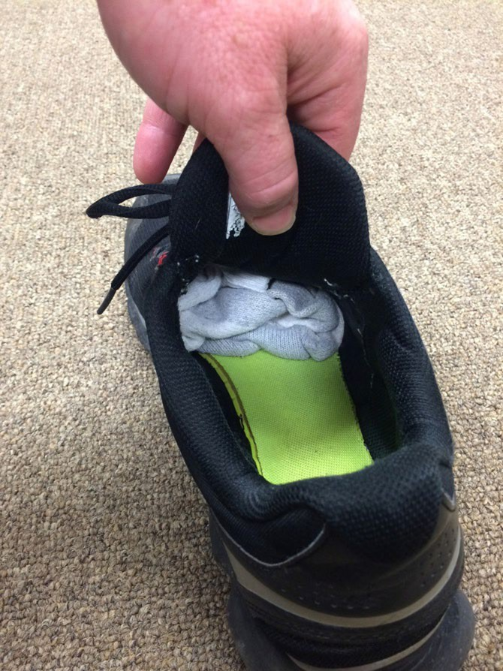
John’s Shoe
Photo credit: Craig Escudé

Slide 57
John – Take Home Points
Think Simple First!

Slide 58
Medical Causes of Behavior
GI distress
Head Pain
Dental
Constipation
Seizures
UTI
Pneumonia
Sexual Abuse
Medication Side Effects
Chest Pain

Slide 59

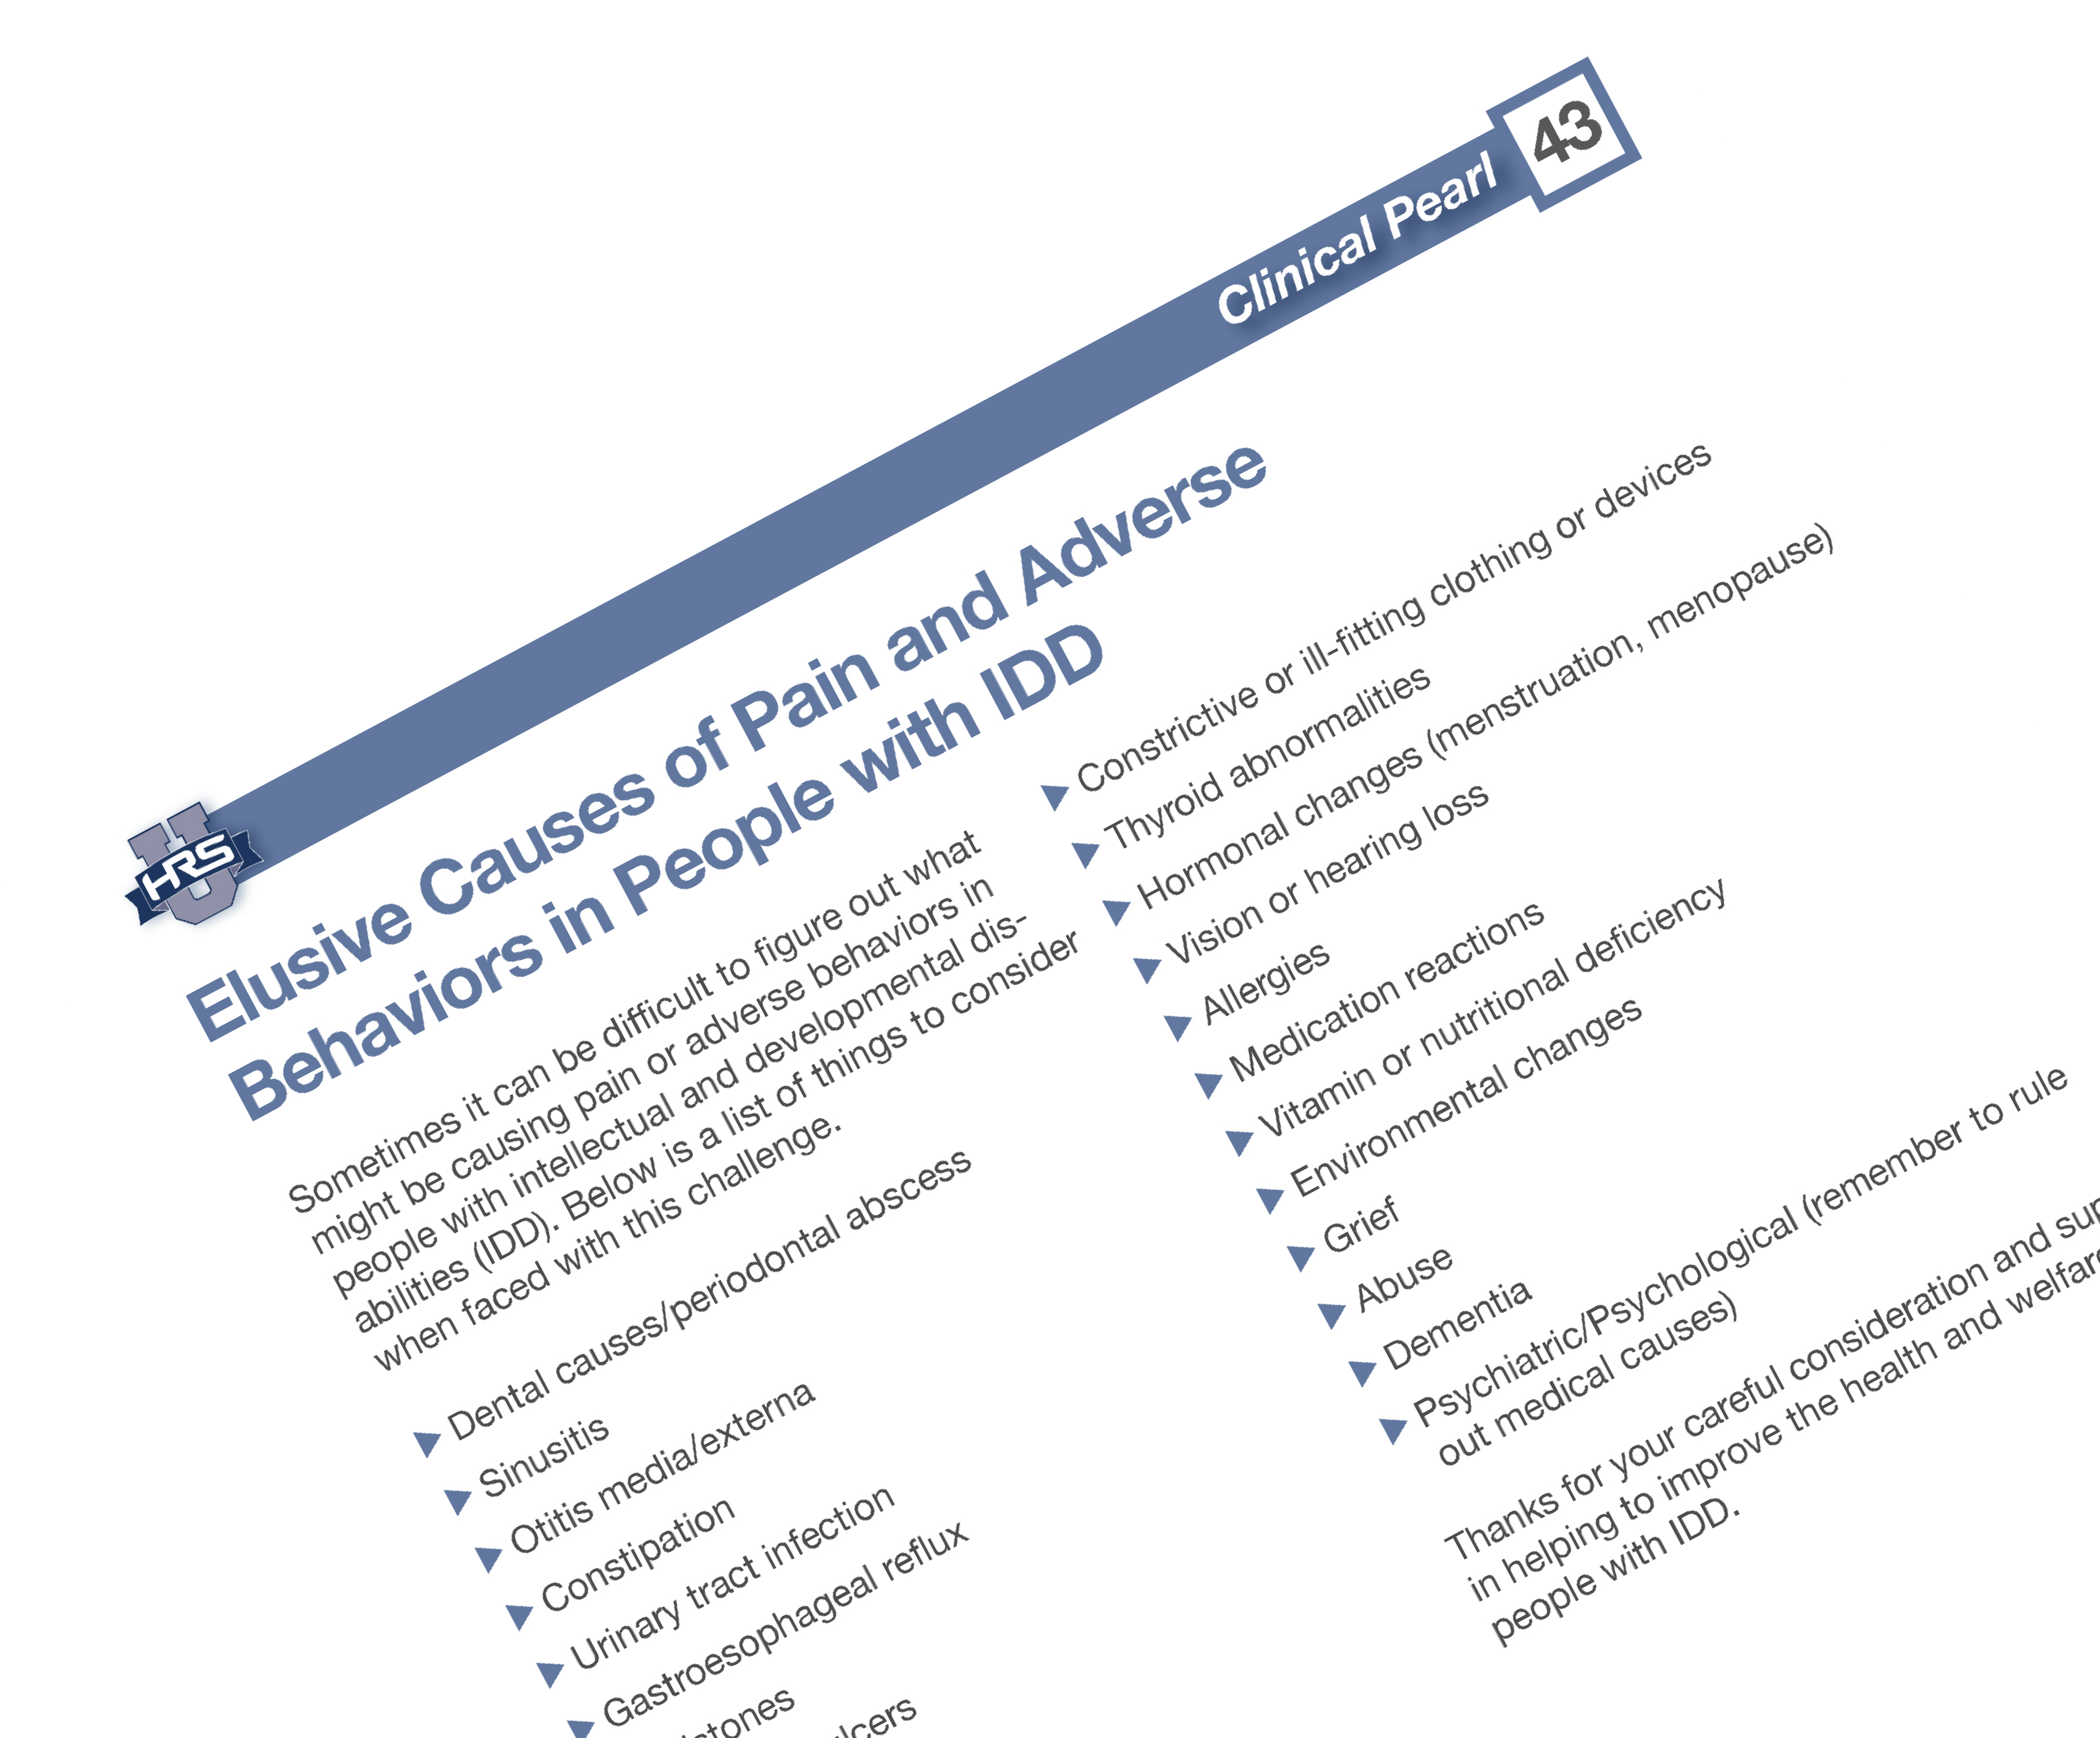
43. Elusive causes of Pain and Adverse Behaviors in People with IDD

Slide 60
Elusive Causes of Pain include:
Dental
Sinusitis
Gallstones
Occult Fracture
Constrictive clothing
Grief
Abuse
And more…

Slide 61
Thank you!
Craig Escude, MD, FAAFP, FAADM Craig@ReplacingRisk.com
ReplacingRisk.com

