Slide 1


Dementia in People with IDD
Craig Escude, MD, FAAFP, FAADM
1

Slide 2

PROGRAM
DISCLOSURES
Neither the speaker nor the planning committee have had a financial relationship with any ineligible companies within the past 24 months. The speaker will not be discussing a product that is still investigational or not labeled for the use under discussion.

Slide 3
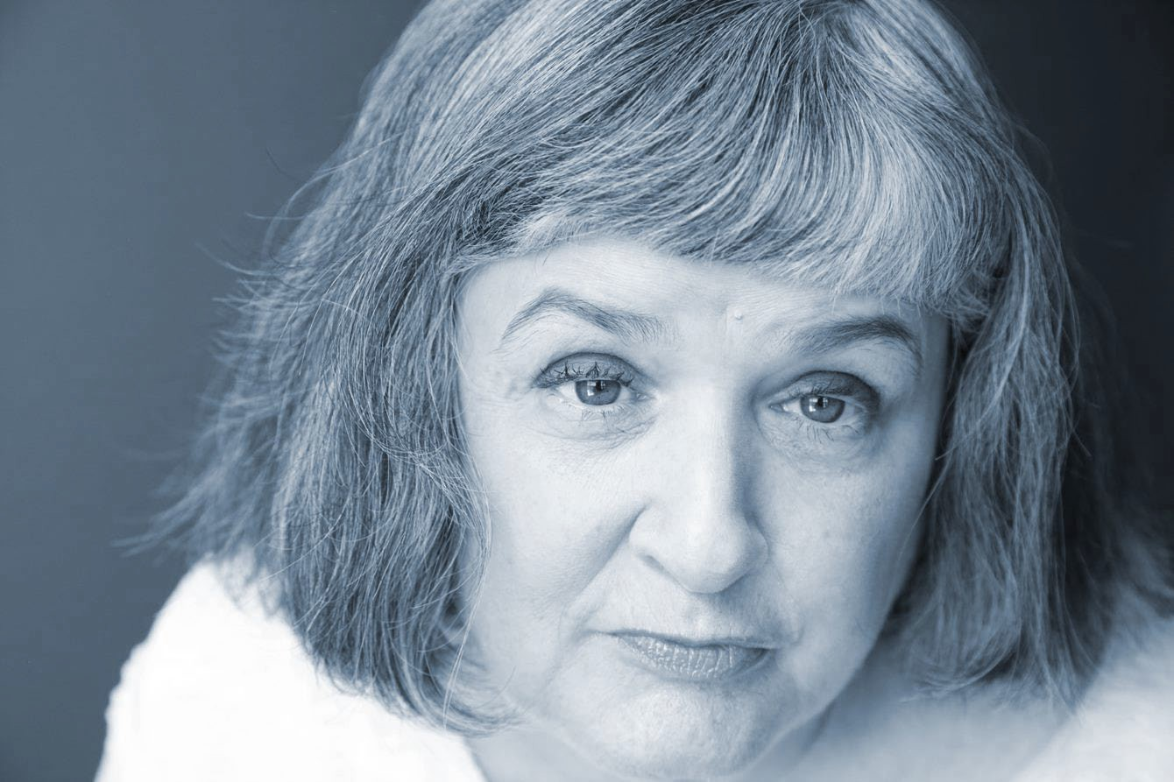
Dementia in People with IDD
PLACE IMAGE HERE
Presented by Craig Escudé, MD, FAAFP, FAADM
Photo credit: Positive Exposure

Slide 4
“Normal” Losses with Aging
“Normal Aging” – different losses.
Free recall- declines
Cued recall – about the same.
Multi-Tasking - may decrease when attention is divided
not remembering where the keys are when unloading groceries
More easily distracted when thinking about something else.

Slide 5
Dementia- Generic Term
Pathologic neurological conditions that result in diminished cognitive capabilities:
MCI- Mild Cognitive Impairment
Korsakoff’s Syndrome
Lewy Body
Parkinson’s
Vascular Dementia- Stroke
MI-Multi-Infarct
DAT- Dementia of the Alzheimer’s Type

Slide 6
MCI- Mild Cognitive Impairment
Some memory difficulties – may be seen in:
Word finding, free recall of items,
Multi-tasking, more easily distracted
May not be notable or significant in early loss of functioning
May show a greater rate of decline over two years

Slide 7
Higher Risks in People with IDD for Cognitive Impairment
Lower Cognitive Resources
Earlier and heavier losses
Complex Problems
Underlying Paranoia, Bipolar, Depression
Medical complications- strokes, etc.

Slide 8
Multi-Infarct Dementia
Mini-strokes -many tiny strokes (loss of blood resulting in damage to areas of the brain.)
Not noticeable at first
Cumulative damage
Variable rates of decline
Multiple types of symptoms- memory loss, functional loss, etc.
Check risks in health history
May co-exist with other dementias

Slide 9
Stroke - Other Neurological Insults
Stroke- quick loss, (stepwise) but not progressive loss as in DAT.
Loss of blood supply to areas of brain
Rapid recognition of symptoms and treatment needed- restore blood supply

Slide 10
Korsakoff Syndrome
Alcohol related
B-1 vitamin loss (thiamine)
may be somewhat reversed
Usually not progressive when arrested

Slide 11
Lewy Body Dementia
Dementia plus one of the core clinical symptoms
fluctuating cognition
Hallucinations
REM sleep behavior disorder
parkinsonism

Slide 12
Lewy Body Dementia
Delirium-like fluctuating cognition: unpredictable changes in thinking, attention and alertness
Repeated visual hallucinations
REM sleep behavior disorder (which may appear long before the dementia)
Parkinsonism, specifically slowed movements, tremor when limbs are at rest, and muscle rigidity

Slide 13
Alzheimer’s Disease (DAT)
DAT- Dementia of the Alzheimer’s Type
Positively diagnosed posthumously
Gold Standard of research- early DX
Could lead to treatment or prevention
May coexist with other dementias such as Multi-Infarct Dementia.
MCI- Mild Cognitive Impairment may be linked as a precursor to early-stage of DAT

Slide 14
Alzheimer’s Disease (DAT)
DAT- Dementia of the Alzheimer’s Type
About 90% of Dementia cases
Age- Risk of onset- “Doubles every ten years”
65 - 1 in 10
85 = 1 in 2
Causes uncertain
Genetics
Risk factors
Inflammation
Trisomy 21- Down- very high risk – early onset.
Other environmental risk factors not certain

Slide 15
Alzheimer’s Disease (DAT)
Progressive loss of cognitive capacity
Notice losses in memory first
Also changes in how a person reacts to the environment
“Personality” changes
More agitation, confusion, and disorientation as the disease progresses
Less recognition of family

Slide 16
Early Onset Alzheimer’s Dementia
Early-onset Alzheimer’s is a rare form of the disease.
Age 30 to 60
Less than 5 percent of all people who have Alzheimer’s disease.
Persons with Down Syndrome show symptoms of DAT and aging 20 years sooner

Slide 17
Down Syndrome
Persons with Down Syndrome are at higher risk for early onset of DAT
May have different symptoms
new onset of seizures
Incontinence
Higher degree of memory loss
disruption of sleep-wake cycle
Over age 40 – approx. 25% will show clinical signs of dementia
Over age 60 – approx. 60%

Slide 18
What is NOT Dementia
“Reversible Conditions” / pseudo-dementia
Any temporary reduction in cognitive capabilities including judgment, decision-making, and memory
May appear as dementia- loss of memory, disorientation, poor judgment
May result from conditions that disrupt the memory/ storage process including medical (hyponatremia; constipation, UTI (more frequent in the aging population)
Trauma, stress, depression, significant changes in life situation, SMI

Slide 19
Things that Look Like Dementia
(but may be reversible)
Must rule out treatable problems to include:
Depression
Anxiety
Medical problems can include:
Thyroid
Nutrition
Electrolytes
Psychotic symptoms can include:
Agitation
Alcohol
Drug effects-Korsakoff’s

Slide 20
Reversable cause of MCI/Dementia
Drugs
Emotional (Depression)
Metabolic (hypothyroidism, B12)
Ears and Eyes (sensory isolation)
Normal Pressure Hydrocephalus (ataxia, incontinence, dementia)
Tumor or other space-occupying lesions
Infection (syphilis, chronic infection)
Atrial Fib/Alcoholism
Sleep Apnea

Slide 21
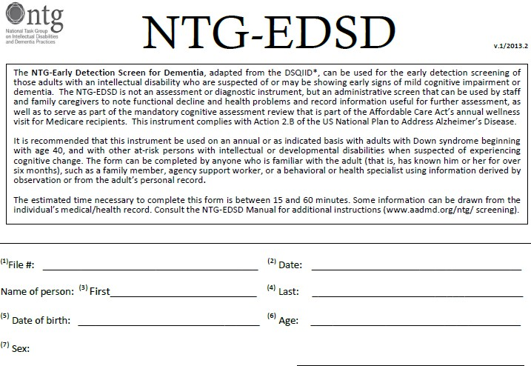
National Task Group

Slide 22
NTG Early Detection Screen for Dementia
Adapted from:
Dementia Screening Questionnaire for Individuals with Intellectual Disabilities (Deb et al., 2007), and
Dementia Screening Tool (adapted by Philadelphia Coordinated Health Care Group from the DSQIID, 2010)
Down Syndrome - begin at age 40 then annually
Non-DS begin at age 50
https://www.the-ntg.org/

Slide 23
NTG workshops
Workshop: Capacity Building
Workshop: Dementia Capable Care (with train-the-trainer component)
Webinars: NTG Special Topics in ID and Dementia
CEU's and Educational credits
Education and Training Curriculum on Dementia and Intellectual and Developmental Disabilities

Slide 24
Dementia Diagnosis Goals
Identify causes of decline in function
Medical
Psychiatric
Sensory decline
Rule out treatable conditions
Even if not definitive- treat what you can
Dementia- may explain problem changes
EG- telling “lies”- agitation- cognitive decline
Depression- may be the cause-also the result
Anticipate care needs- for family and facility
Avoid solutions that may generate more problems-
Psychotropic meds; wrong meds, etc.

Slide 25
Dementia Diagnosis Goals
Measure a Baseline (by 40 or earlier)
Monitor changes-6 months?
Gradual decline or not

Slide 26
Medications for Alzheimer’s
Cholinesterase inhibitors are commonly prescribed:
Donepezil (Aricept) is approved to treat all stages of Alzheimer's.
Rivastigmine (Exelon) is approved to treat mild to moderate Alzheimer's.
Galantamine (Razadyne) is approved to treat mild to moderate Alzheimer’s.
Glutamate regulators
Memantine (Namenda®)
Anti-amyloid IV infusion
Donanemab (Kisunla)
Lecanemab (Leqembi) anti-amyloid IV infusion
Psychiatric meds used “Off-Label”
Target aggression, depression, delusions, hallucinations, apathy, disinhibition
https://www.alz.org/alzheimers-dementia/treatments/medications-for- memory

Slide 27
General Management at All Stages
Maximize Independence
Focus on what he/she can do
Variety of activities
Support dignity and self-esteem.
Protect from Injury
How to reconcile conflicting goals? (security vs independence)

