Slide 1


WELCOME!
Welcome to

Slide 2
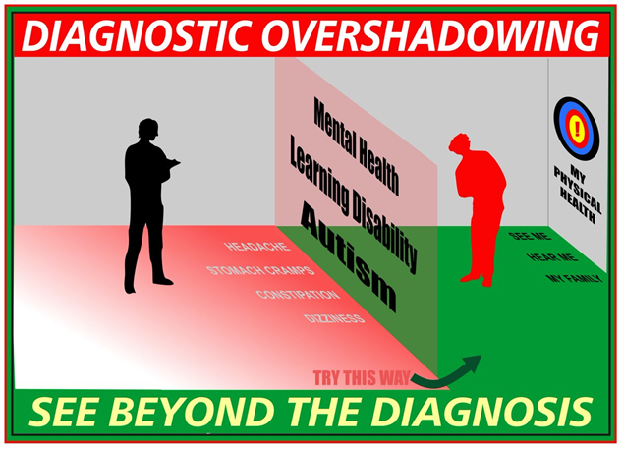
Challenging behavior
25-50% of PWID
50-75% do NOT have challenging behavior
Common presenting symptom to healthcare providers

Slide 3
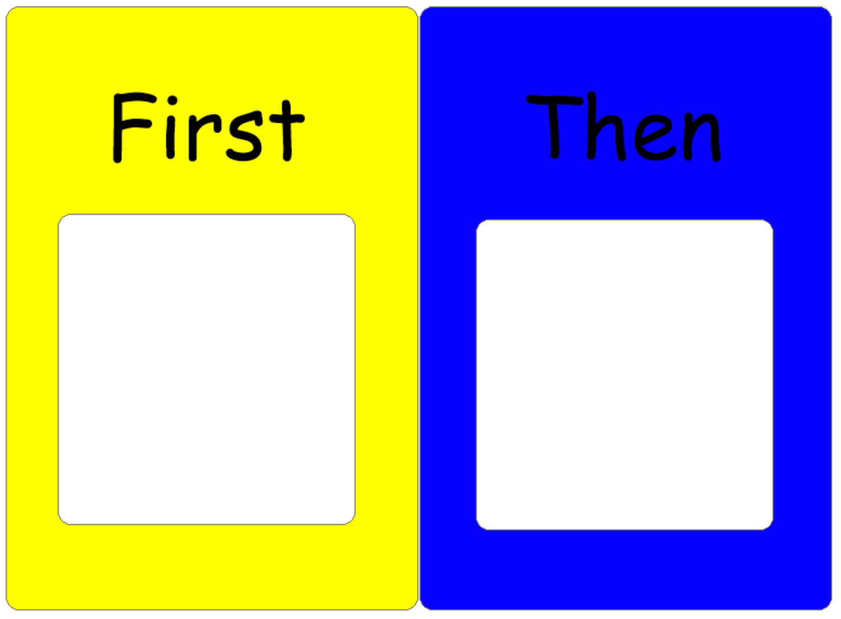
Challenging behavior – how to treat?
Develop treatment plan based on underlying cause of behavior.
Determine underlying cause of behavior.

Slide 4



I want something.
I don’t want to do that.
Pay attention to me.
I have a medical illness.
I have side effects from my medications.
I need to develop new skills.
I have a mental illness.
I am being abused.
I am bored.

Slide 5
Individuals with ID often have a high pain threshold
Medical conditions often present differently in individuals with ID
Often associated with challenging behavior
Connect with PCP
Monitor bowel movements, change in appetite, weight loss, new medications, changes in hearing as first starts
I have a medical illness.

Slide 6
Individuals with ID are often prescribed A LOT OF MEDICATIONS
Often associated with challenging behavior
Important to know what medications client is on and why
Always consider side effects as cause of a change in behavior
Monitor for restlessness, tremor, tight muscles, sedation, cognitive decline
I have side effects from my medications.
Notes:
What do look for?
Can’t sit still
Tremor
Tight muscles
Tired
Slurred speech
Unsteady on feet/falls
Constipation
Decreased in ability to do ADL’s
Weight gain

Slide 7
High rates of mental illness and abuse
Mental Illness often present differently in individuals with ID
Often associated with challenging behavior
Monitor changes in sleep, appetite, interest, level of functioning
I have a mental illness.
I am being abused.

Slide 8
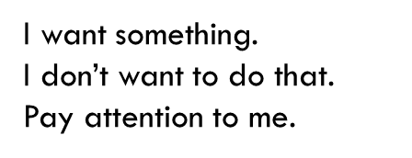
Behavior can serve as a ‘function’
To determine ‘function’ track ABC’s of behavior
(A)ntecedent – what happens before
(B)ehavior – what is the challenging behavior
(C)onsequence – what happens after
Notes:
Depression, Anxiety, Psychotic Disorder
Post Traumatic Stress Disorder
Grief (not an illness!)
What is your client’s baseline?
Does behavior in all environments?
Change in sleep or appetite
Change in interest level
Change in behavior
Change in level of functioning

Slide 9


A lack of skills can result in challenge behavior
Communication
Friendships
Boundaries
Sex education
Notes:
Depression, Anxiety, Psychotic Disorder
Post Traumatic Stress Disorder
Grief (not an illness!)
What is your client’s baseline?
Does behavior in all environments?
Change in sleep or appetite
Change in interest level
Change in behavior
Change in level of functioning

Slide 10
Lack of activities
Lack of meaningful activities
Lack of job
Lack of friendships
Lack of exercise
I am bored.

Slide 11
I want something.
I don’t want to do that.
Pay attention to me.
I have a medical illness.
I have side effects from my medications.
I need to develop new skills.
I have a mental illness.
I am being abused.
I am bored.

Slide 12
Tips on how to get the best care for your clients….
Health Care Team
Be prepared for appointments
Primary Care Provider
Mental Health Provider
Therapist (BCBA)
Dentist
Speech Therapist
Last hearing exam
Last eye exam
Ensure client is seen regularly by all providers
Don’t over rely on Quick Care
Consistent staff accompany client to appointment
Medication list
Health care team and date last seen
Best way to communicate
Interests/Physical activity
Baseline
Change in sleep, appetite
Change in behavior/functioning
Bowel Movements
Stressors/changes
Any concerns/questions

Slide 13

THANK YOU!

