Slide 1
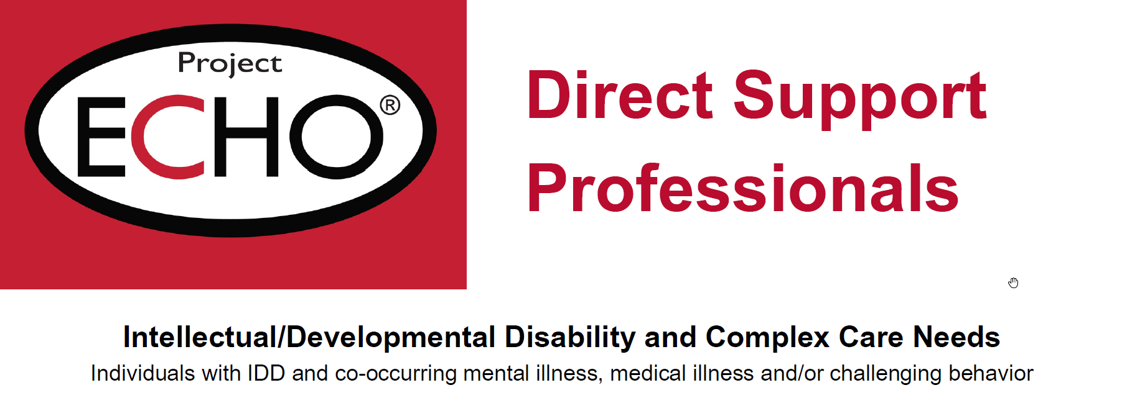

WELCOME!
Welcome to

Slide 2



I want something.
I don’t want to do that.
Pay attention to me.
I have a medical illness.
I have side effects from my medications.
I need to develop new skills.
I have a mental illness.
I am being abused.
I am bored.

Slide 3
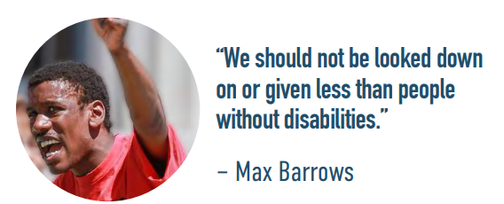
Improving health for those with IDD starts with:
Community Living, Employment, Expenditures, Technology AND THEN A DOCTOR APPOINTMENT

Slide 4
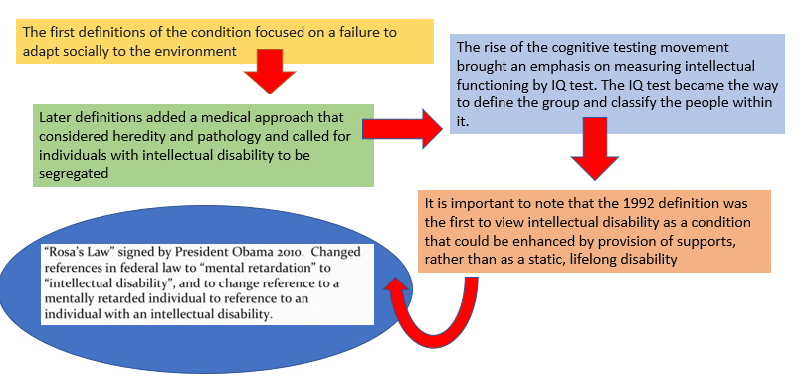
Historical view of intellectual Disability

Slide 5
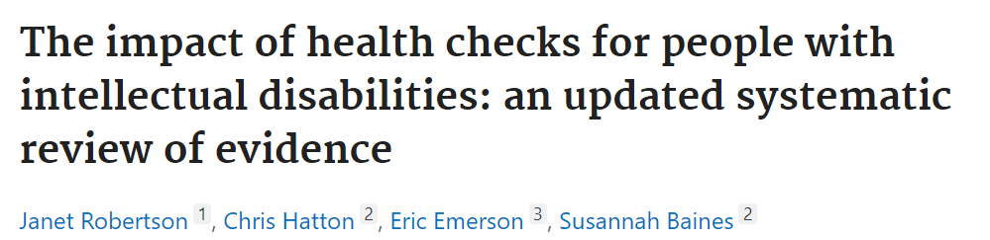
Health checks consistently led to detection of unmet health needs and targeted actions to address health needs.
Health checks also had the potential to increase knowledge of the health needs of people with intellectual disabilities
Health checks are effective in identifying previously unrecognized health needs, including life threatening conditions.
Ability to address transitional needs and support services in place
Identify gaps in health services for preventive services
Able to identify health care needs specific to a certain diagnosis

Slide 6
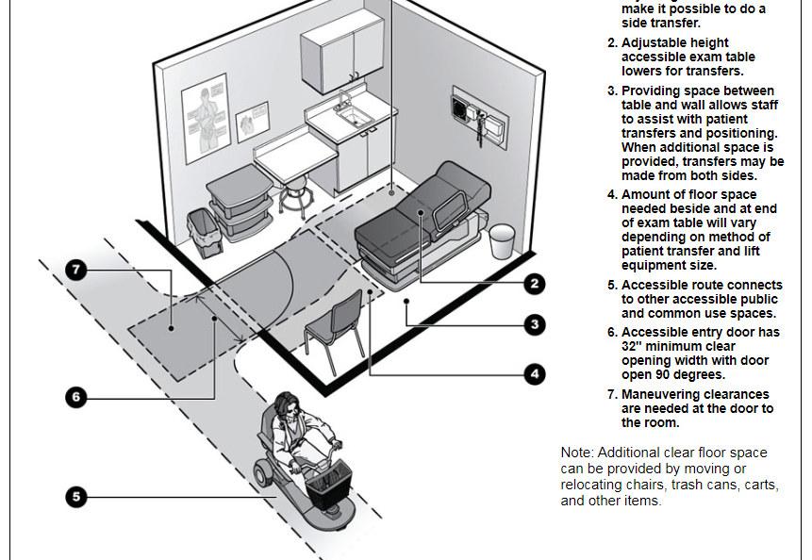
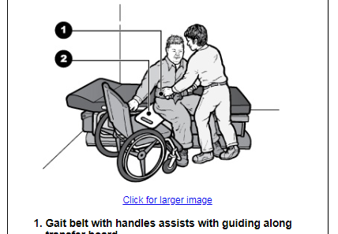
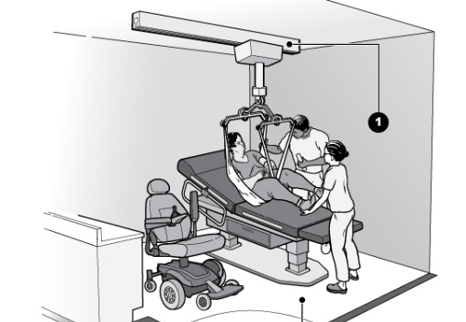
Assess your clinic space
Make sure your room accommodates wheelchair
Hoyer lift for exams. Include patient in consent to do this
Make sure nursing staff practice this so can accommodate

Slide 7

Toolkit for Primary Care Providers http://www.iddtoolkit.org

Slide 8
Medical Causes of Behavioral Change
First, blame the medication.
Is this person constipated?
Does he/she have gastroesophageal reflux (GERD)?
Could the behavior be a seizure?
Is he/she aspirating?
What’s the etiology of the intellectual disability – does he/she have a syndrome?
Is his/her behavior different from usual?
How would we know if he/she is having pain?
How is he/she sleeping?
How’s the person eating? / Does the person have dental problems?
Is there a psychiatric disorder present?

Slide 9
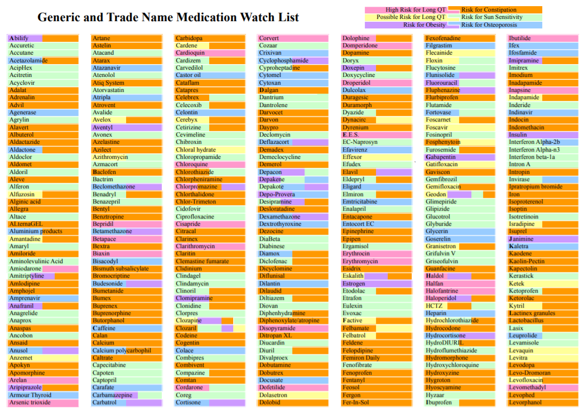
Common medication side effects

Slide 10
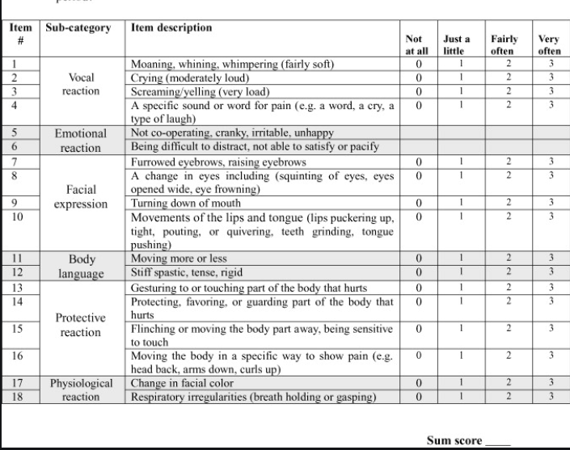
Pain
Pain and distress can manifest atypically in patients with limited communication and can be difficult to recognize.
Nonspecific changes in vital signs, appearance, and behavior, including being less responsive and more withdrawn should prompt evaluation

Slide 11
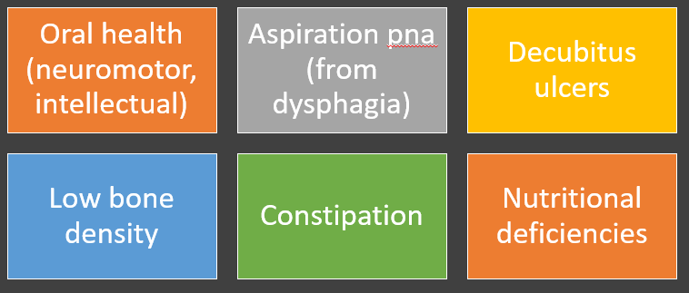
Secondary health consequences

Slide 12
Common Health Conditions
Check ears at each visit or at least every 6 months
-- Provide guidance for preventing (mineral drops, Colace,
-- No Q-Tips
Physical inactivity and obesity | Oral disease | Vision and hearing impairments
Risks of Weight gain Screen for DM2 Lots of disparity in access to activites | People with IDD can have difficulty maintaining oral hygiene routines and accessing dental services that accommodate their needs | Vision and hearing concerns are often underdiagnosed Can lead to behavioral issues as well as being withdrawn Cerumen impaction is often a leading cause of hearing impairment

Slide 13
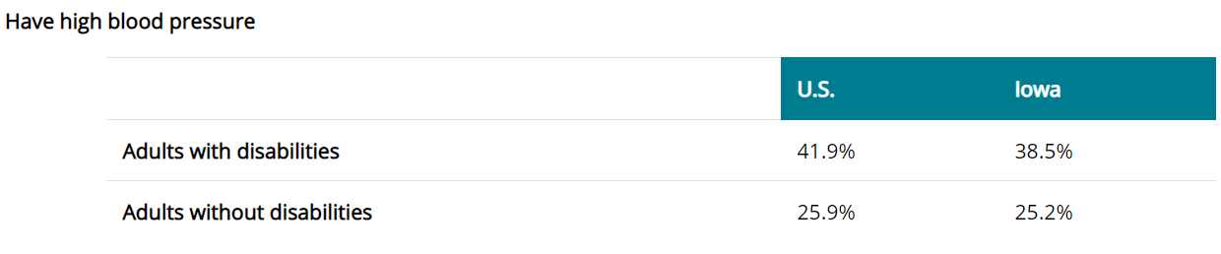
Cardiovascular disease
Prevalent among people with IDD, especially those with Down, 22q11 deletion, and Prader-Willi syndromes. Risk factors for cardiac disorders are increased owing to physical inactivity, smoking, obesity, and prolonged use of certain psychotropic medications CHF is also 3 times higher than in general population. Get echo if signs of CHF or hx of CAD

Slide 14
GI problems
GI issues are common among people with IDD and are manifested by food aversions, changes in behavior, or weight loss Monitor for GERD and manage GERD. Often treated with medications like ibuprofen which can have side effects Constipation is a common problem
Respiratory disorders
Aspiration pna is common cause of death for those with IDD b/c of issues with swallowing Monitor for these signs and symptoms Asthma and COPD are more prevalent Screen for OSA Ask about smoking!!! Give pneumovax 20

Slide 15
NeuroMSK and skeletal disorders | Epilepsy | Endocrine disorders
Increased risk factors for osteoporosis specific to people with Underlying neuromuscular issues- scoliosis, spasticity can lead to pain Treat and use regiments (PT, OT) to increase activity | Epilepsy occurs in about 1 in 5 people with IDD compared with 1 in 100 people without IDD. The prevalence increases with the severity of IDD. It contributes to early mortality. | Higher incidence of thyroid dysfunction Can also be affected by medications Increased risk of DM2 (medication related vs inactivity vs obesity) Screen frequently

Slide 16
Infectious disease | Cancer Screening | Sleep Problems
People with IDD living in group residential settings are at higher risk of developing such infections but have lower rates of immunization and screening compared with the general population Offer Hep A an B to all living in group homes Yearly flu shots | Screen in routine manner with awareness of providing comfort and guidance for invasive procedures Review family hx of cancer | Review medications that might negatively affect sleep Screen for OSA

Slide 17
Driving principles
In summary, it is the position of the American Academy of Developmental Medicine and Dentistry that all treatment-based medical decision making should be derived without the consideration of a co-existing condition involving compromised intellect. Thus, the operative question should always be, “If this patient did not have an intellectual/developmental disability, which treatment would be in the patient’s best interests?”•

