Slide 1

Interventional psychiatry at iowa healthcare
Holly Van Den Beldt, MD
Rural Behavioral Health iECHO

Slide 2
The basics
Specialized team of psychiatrists and neurologist.
We offer multiple modalities of treatment for psychiatric illnesses that are severe and/or difficult to treat.
Referrals should come from the patient’s psychiatric provider.
We review referral information and clinical notes and triage each referral. We may ask for more information.
We see appropriate patients in person for an evaluation and make recommendations. We provide the interventional treatment that is decided on.
We do not assume overall care for the patient. They should continue with their usual providers.
We can see patients more than once, change modalities, etc. It’s ok if they elect not to receive treatment from us.
There may be options for patients closer to home.

Slide 3
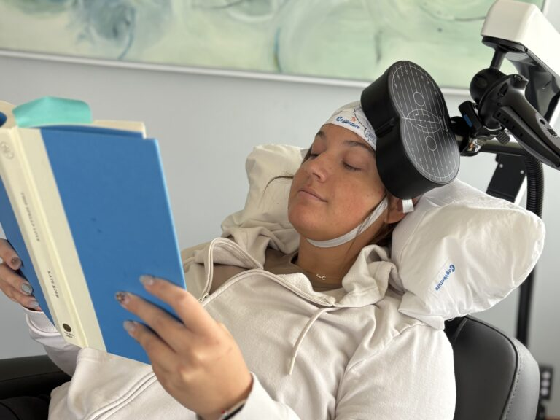
TMS

Slide 4
TMS
Magnet is placed against the head in a specific location. Brain region is stimulated via an electromagnetic field.
Indicated for treatment resistant depression.
Few minor side effects- scalp pain, headache most common.
36 daily sessions (Mon-Fri).
Takes several weeks to respond.
Does not affect ability to drive or work on treatment days.
Outpatient only.
Insurance only covers 18+.

Slide 5
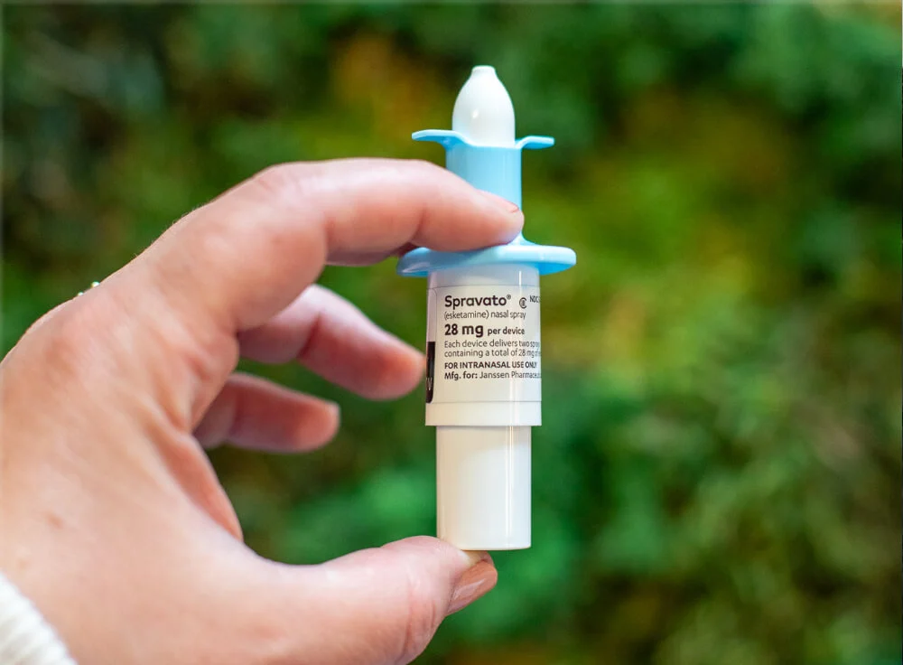
Esketamine (spravato)

Slide 6
esketamine
Nasal insufflation. We do not currently offer IV ketamine.
Treatments done in clinic. We cannot send medication home with patient.
Twice weekly for 4 weeks (8 treatments). Many patients require maintenance after this index series.
Patients must be monitored in clinic for 2 hours after treatment each time.
Need someone to provide transportation. Cannot drive or work the days of treatment.
Some side effects common- perceptual disturbances, nausea, fatigue, dizziness, dissociation.
Response tends to be fairly rapid, but often not long lasting.
Indicated for treatment resistant depression or depression with suicidal ideation.
Outpatient only.
Insurance covers 18+.

Slide 7
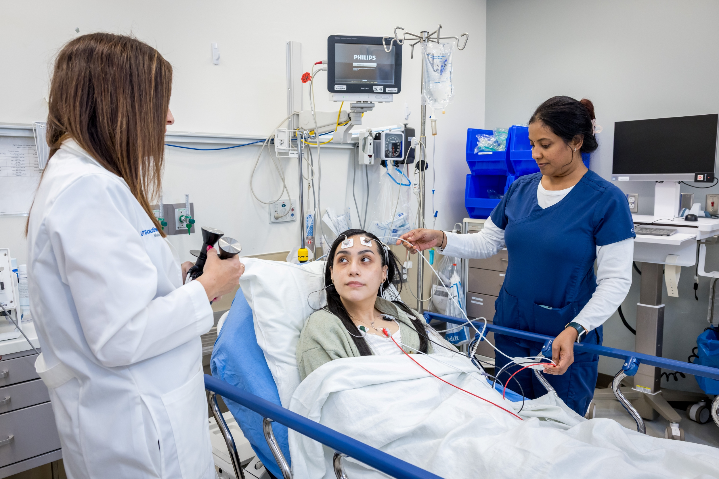
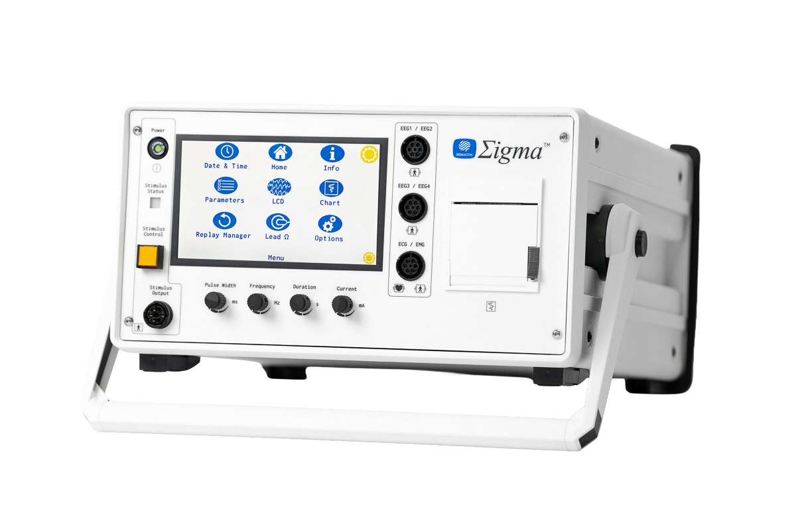
ECT (electroconvulsive therapy)

Slide 8
ect
Patient undergoes brief general anesthesia and given medication to relax muscles.
We deliver an electrical stimulus to the head and induce a seizure.
  Monitor and manage seizure and vitals (HR, BP, etc.)
  Breathing assistance provided during treatment.
Done in a hospital setting, requires anesthesiologist and IV placement.
3 times per week for 2-4 weeks (can vary). Some patients go on to receive maintenance treatments after index course.
Common side effects- nausea, headache, muscle soreness, jaw pain, confusion, temporary short term memory impairment.
Small risk of serious side effects- heart attack, stroke, status epilepticus, intubation.
Requires medical work up prior to initiation.

Slide 9
ECT
Patient needs to be driven and monitored after treatments (if outpatient). Cannot drive or work during the entire index series (2-4 weeks on average).
Wider range of diagnoses treated- severe depression, psychotic depression, mania, treatment resistant schizophrenia, catatonia.
Patients tend to respond after apx. 1-2 weeks (varies).
Generally, the highest efficacy.
Insurance covers all ages.
Can be inpatient or outpatient.
Not like how it is portrayed in media.

Slide 10
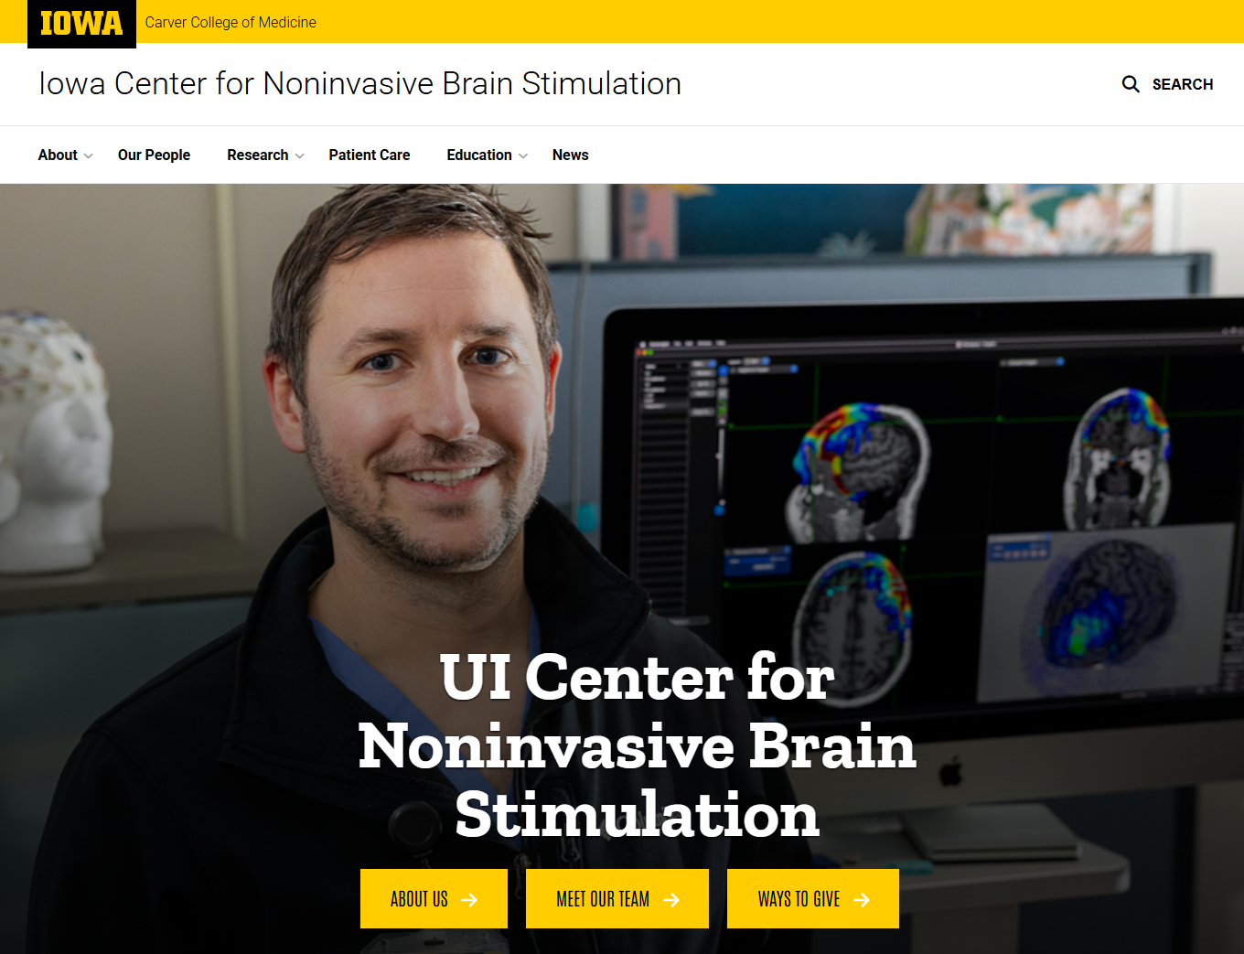
How to contact/refer
Website: https://nbs.medicine.uiowa.edu/
Email: Brain-Stim@healthcare.uiowa.edu
Main contact human: Christopher Sanborn

